Slide 1
An update to Coast Survey’s Inquiry and Discrepancy System
10/05/2017
George Britzolakis, IT Specialist
Geospatial Applications Development Branch
Coast Survey Development Laboratory
^{Office of Coast Survey}
National Oceanic and Atmospheric Administration

Slide 2
Agenda
Motivation
New features
Schedule and Release
Interoperability
Looking for your input
Questions
^{Office of Coast Survey}
National Oceanic and Atmospheric Administration

Slide 3
Motivation
Add georeferenced information Inquiries and Discrepancies
Continuous customer surveys to replace the annual paper surveys
Provide a mobile and user friendly experience
Merge Inquiries/Discrepancies input in a single form
Make it compatible with most of the smart phones and tablets on the market
Expedite the response time by having actual map representation for reporting
Ensure the quality of our nautical charting products
Produce meaningful report statistics about Inquiries Discrepancies we receive
^{Office of Coast Survey}
National Oceanic and Atmospheric Administration

Slide 4
New Features
Improved GUI
Reference report to an actual map location
Ability to submit Georeferenced reports from a Cell Phone
Multiple chart layers with the ability to toggle off/on
Streamlined internal workflow for faster responses to customers with less back and forth clarification
^{Office of Coast Survey}
National Oceanic and Atmospheric Administration

Slide 5
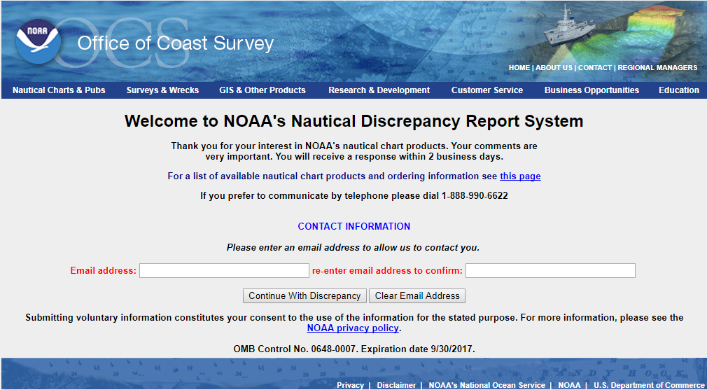
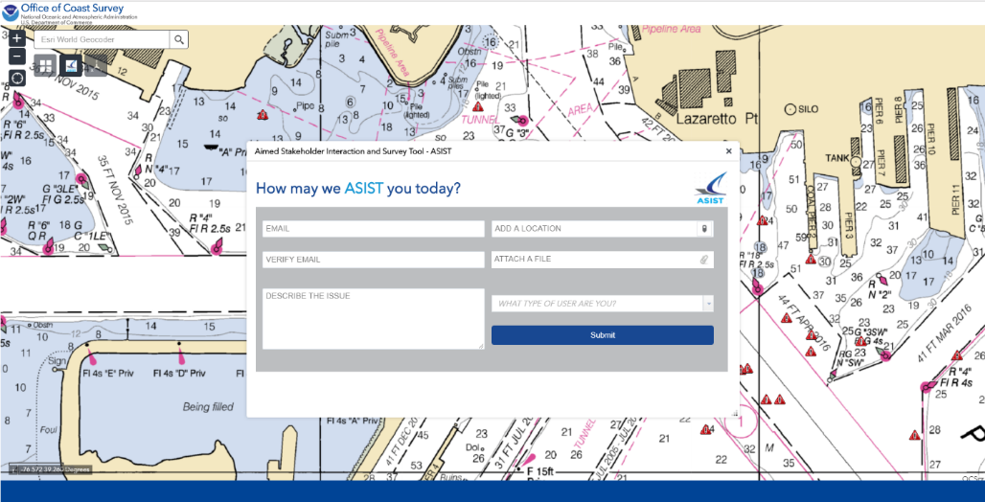
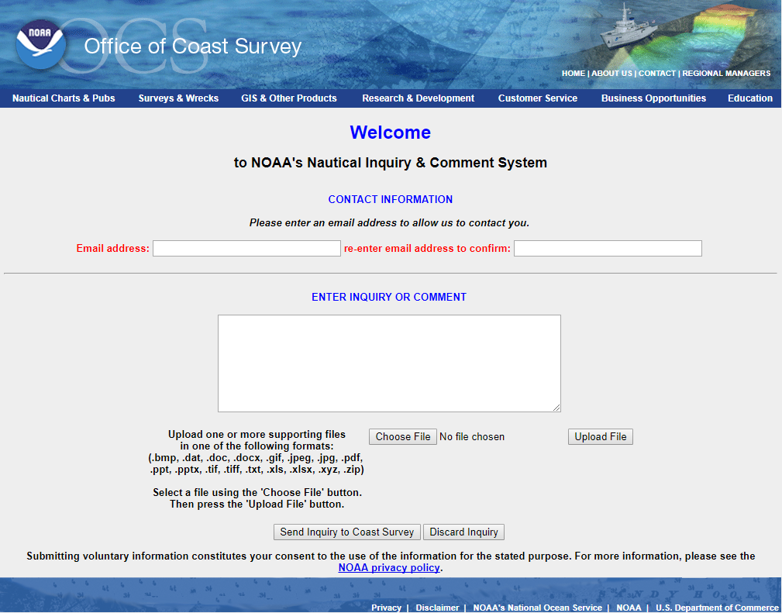
New Features
^{Office of Coast Survey}
National Oceanic and Atmospheric Administration

Slide 6
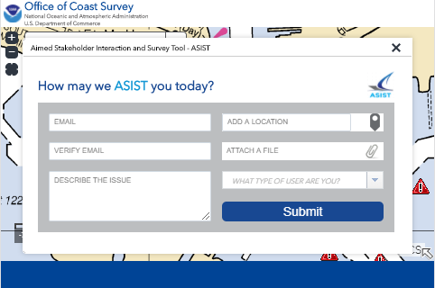
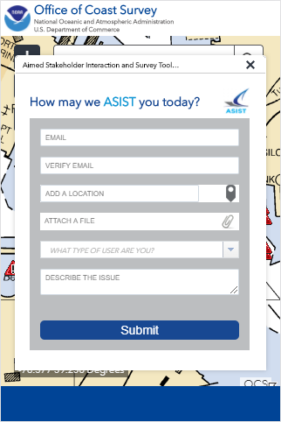
New Features
Landscape mobile view
Portrait mobile view
View on Desktop/Laptop
^{Office of Coast Survey}
National Oceanic and Atmospheric Administration

Slide 7
Schedule and Release
Finalize the multiple/resolution functionality
Conduct thorough application testing
Communicate new System to constituents and stakeholders
Release to the public
^{Office of Coast Survey}
National Oceanic and Atmospheric Administration

Slide 8
Interoperability
Uses industry standard geodatabase and REST service (ESRI)
Developers will be able to submit directly using REST API
What interoperability features could be helpful to you?
^{Office of Coast Survey}
National Oceanic and Atmospheric Administration

Slide 9
Looking for your input
Do you have a helpful suggestion for making our interactions with you easier or more beneficial?
Please let us know:
Georgios.Britzolakis@noaa.gov
Or feel free to use our current inquiry system at:
http://www.nauticalcharts.noaa.gov/inquiry/
^{Office of Coast Survey}
National Oceanic and Atmospheric Administration

Slide 10
Questions ?
^{Office of Coast Survey}
National Oceanic and Atmospheric Administration

