Slide 1
National Charting Plan
A strategy to transform nautical charting
NOAA Industry Day
October 5, 2017
^{Office of Coast Survey}
National Oceanic and Atmospheric Administration

Slide 2
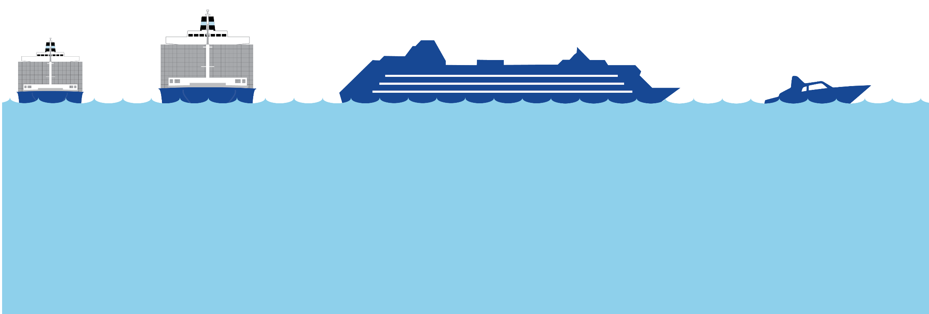
A Changing World
Ships are growing, requirements are changing, technology is advancing
Container ship size has increased four-fold in 30 years.
Use of electronic charts and ECDIS will soon be mandatory for all large commercial vessels.
Electronic chart display use is rising among recreational boaters.

Slide 3
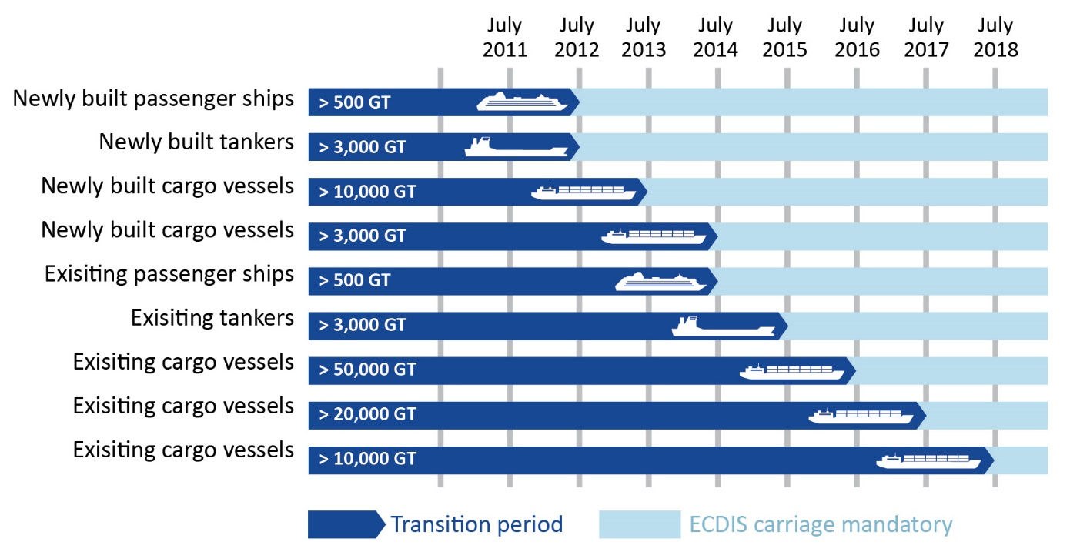
IMO Mandate for use of ECDIS
2012: International Maritime Organization (IMO) starts phasing in requirement for ECDIS use by commercial vessels on international voyages
July 2018: Transition to ECDIS mandate ends.
Use of ECDIS will be required for all:
Passenger ships > 500 Gross Tons
Tankers > 3,000 Gross Tons
Cargo vessels > 3,000 Gross Tons

Slide 4
U.S. Coast Guard Carriage Requirements
2016 – USCG authorizes use of ENC for navigation by commercial vessels on domestic voyages in US waters
Simpler, cheaper Electronic Charting Systems (ECS) may be used to display ENC data
Paper nautical charts may still be used, but will not be required if an ECS with ENCs is being employed
USCG NVIC 16-1, “Use of Electronic Charts and Publications In Lieu of Paper Charts” is at:
https://www.navcen.uscg.gov/pdf/electronic_charting/NVIC_01-16_electronic_charts_and_publications.pdf

Slide 5
National Charting Plan Overview
Purpose
Improve NOAA nautical chart coverage, products, and distribution
Improvements
Reduce
unwarranted
alarms
Convert to metric
Provide
timelier data
Improve
chart coverage
Create an orderly layout
Reduce
uncertainties
Improve chart update information
Increase efficiency
Outcome
Ease of access to more precise, higher-resolution charts that deliver the most up-to-date navigation information possible
Public comment period for Feb 2017 draft ended June 30, 2017
Updated final version was released Oct 2017

Slide 6
Transforming Nautical Charting
Actions to improve charting and marine navigation
Improving Chart Updates
Improving Chart Content
Improving Chart Schemes
Improving Chart Production Efficiency
MSDI and Open Data

Slide 7
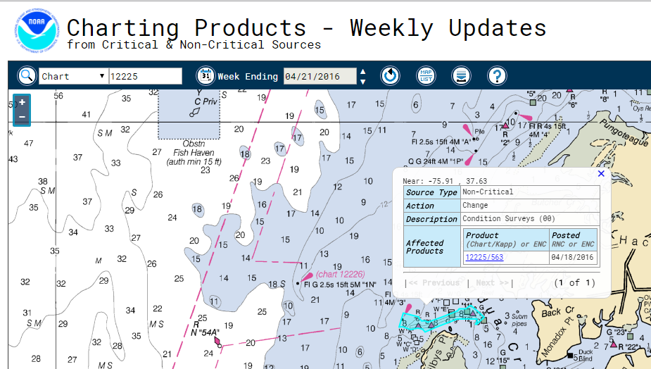
Improving Chart Updates
Improve chart update information

Slide 8
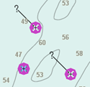
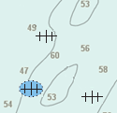
Improving Chart Content
Reduce unwarranted alarms &
isolated danger symbolization
ECDIS display of wrecks with an "isolated danger" symbol
“Normal” ECDIS display of the same two "non-dangerous" and one "dangerous" wrecks

Slide 9
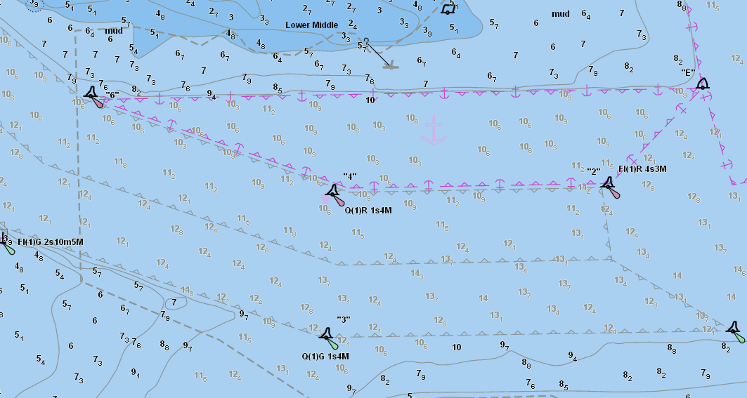
Improving Chart Content
Provide timelier data
Standardization of USACE data formats

Slide 10
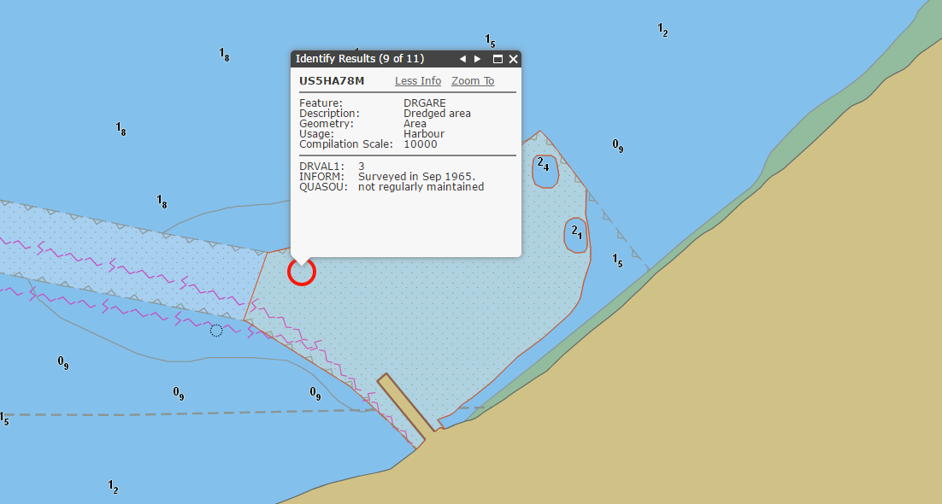
Improving Chart Content
Provide timelier data
Standardization of USACE data formats

Slide 11
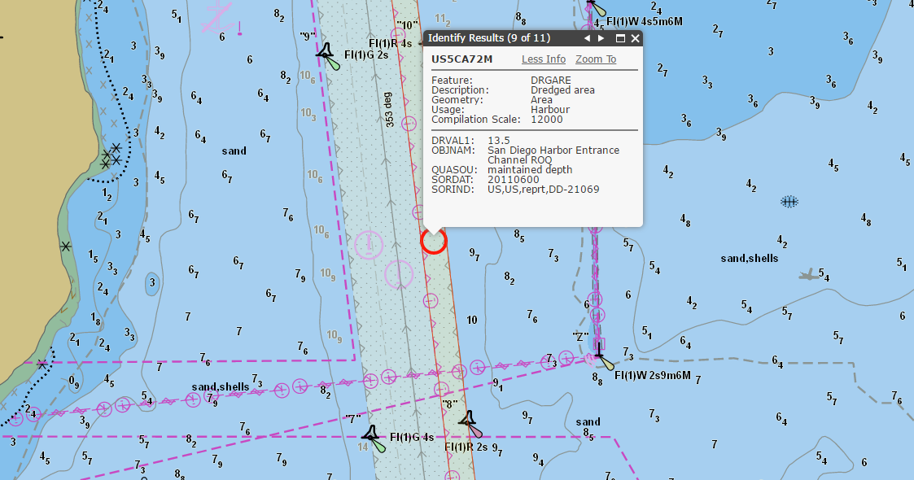
Improving Chart Content
Provide timelier data
Standardization of USACE data formats

Slide 12
Improving Chart Content
Data Consistency and general ENC clean-up

Slide 13
Improving Chart Schemes
Create an orderly layout for ENCs

Slide 14
Improving Chart Schemes
Standardize Scales

Slide 15
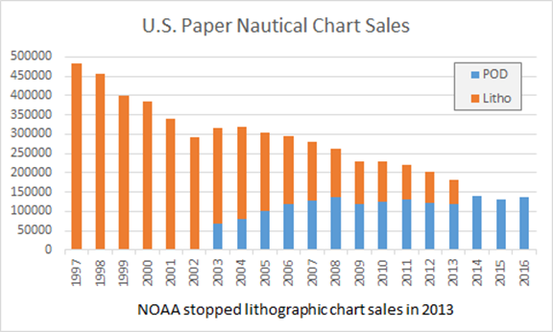
Declining use of Paper Nautical Charts

Slide 16
Commitment to Paper Charts
NOAA will continue making both raster (paper, RNC and PDF) and vector (ENC) nautical chart formats
Coast Survey is always exploring options that will put resources to the best use updating products that have the greatest impact on safety of navigation for mariners and recreational boaters
If use of paper nautical charts continue to fall, NOAA may re-evaluate the paper chart suite to make it better suited for:
Paper chart back up,
Recreational navigation, and
Small scale overview charts for voyage planning.
Paper nautical charts may eventually look a little different to better support these purposes

Slide 17
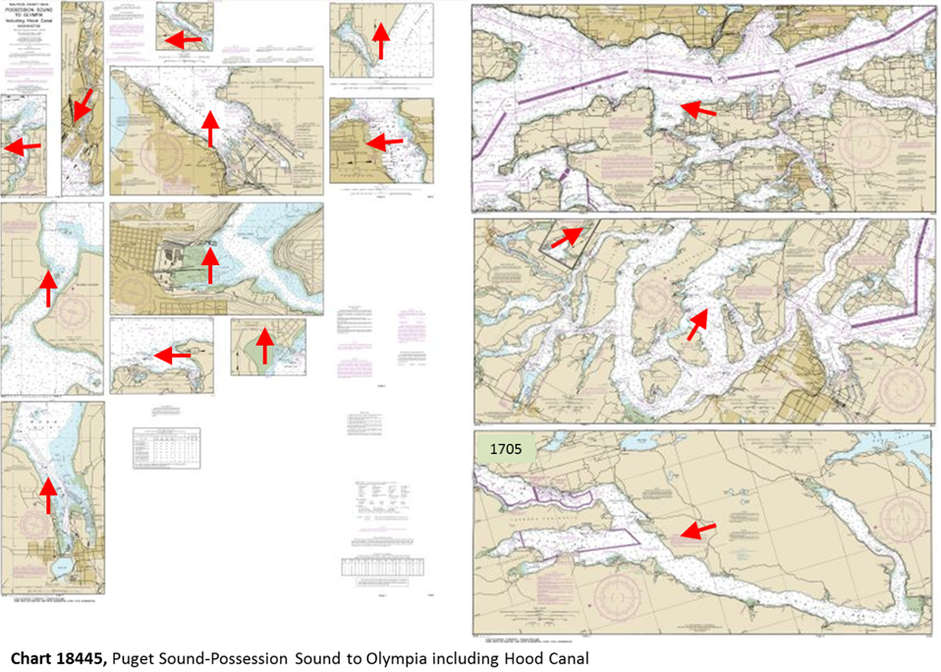
Improving Chart Schemes
Improve chart coverage
need image

Slide 18
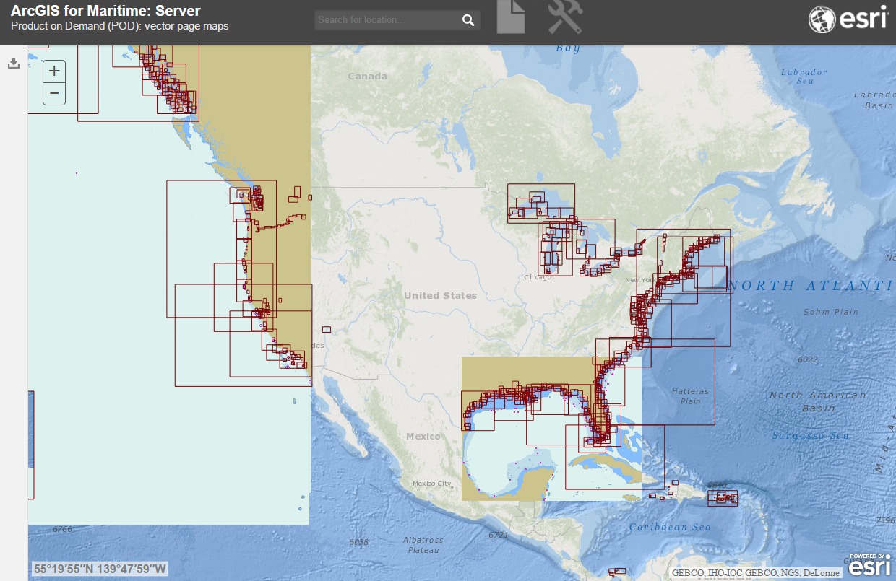
Improving Chart Schemes

Slide 19
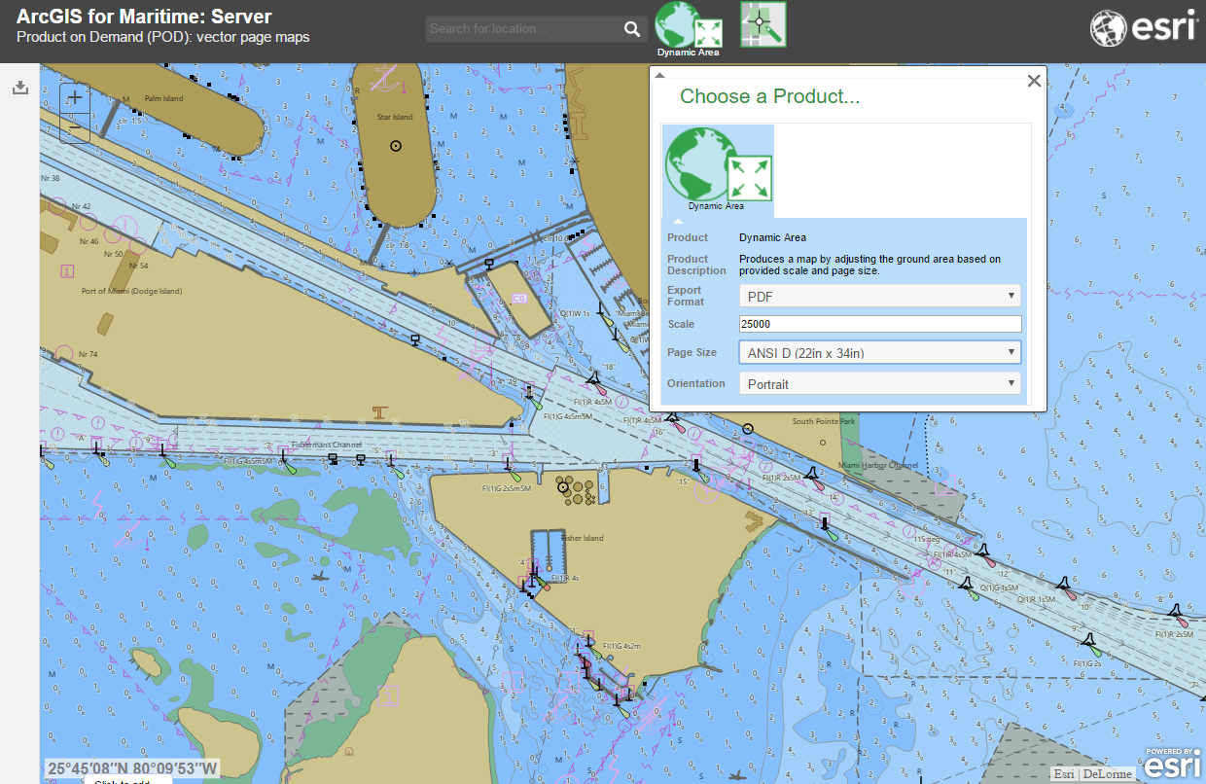
Improving Chart Schemes
Chart on Demand

Slide 20
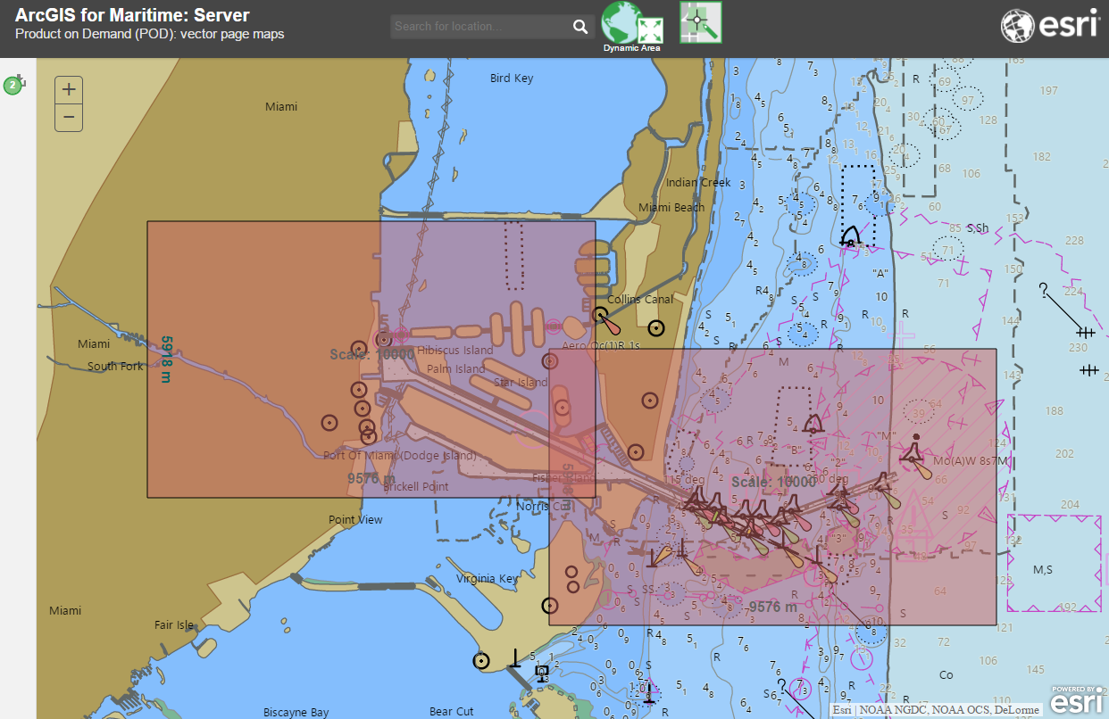
Improving Chart Schemes
Chart on Demand

Slide 21
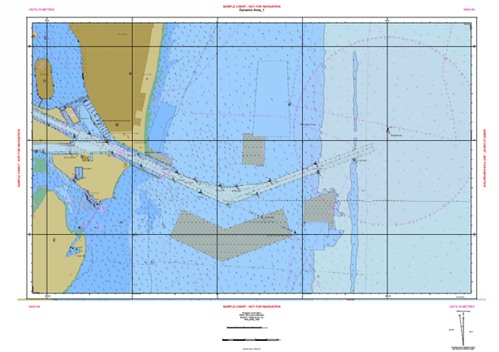
Improving Chart Schemes
Chart on Demand

Slide 22
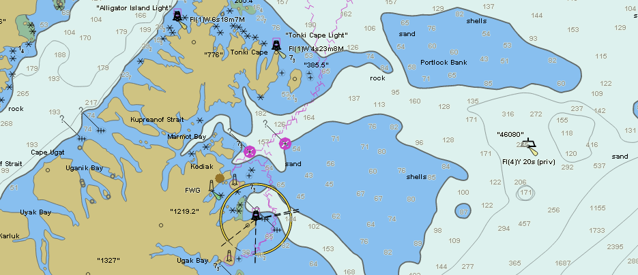
Improving Chart Production Efficiency
Increase efficiency
Direct input of USCG light list data into production

Slide 23
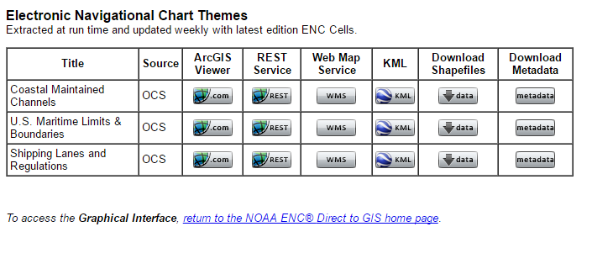
Marine Spatial Data Infrastructure
Open data policy MSDI

Slide 24
