Slide 1
Data Standards for Navigation Systems
October 4, 2017
Julia Powell
^{Office of Coast Survey}
National Oceanic and Atmospheric Administration

Slide 2
What is S-100
Provides the data framework for the development of the next generation Electronic Navigational Charting products, as well as other digital products required by the hydrographic, maritime and GIS communities
^{Office of Coast Survey}
National Oceanic and Atmospheric Administration

Slide 3
What is S-100
Broad geospatial data framework
Not specific to ECDIS or charting
Create different product specifications to meet specific requirements
Designed for Interoperability
^{Office of Coast Survey}
National Oceanic and Atmospheric Administration

Slide 4
Why should I care?
Leads to a global consistency of products
Specifies encoding formats based on product type
ISO 8211
S-101 ENCs
HDF5
S-102 Bathymetry
S-111 Surface Currents
S-104 Water Level Information
S-412 Gridded Weather Information
GML
S-412 Vector Weather Information
S-122 Marine Protected Areas
Moves to machine readable catalog mechanism
XML based Feature Catalogue
XML based Portrayal Catalogue
XML based Interoperability Catalogue
Bul
^{Office of Coast Survey}
National Oceanic and Atmospheric Administration

Slide 5
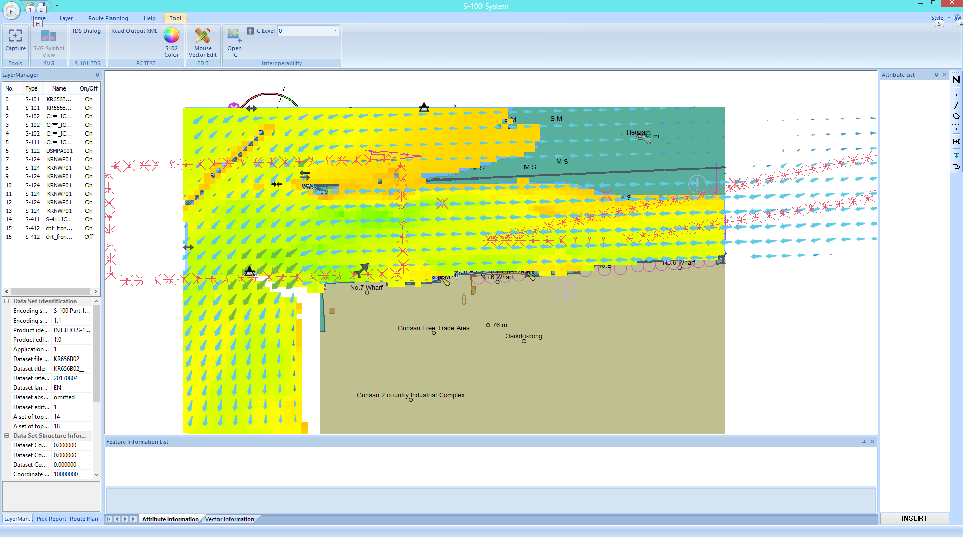
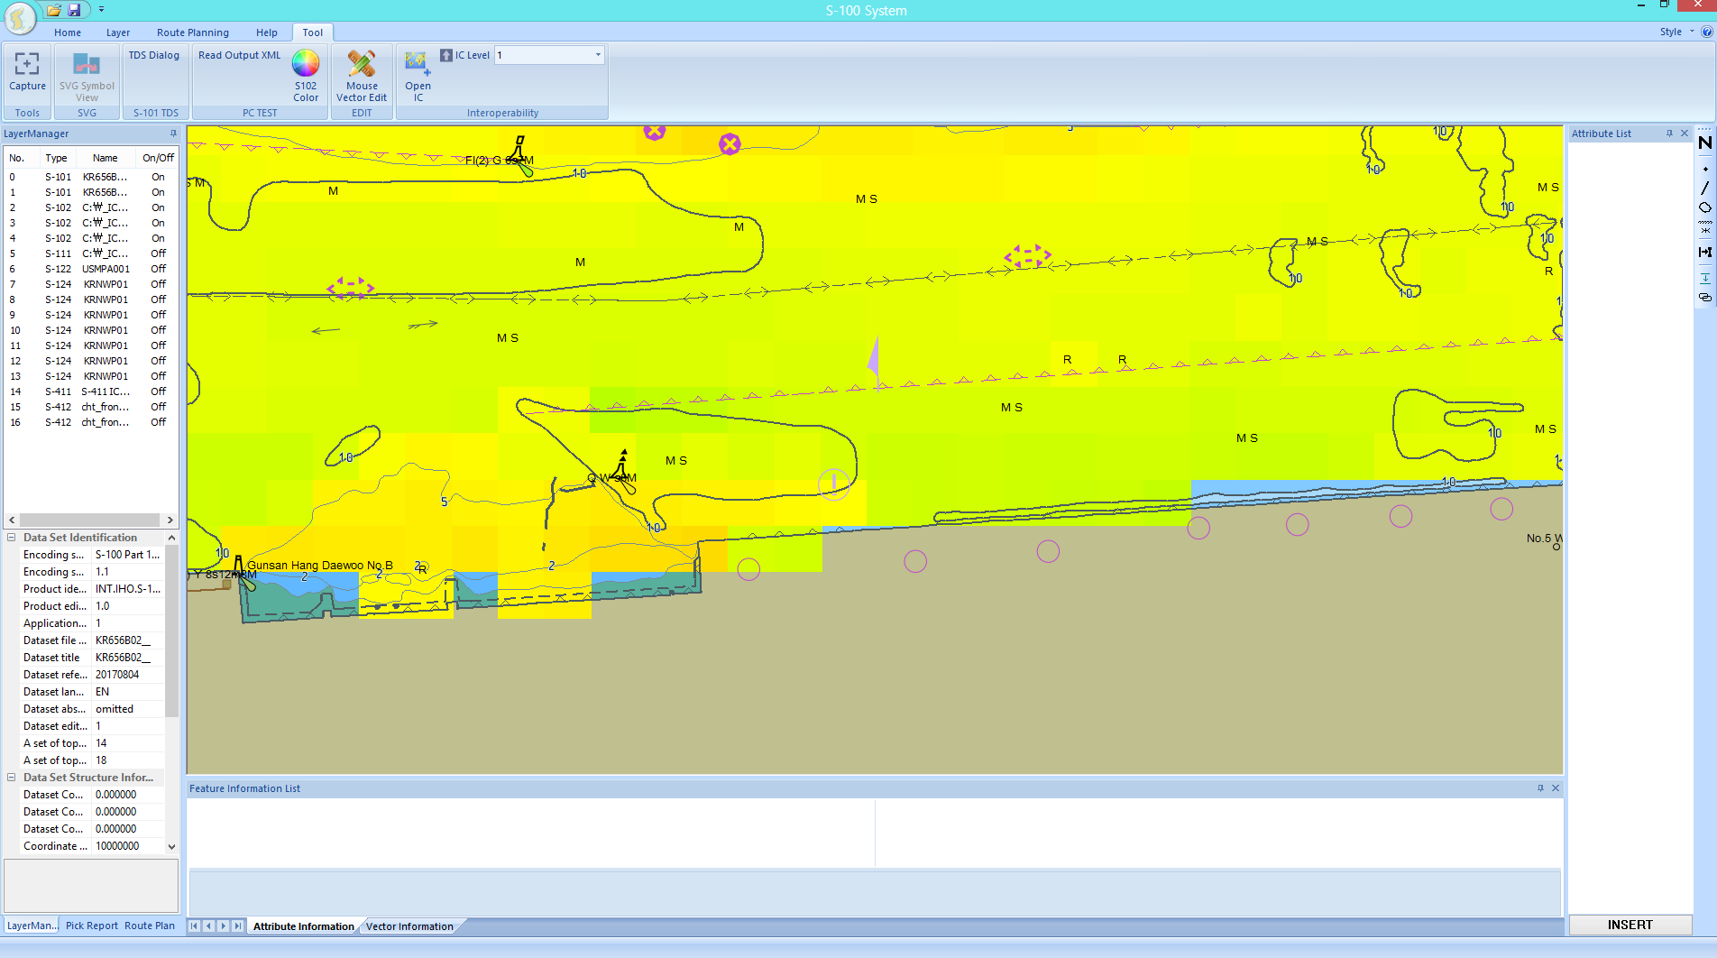
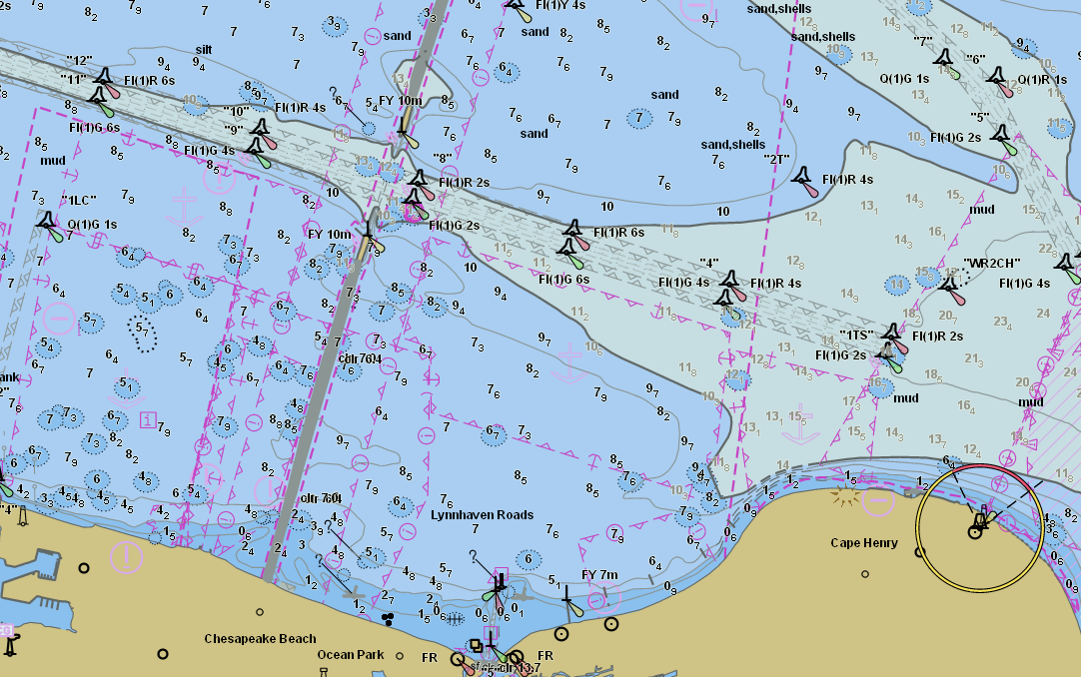
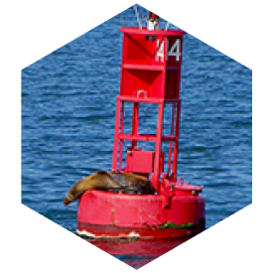
BAD Interoperability

Slide 6
Improved Interoperability
Takes into account how specifications relate to each other
Interleaving of features between products
Harmonizes Portrayal between products
^{Office of Coast Survey}
National Oceanic and Atmospheric Administration

Slide 7
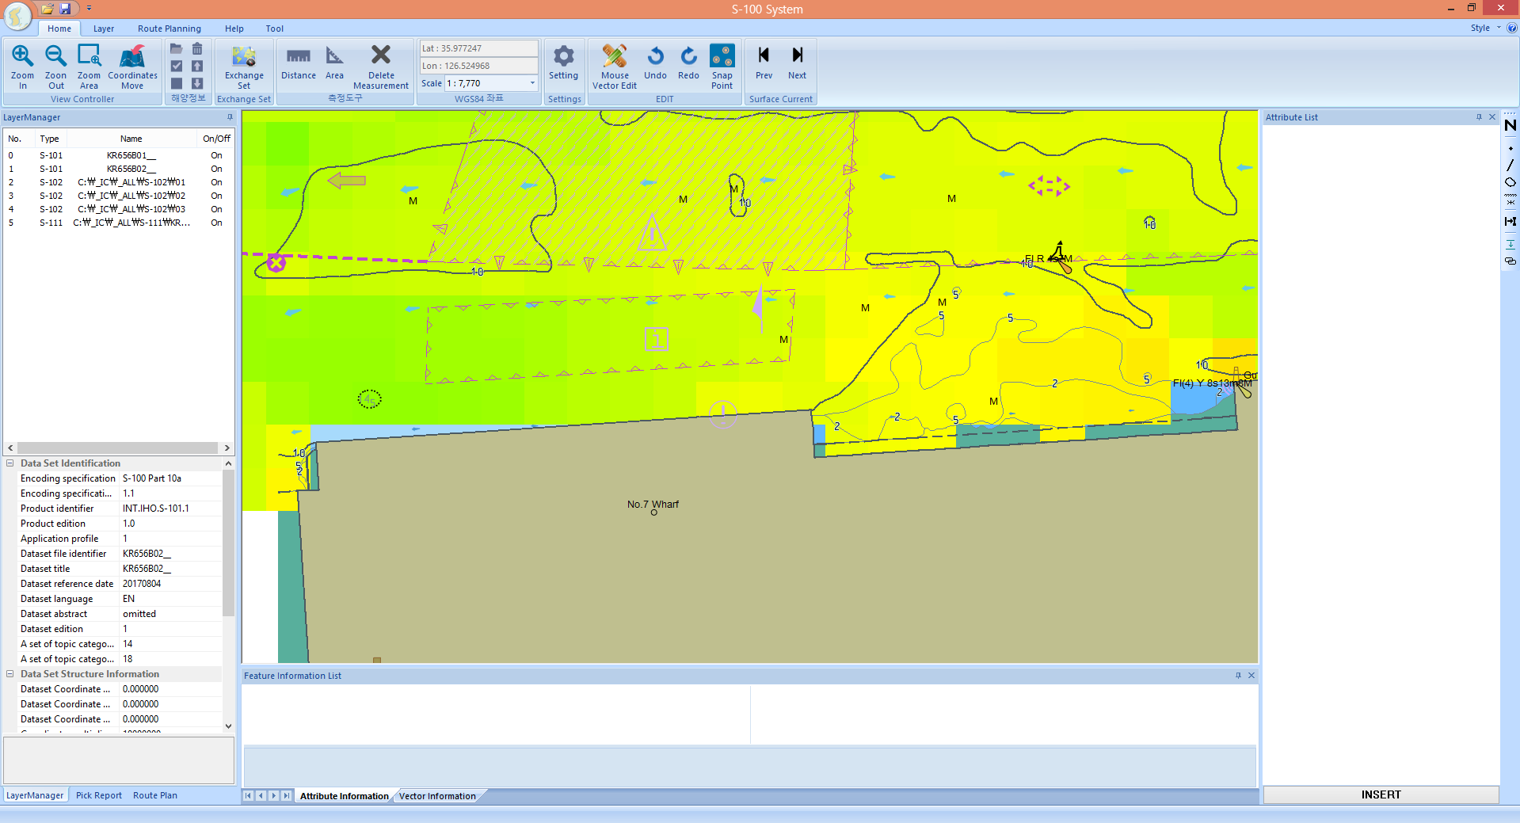
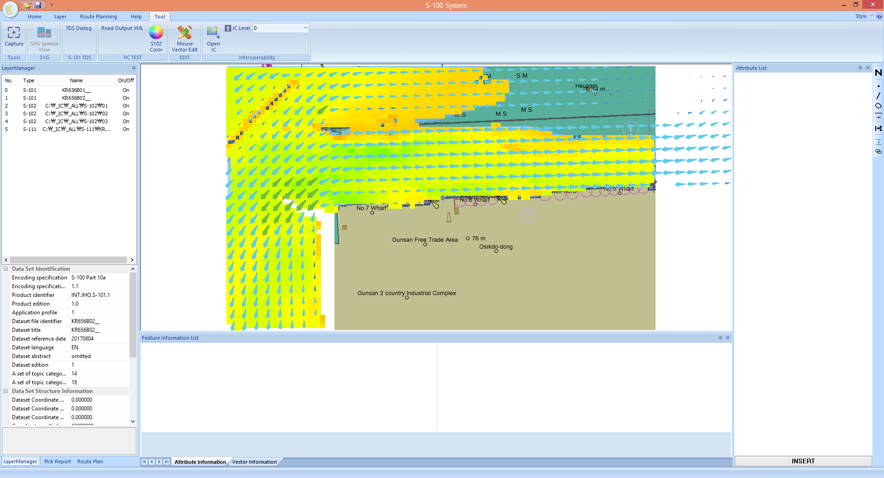
Better Interoperability
Rules Applied
Bathymetry no longer goes over the shoreline
Underlying ENC features are Visible
NO Rules Applied – ENC/Bathymetry/Surface Currents
^{Office of Coast Survey}
National Oceanic and Atmospheric Administration

Slide 8
Operationalizing Surface Currents – S-111
S-111 is the IHO specification for surface currents
Specifies
HDF5 encoding
Metadata
Grid Types
Dataset size for transmission
Harmonizes portrayal
Office of Coast Survey has embarked on a project to extract the OFS output into S-111 conforming datasets
^{Office of Coast Survey}
National Oceanic and Atmospheric Administration

Slide 9
Portrayal examples of S-111

Slide 10
S-111 Test Data set Availability on the IHO website
US
Time series at a few fixed locations
Fictive Data
4 stations
6 minutes interval
Regularly gridded data
Lake Ontario
25 x 61 grid
6 hours of data
Irregularly gridded data
Chesapeake Bay
1560 data points
6 hours of data
Argo surface drifter data
Pacific
384 data points
Canada
Hindcast of West Coast
72963 data points
24 hours of data
30 Mo
Hincast of East Coast
27016 data points
24 hours of data
10 Mo
2017 Currents predictions of all stations in Canada
23 stations
15 minutes interval
12 Mo, comp. 1.5 Mo
https://www.iho.int/mtg_docs/com_wg/IHOTC/S-100_PS/S-111_Compatible_Data_Sets/S-111_Compatible_Data_Sets.htm
^{Office of Coast Survey}
National Oceanic and Atmospheric Administration

Slide 11
Point of Contact:
Julia.Powell@noaa.gov
^{Office of Coast Survey}
National Oceanic and Atmospheric Administration

