Slide 1
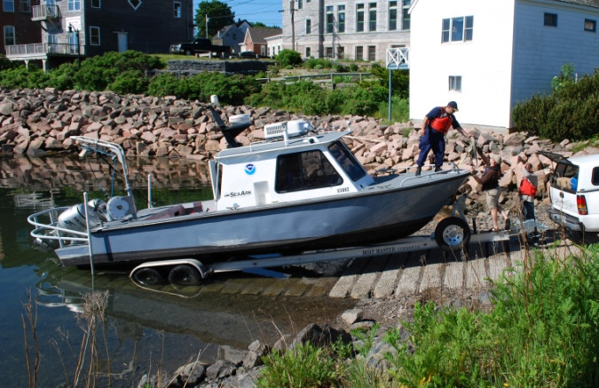
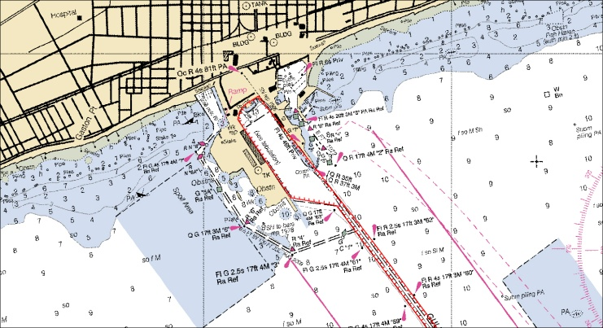
Visualizing Model Data for Mariners
Dr. Neil D. Weston & Dr. Kurt Hess
Office of Coast Survey, NOAA
^{Office of Coast Survey}
National Oceanic and Atmospheric Administration

Slide 2
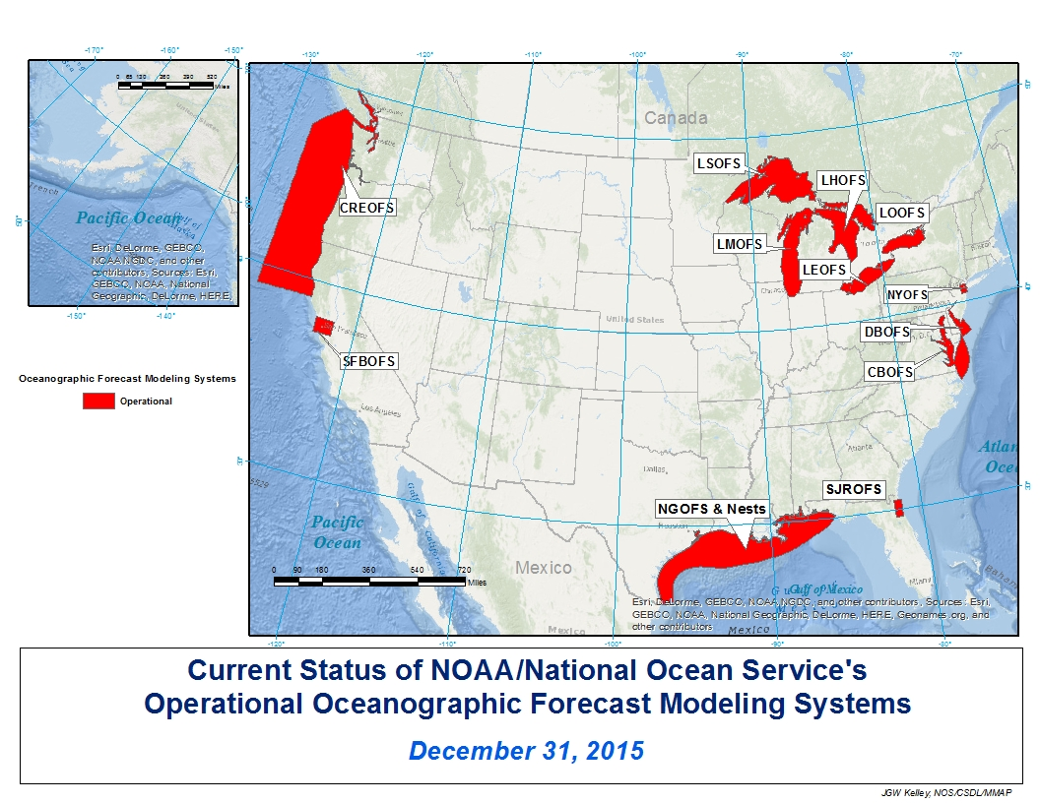
Operational Forecast Systems
Bullet
Bullet
Bullet
^{Office of Coast Survey}
National Oceanic and Atmospheric Administration

Slide 3
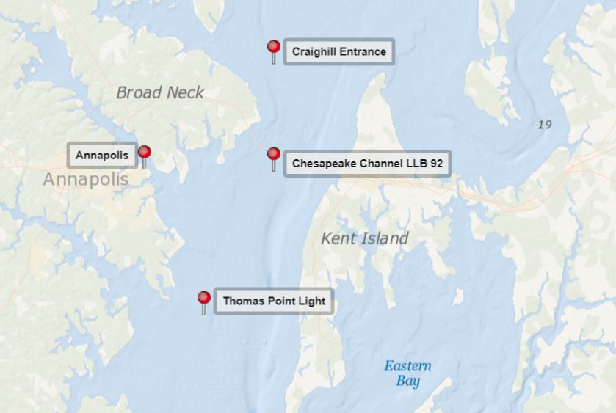
Chesapeake Bay Ports Observation System
Model Inputs
Winds
Model Outputs
Water Levels
Currents
Water Temperature
Water Salinity
^{Office of Coast Survey}
National Oceanic and Atmospheric Administration

Slide 4
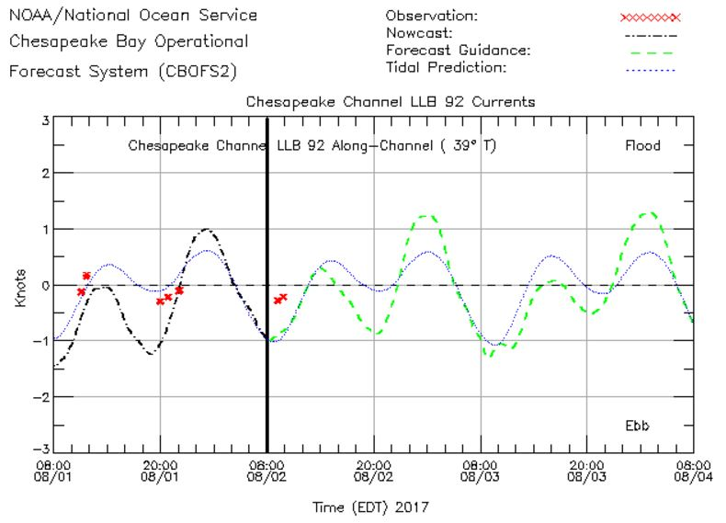
Chesapeake Channel LLB 92 - Currents
^{Office of Coast Survey}
National Oceanic and Atmospheric Administration

Slide 5
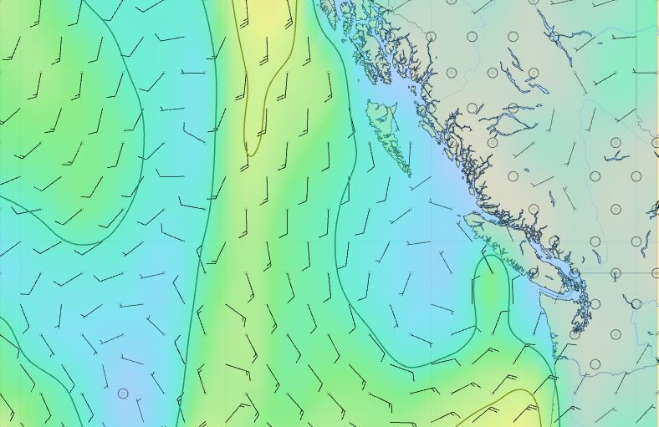
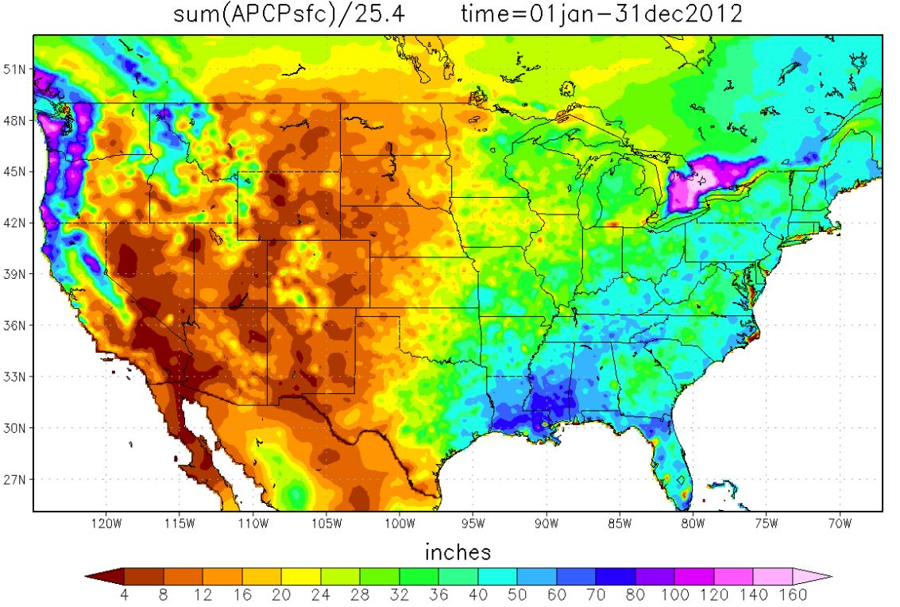
GRIB Data
GRIB – GRidded Information in Binary
Used operationally worldwide, primarily by The World Meteorological Organization
Self-contained records of 2-D data
Ideal for storing historical and forecast data
Examples below – wind speed/direction (Pacific Northwest) and annual precipitation
in the United States
Wind speed and direction
Annual precipitation
^{Office of Coast Survey}
National Oceanic and Atmospheric Administration

Slide 6
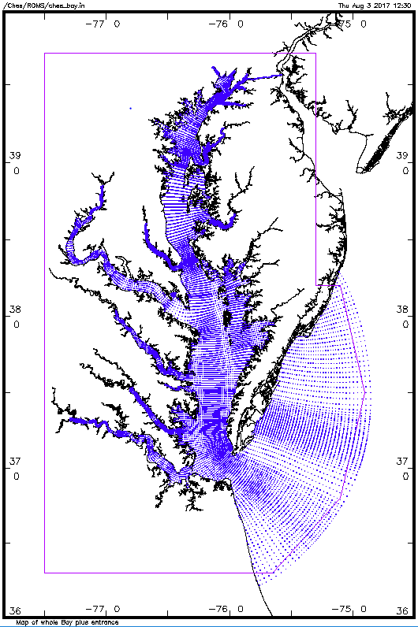
Chesapeake Bay OFS
Irregular Grid
pts = 78,480
^{Office of Coast Survey}
National Oceanic and Atmospheric Administration

Slide 7
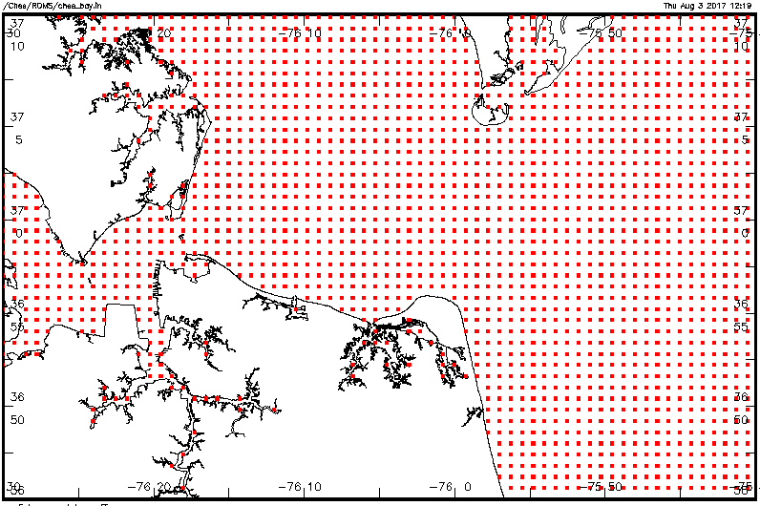
Lower Bay, James River, and Harbor Entrance:
Regular Grid Points
dx = 0.0125 deg dy = 0.0100 deg
^{Office of Coast Survey}
National Oceanic and Atmospheric Administration

Slide 8
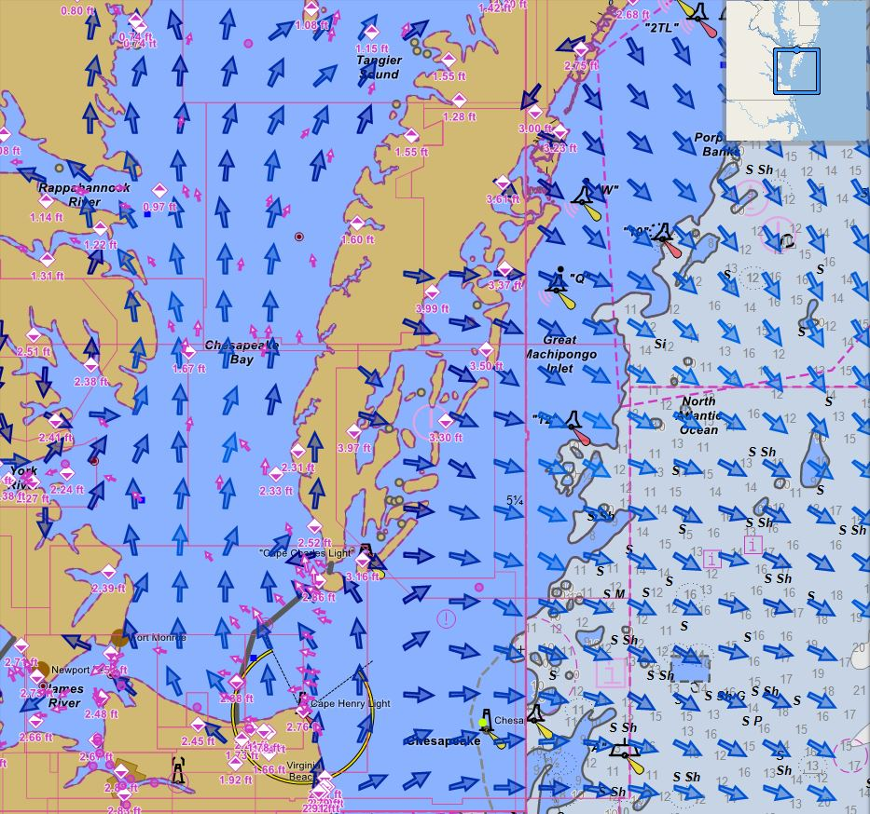
Lower Bay, James River, and Harbor Entrance:
Current Vectors
^{Office of Coast Survey}
National Oceanic and Atmospheric Administration

Slide 9
Operational Forecast Systems - Applications
Hydrography
Route survey
Habitat mapping
Deep sea mining
Charting
EEZ survey
Shipping
Baseline environmental assessment
Geophysical survey
Pipeline survey
Debris/clearance survey
Route optimization
Environmental Monitoring
Emergency response
Water quality
Ecosystem assessment
Spill assessment
Search & Recovery
Asset location
Marine archaeology
^{Office of Coast Survey}
National Oceanic and Atmospheric Administration

Slide 10
Resources
http://www.nco.ncep.noaa.gov/pmb/codes/GRIB2/
http://www.nco.ncep.noaa.gov/pmb/docs/grib2/grib2_doc.shtml
Thank you
Neil D. Weston OCS, NOAA
neil.d.weston@noaa.gov
240-847-8250
^{Office of Coast Survey}
National Oceanic and Atmospheric Administration

