Slide 1
Nearshore Wave Prediction System
André van der Westhuysen^{1,2}
¹NOAA / National Weather Service
National Centers for Environmental Prediction
²I.M Systems Group, Rockville MD
NOAA Industry Day, Oct 5, 2017
1
1

Slide 2
Intro: Seamless Suite of Weather Forecast Products
Forecast
Uncertainty
Years
Outlook
Seasons
Guidance
Months
Threats Assessments
2 Week
Climate/Weather
Linkage
Forecast Lead Time
1 Week
Forecasts
Days
Watches
Hours
Warnings & Alert Coordination
Minutes
Benefits
Maritime
Health
Aviation
Agriculture
Commerce
Recreation
Life & Property
Fire Weather
Hydropower
Ecosystem
Environment
Space Operations
Emergency Mgmt
Energy Planning
Reservoir Control
2

Slide 3
Data types and access
High-resolution (5 km – 200 m) fields of:
Official forecast wind field
Significant wave height
Mean wave direction
Mean wave period
Global model current fields
Fields of individual wave systems
Future: Rip Current and Erosion/Overwash hazards
Example viewer: NWPS validation viewer
Data access: ftp.ncep.noaa.gov/pub/data/nccf/com/nwps/prod/
3

Slide 4
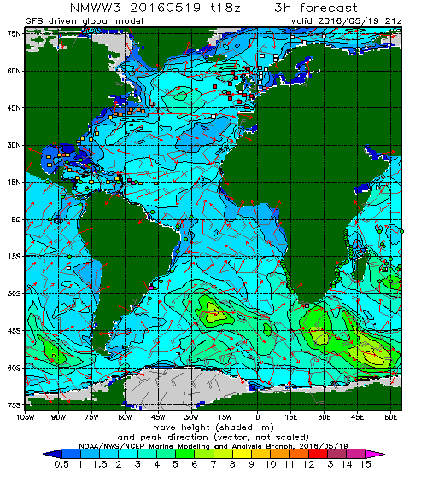
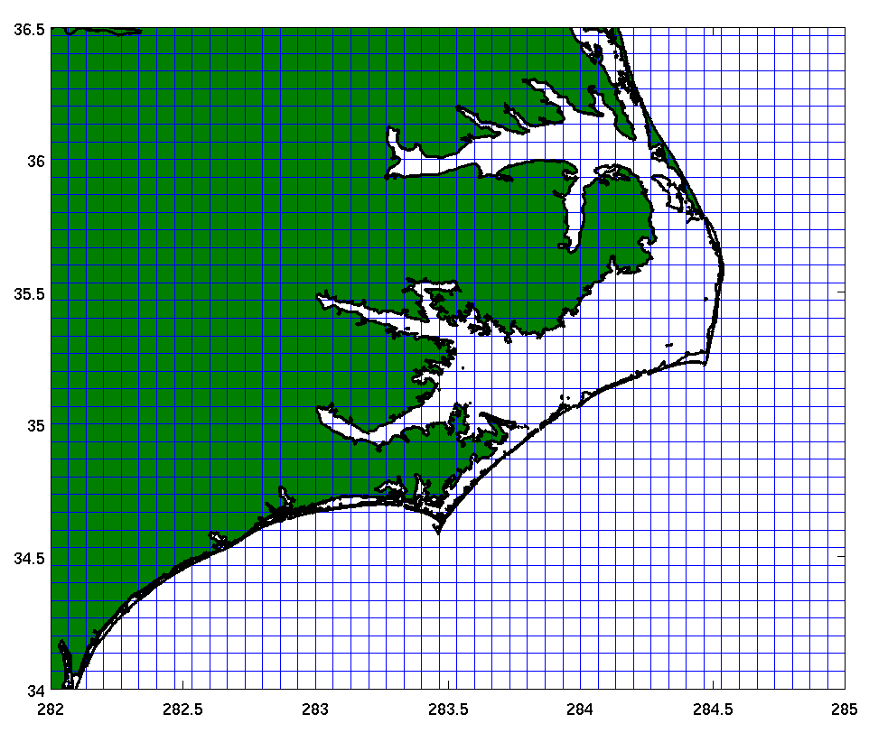
Ocean waves and Coastal downscaling
Coastal application
Desired resolution: 1.8 km - 200 m
Hourly output, out to 6 days
Forecaster consensus wind forcing
4

Slide 5
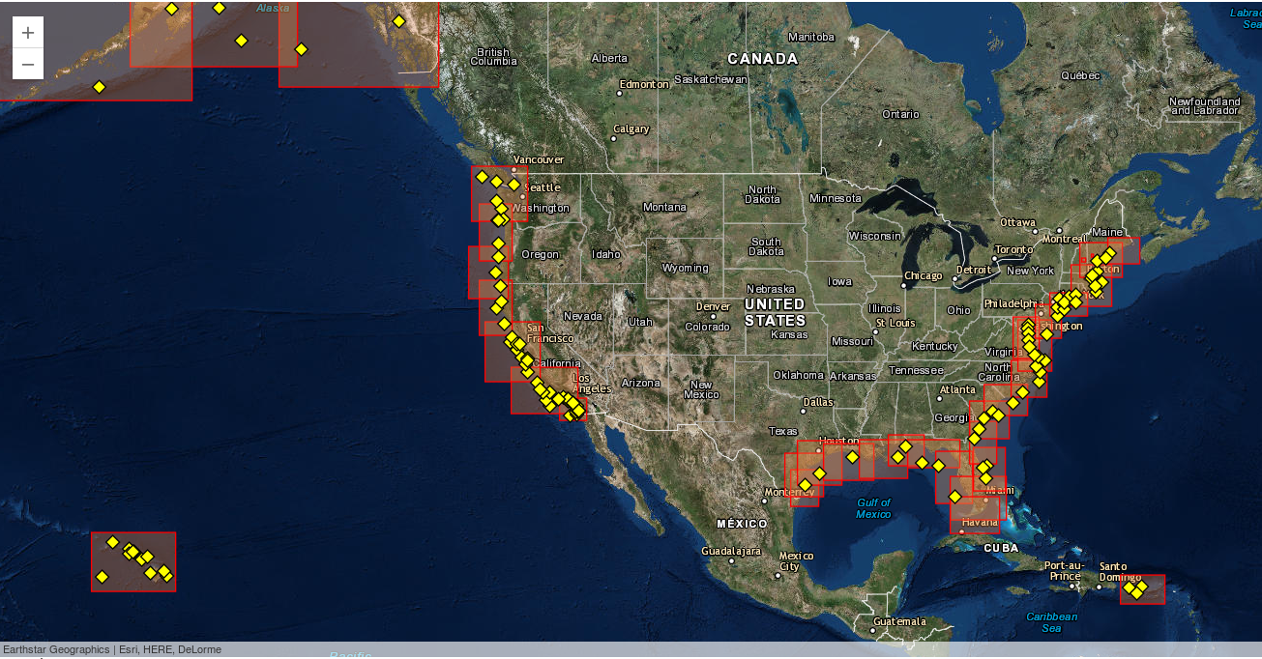
Nearshore Wave Prediction System
SWAN-based operational coastal wave model
http://polar.ncep.noaa.gov/nwps/para/viewer.shtml
5

Slide 6
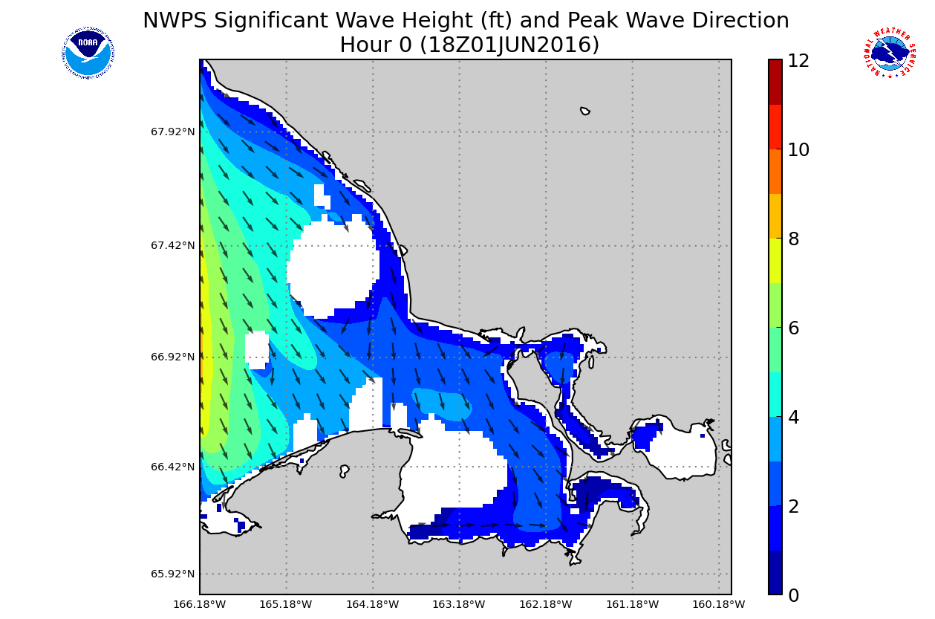
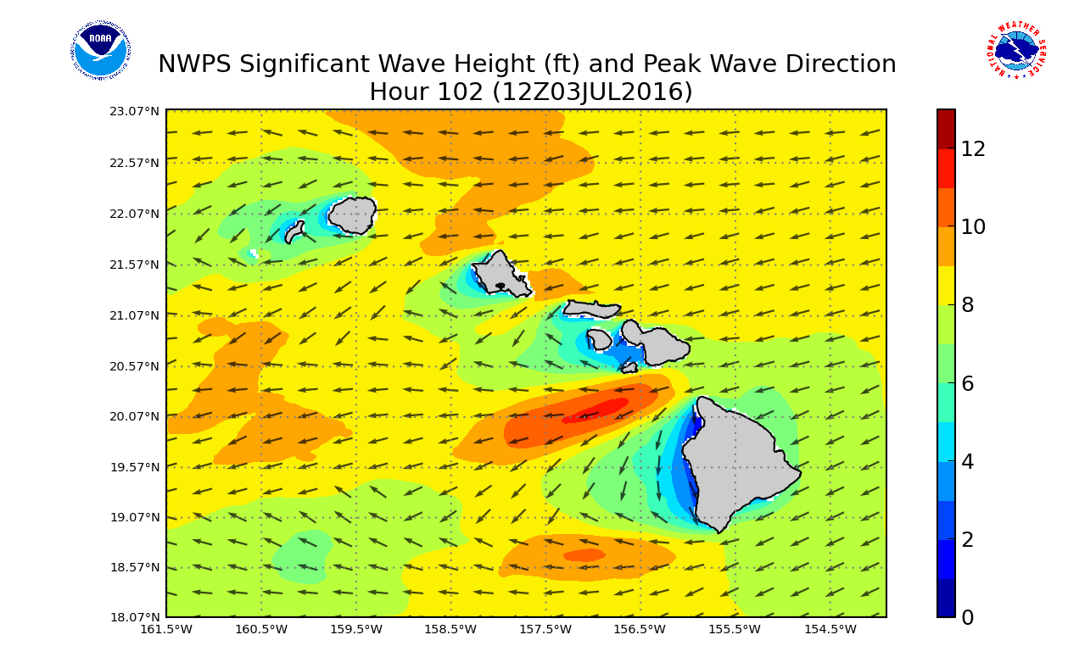
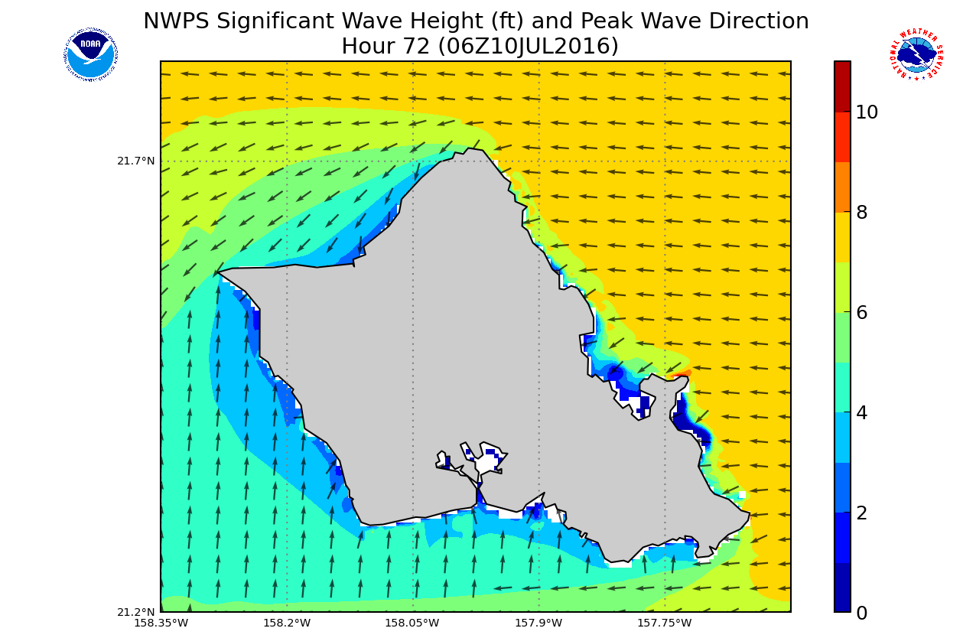
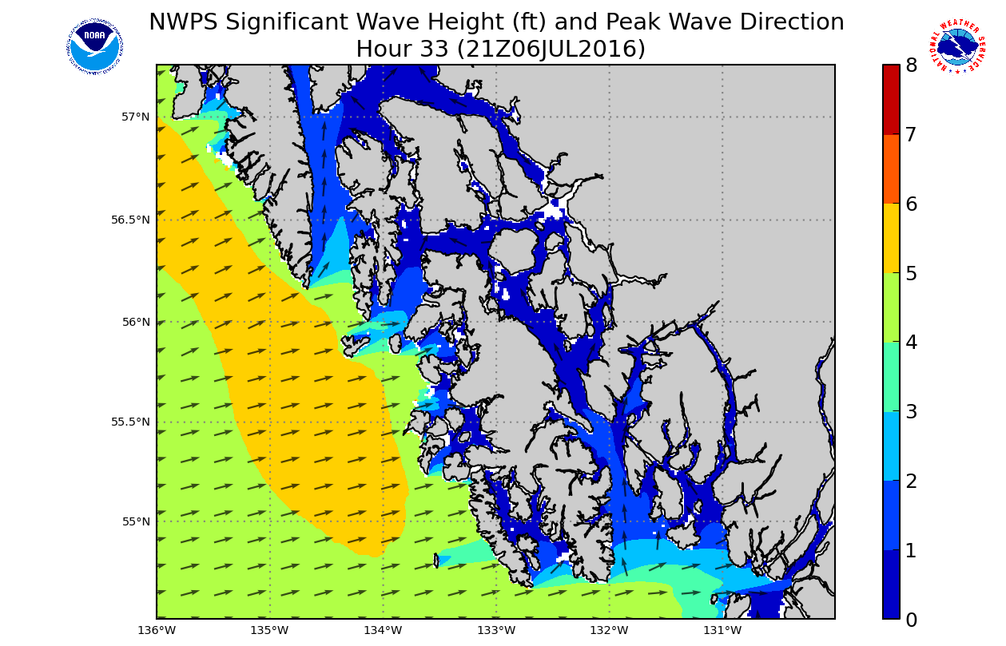
Example NWPS output
Kotzebue Sound, AK
Hawaii
Oahu, HI
Juneau, AK
Columbia River Mouth, OR
6

Slide 7
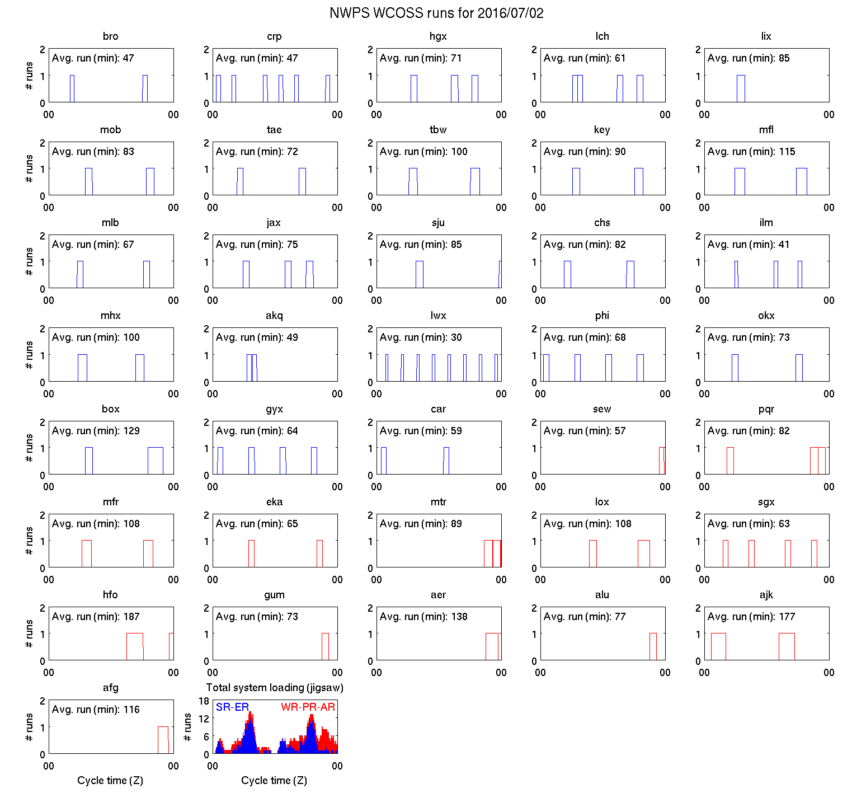
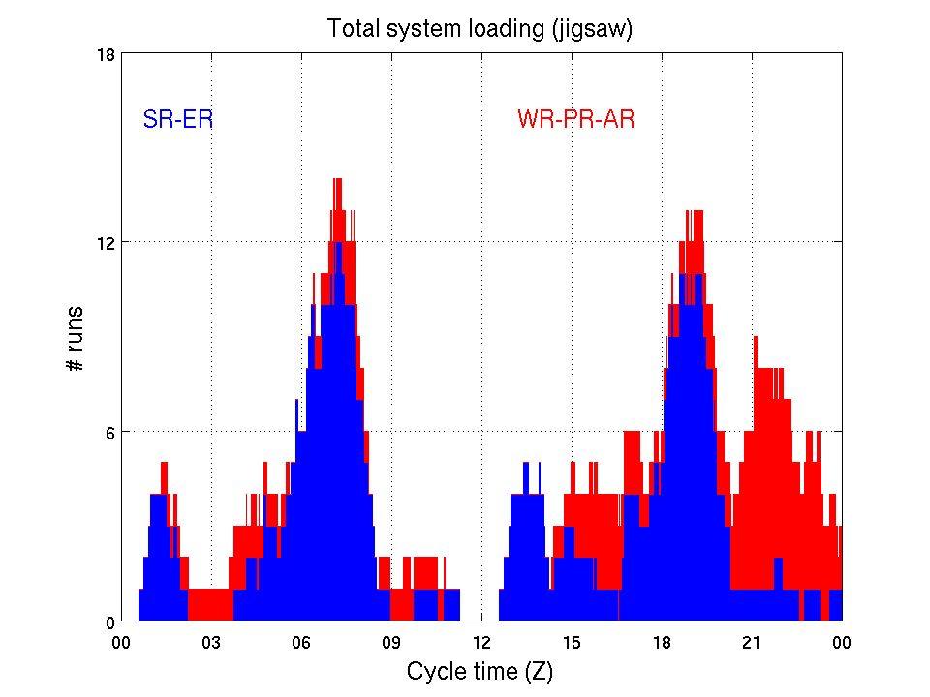
On-demand run triggering
Blue: Southern and Eastern Regions
Red: Western, Pacific and Alaska Regions
Total runs: ~90/day
Avg. run times = 30-150 min
7

Slide 8
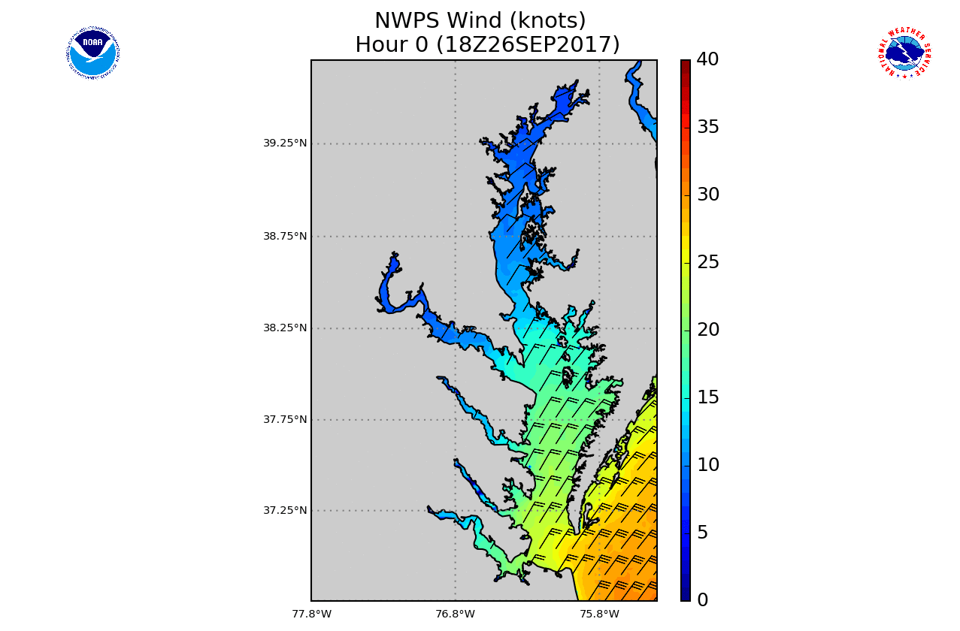
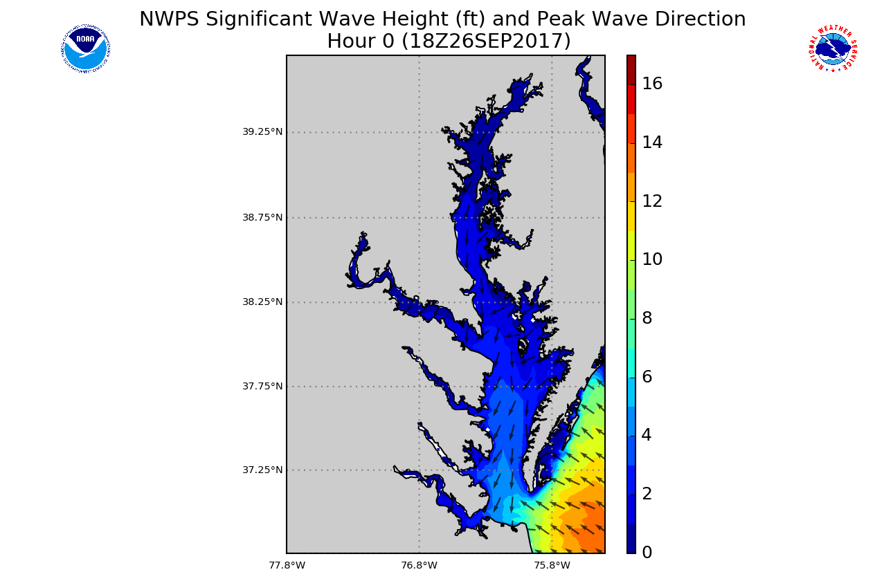
Example output: Baltimore/Washington
Forecast wind field, generated wave field
http://polar.ncep.noaa.gov/nwps/
8

Slide 9
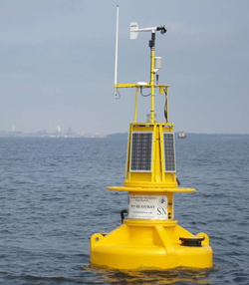
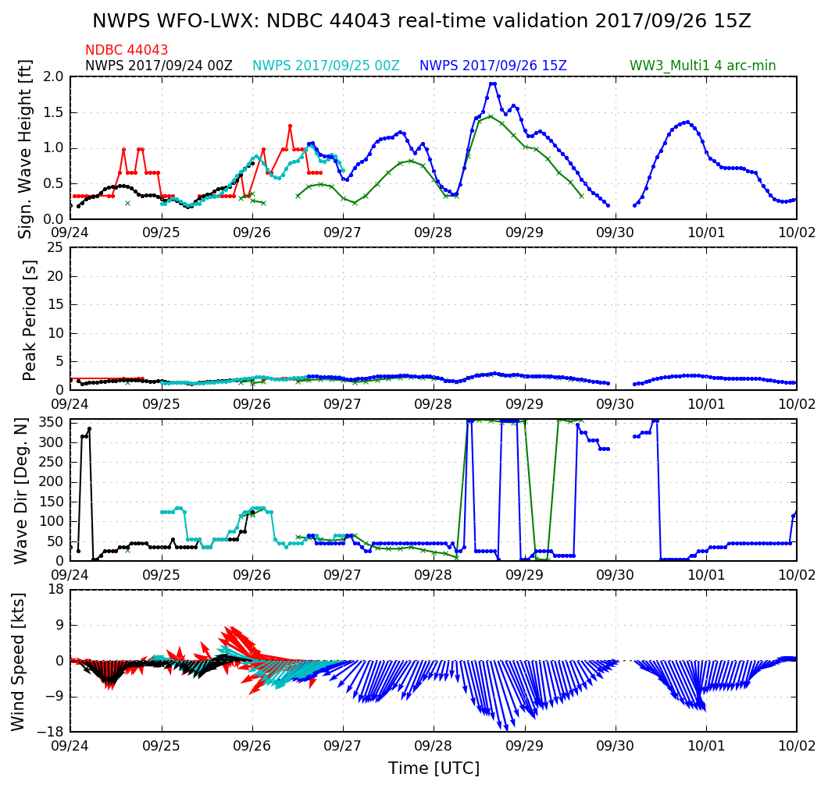
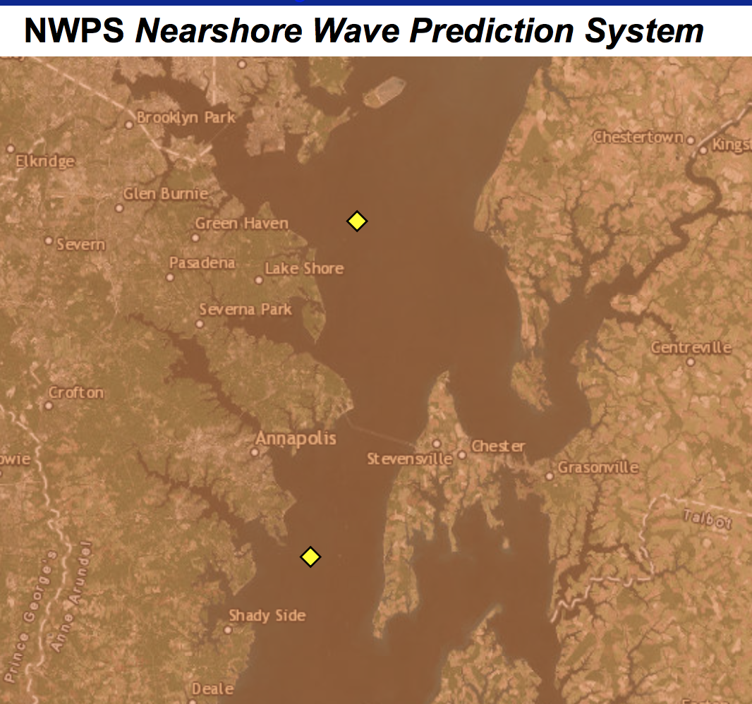
Validation: Baltimore/Washington
Patapsco, MD
9

Slide 10
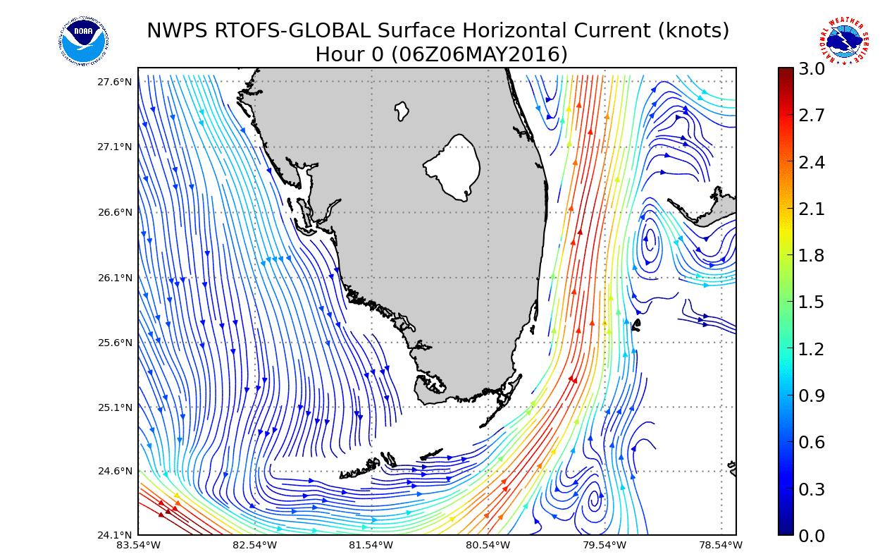
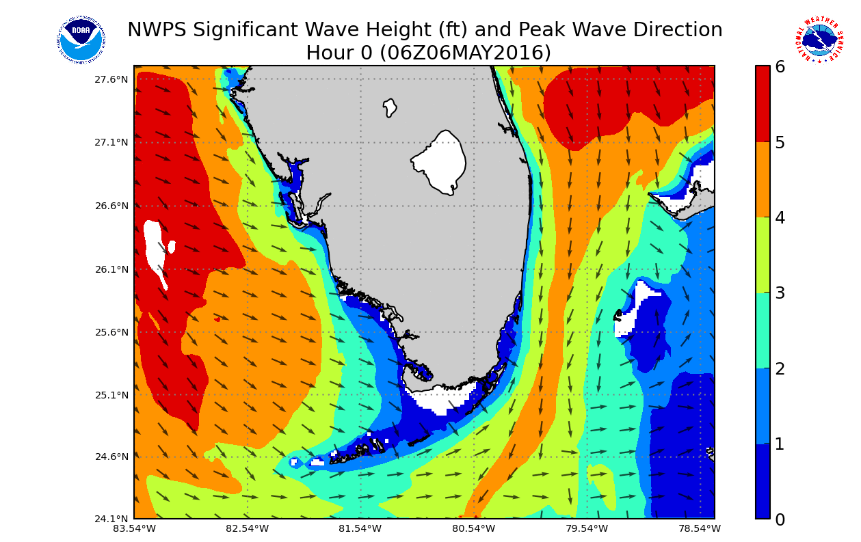
Wave-current interaction
Example: Miami, FL
Coastal wave response
Surface currents from NOAA’s global circulation model RTOFS
http://polar.ncep.noaa.gov/nwps/
10

Slide 11
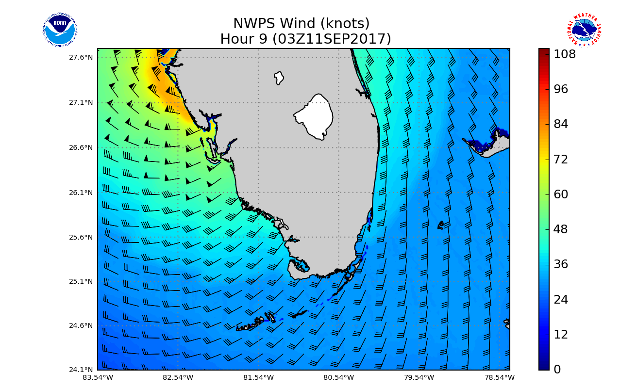
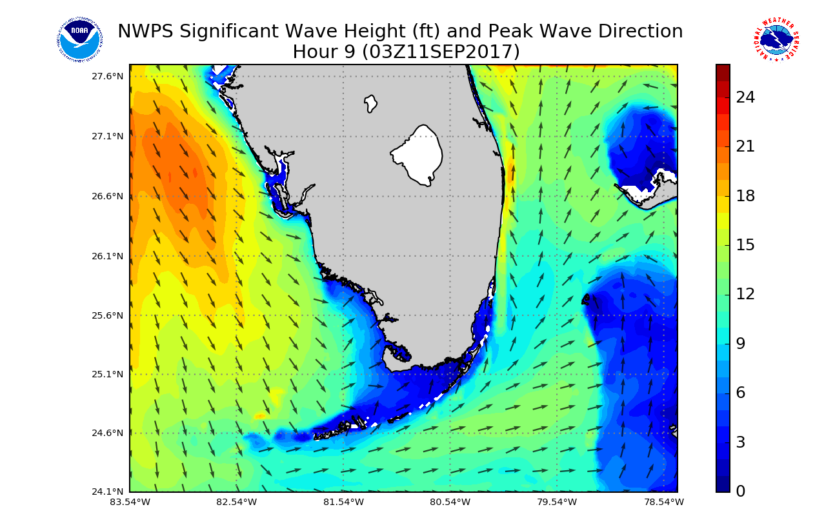
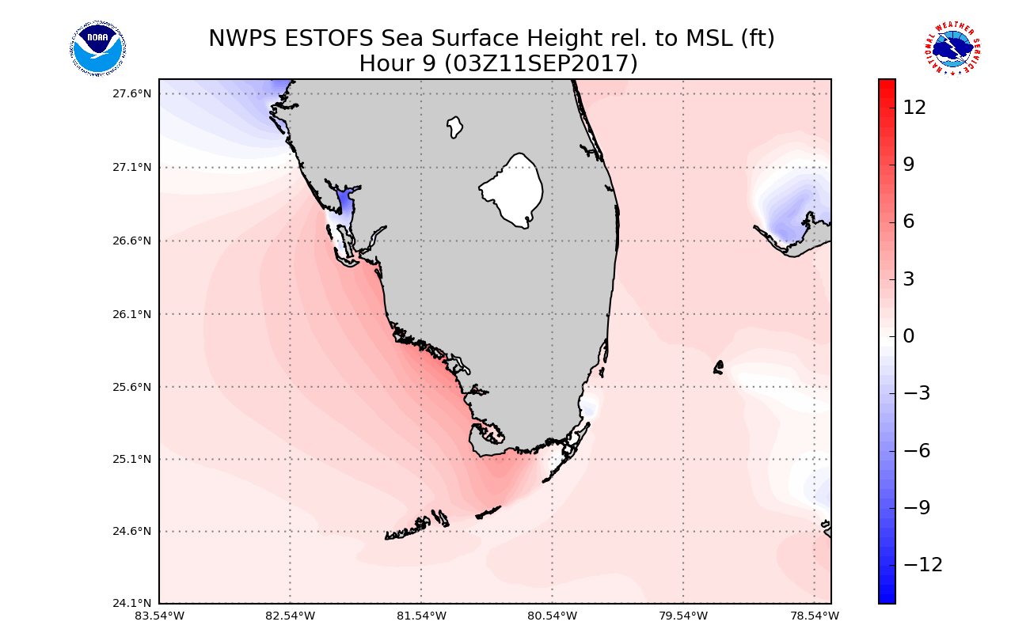
Inclusion of tide and surge water levels
Hurricane Irma (2017/09/11)
Hurricane wind field
Tide + wind surge
(ESTOFS model)
10

Slide 12
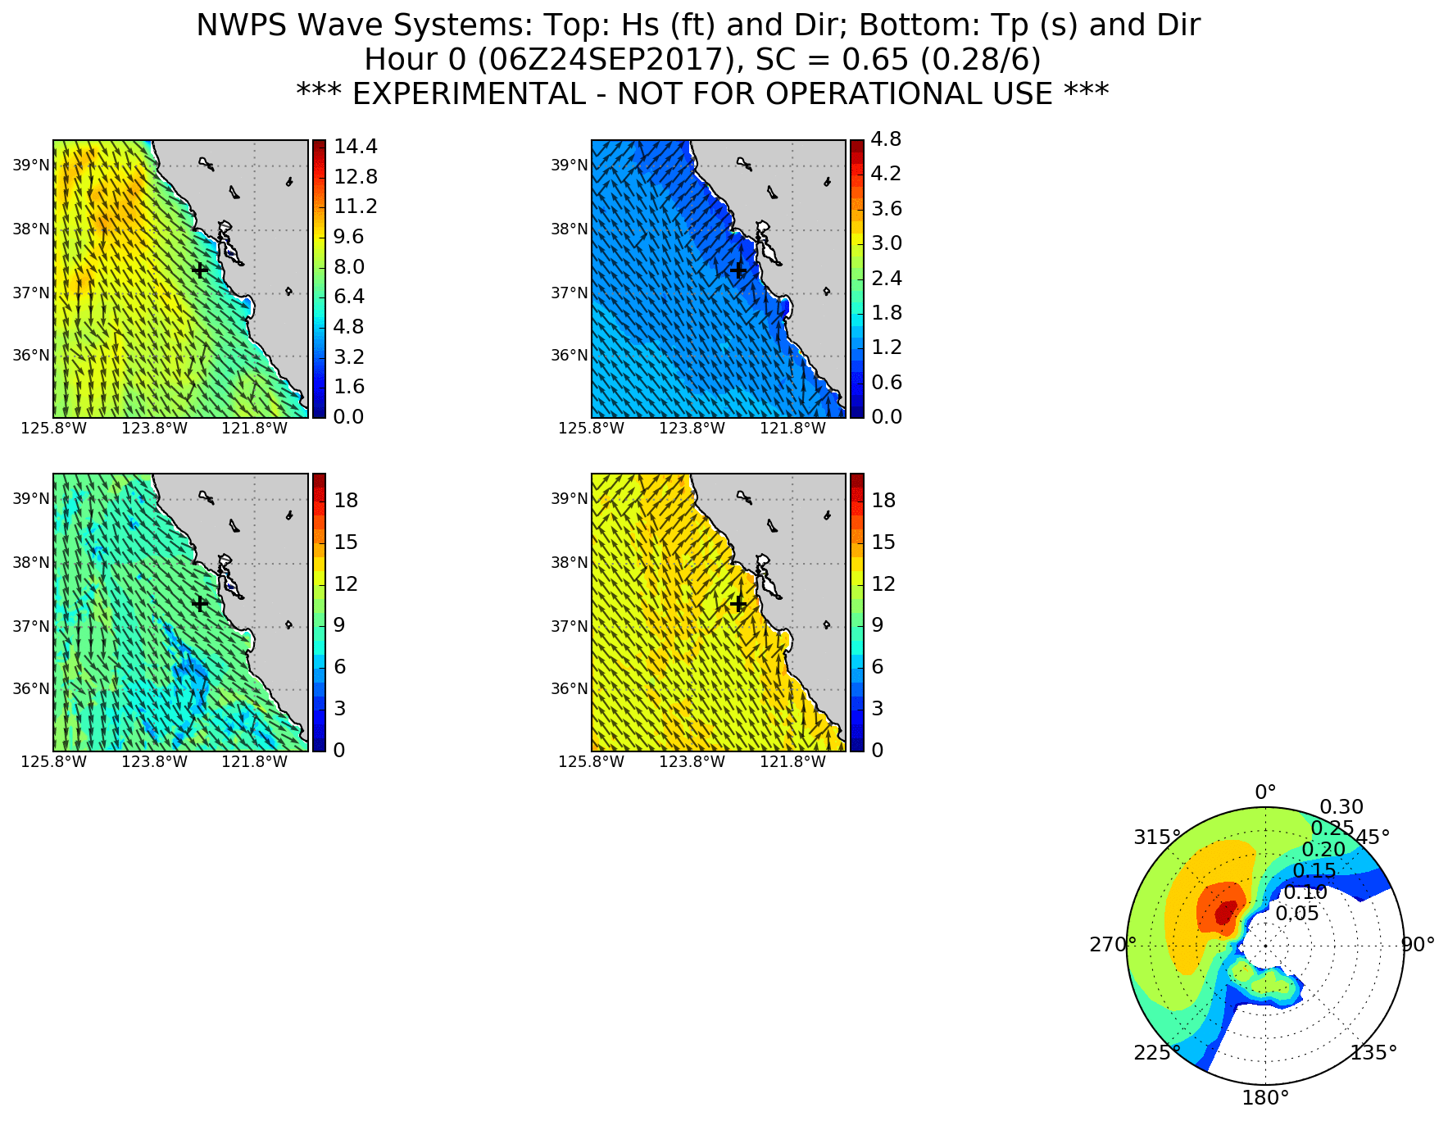
Dealing with complexity: Wave systems
ML clustering, e.g. Monterey, CA (2 systems)
Hs, sys1
Hs, sys2
Tp, sys1
Tp, sys2
12

Slide 13
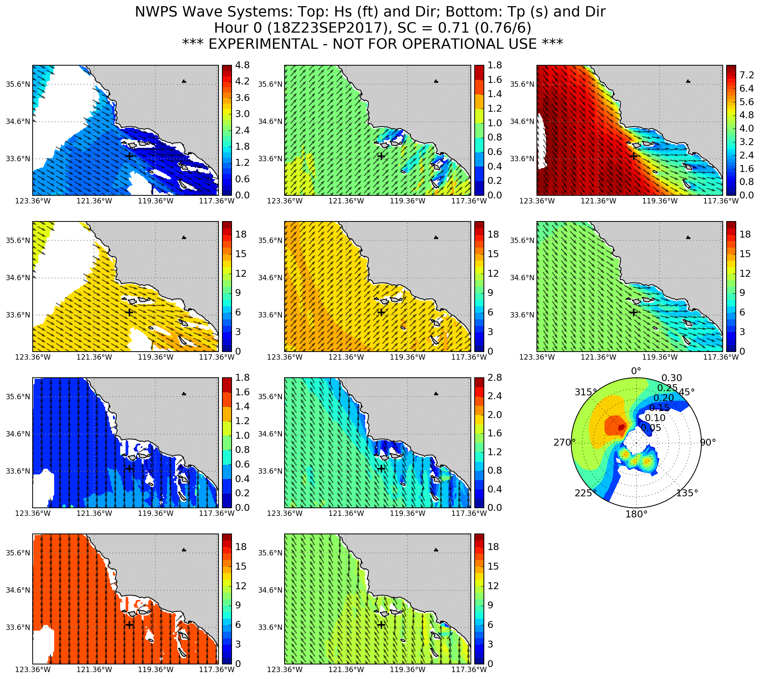
Dealing with complexity: Wave systems
ML clustering, e.g. Los Angeles, CA (5 systems)
Hs, sys1
Hs, sys2
Hs, sys3
Tp, sys1
Tp, sys2
Tp, sys3
Hs, sys4
Hs, sys5
Tp, sys4
Tp, sys5
13

Slide 14
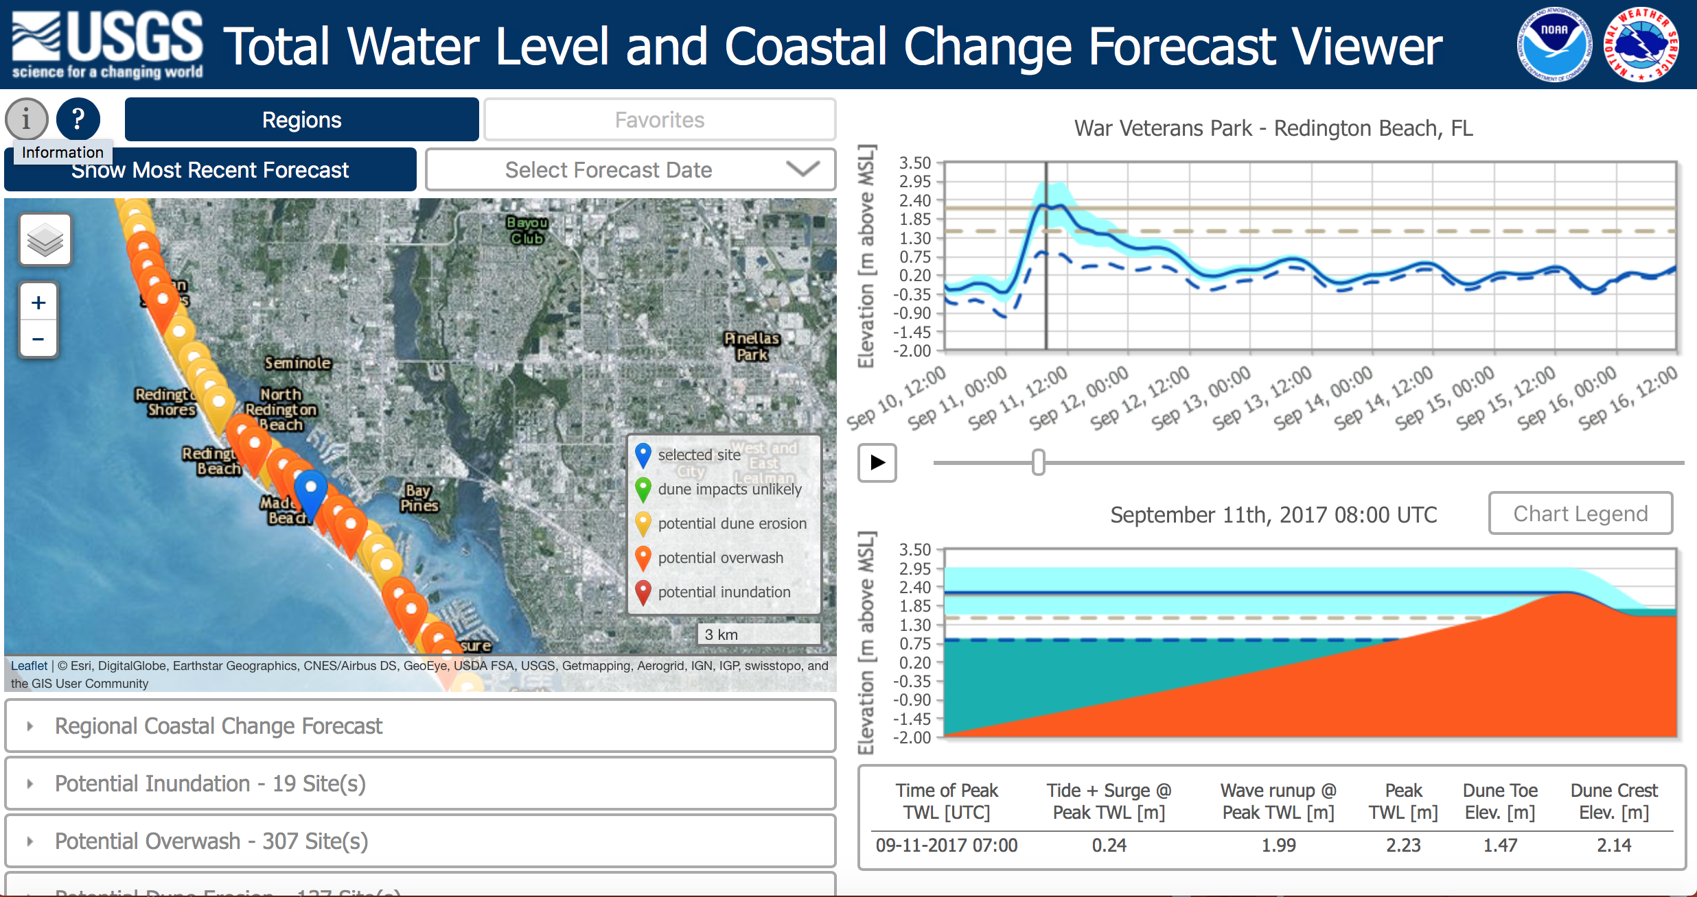
Future: Erosion/overwash guidance
Hurricane Irma (2017/09/11)
14

Slide 15
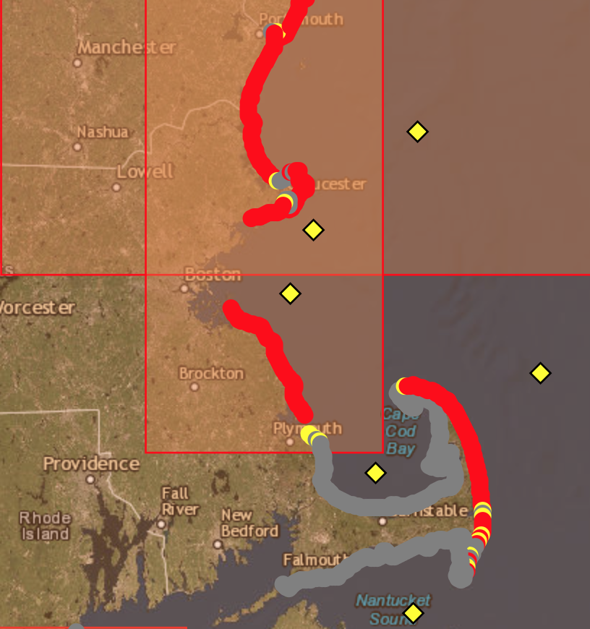
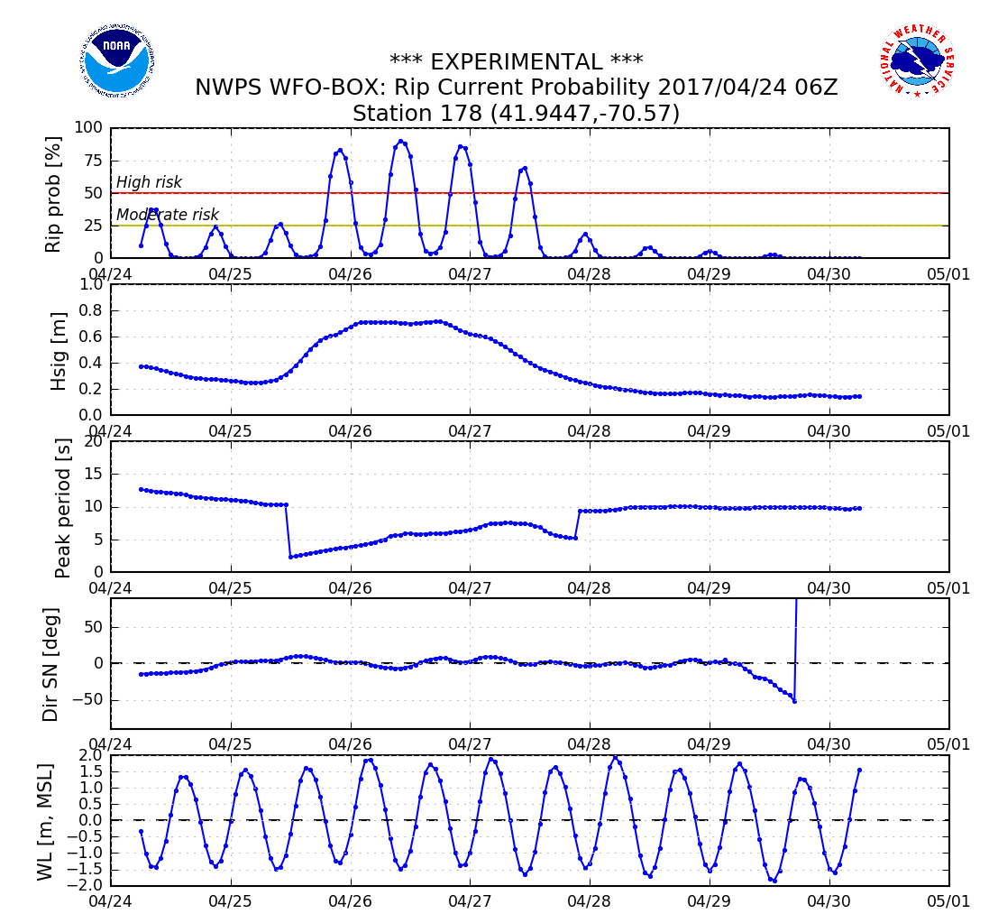
Future: Rip Current guidance
Example Cape Cod/Boston, MA
http://polar.ncep.noaa.gov/nwps/para/viewer.shtml
15

Slide 16
Summary
Nearshore Wave Prediction System provides on-demand, high-resolution wave model output. Spatial resolution: 2 km – 200 m. Temporal resolution: Hourly, out to 6 days.
Coverage for all of Continental US, Alaska, Hawaii and Puerto Rico.
Wave model takes into account official forecast winds, offshore surface currents, tide & surge water levels.
Output includes basic wave parameters, wave systems, and in future rip current and erosion/overwash guidance.
Model visualizations at (non-operational): polar.ncep.noaa.gov/nwps/viewer.shtml
Contact: Andre.VanderWesthuysen@noaa.gov.
16

