Slide 1
Marine Weather
André van der Westhuysen^{1,2} Darren Wright³,
Jeff McQueen¹
¹NOAA / National Weather Service
National Centers for Environmental Prediction
²I.M Systems Group, Rockville MD
³NOAA / National Weather Service / Analyze, Forecast, and Support Office
NOAA Industry Day, Oct 5, 2017
1

Slide 2
Intro: Seamless Suite of Weather Forecast Products
Forecast
Uncertainty
Years
Outlook
Seasons
Guidance
Months
Threats Assessments
2 Week
Climate/Weather
Linkage
Forecast Lead Time
1 Week
Forecasts
Days
Watches
Hours
Warnings & Alert Coordination
Minutes
Benefits
Maritime
Health
Aviation
Agriculture
Commerce
Recreation
Life & Property
Fire Weather
Hydropower
Ecosystem
Environment
Space Operations
Emergency Mgmt
Energy Planning
Reservoir Control
2

Slide 3
Weather data types and access
High-resolution atmospheric models in marine zone
High-resolution ocean wave models
Example viewer: NOAA’s nowCOASTTM
Crowdsourcing data
Data access: ftp://ftp.ncep.noaa.gov/pub/data/nccf/com/
3

Slide 4
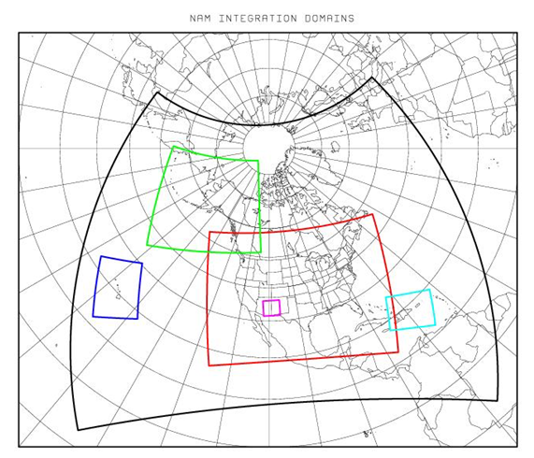
North American Model (NAM)
Larger-scale model over continent at 12 km resolution
Simulated period of 84 hr, updated 4 times/day
1-way interactive high-res nests, with simulated period of 60 h:
4 km CONUS
6 km Alaska
3 km Hawaii and Puerto Rico
4

Slide 5
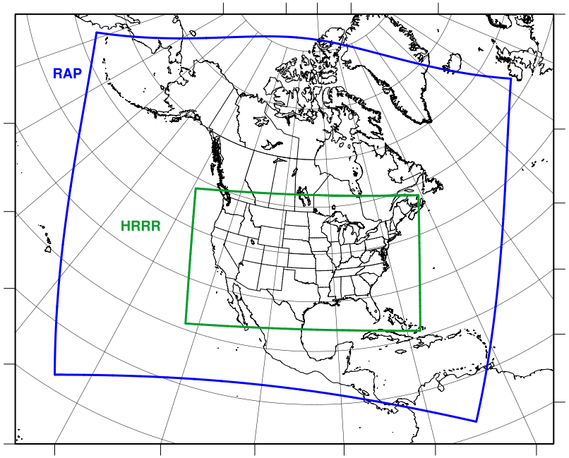
Rapid Refresh / High-Res Rapid Refresh
NOAA hourly updated models
(Situational awareness for energy, aviation, severe weather, etc.)
13km Rapid Refresh (RAP) (mesoscale)
Simulated period: 18 h
RAP
Nested 3km High Resolution Rapid Refresh (HRRR) (storm-scale)
HRRR
Simulated period: 15 h
5

Slide 6
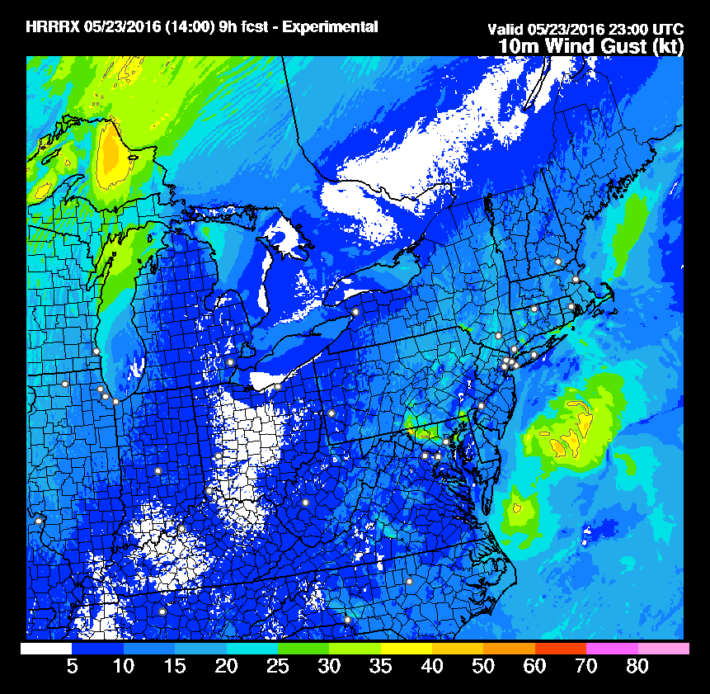
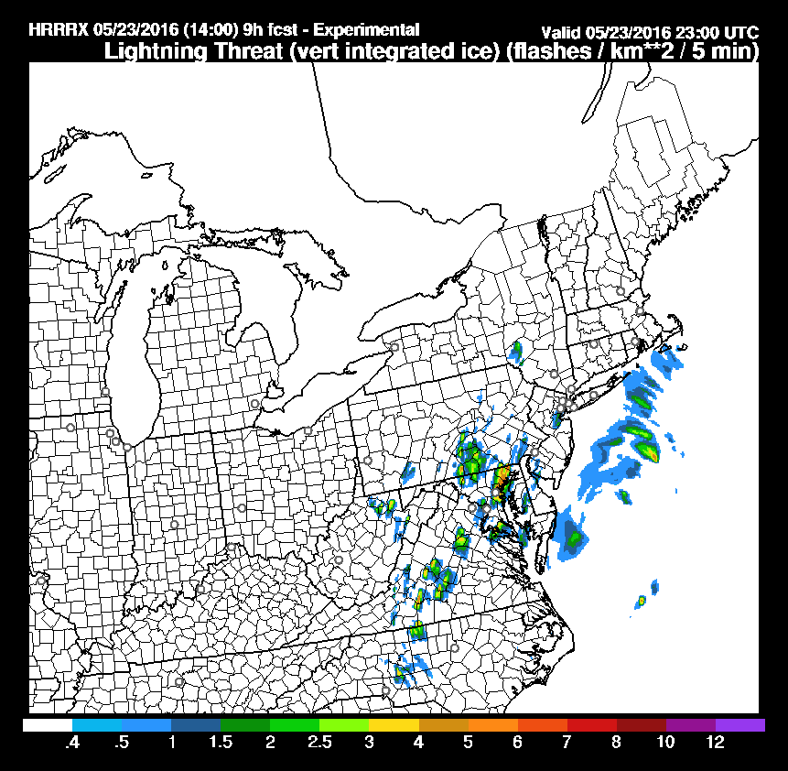
High-resolution thunderstorm forecast
(HRRR model, 15 h forecast horizon)
3 km resolution forecast, valid 7 PM EDT May 23, 2016
10m Wind Gust
Likely thunder-storms with gales over Northern Chesapeake Bay
Lightning
threat
6

Slide 7
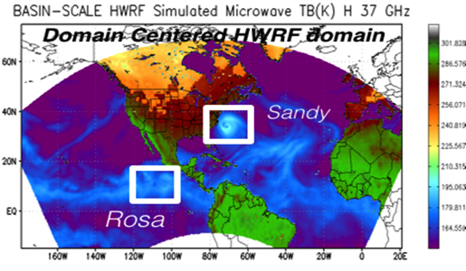
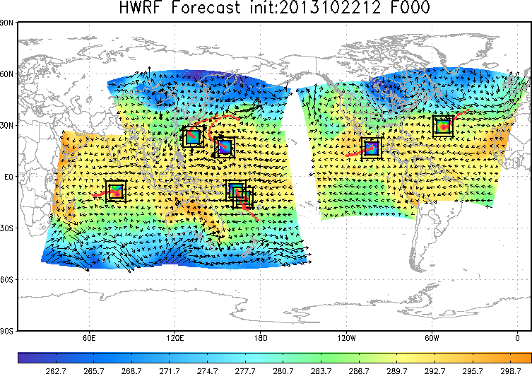
Basin-Scale Hurricane Model
Hurricane Weather Research and Forecasting model (HWRF):
Available during active hurricanes (every 6 hours)
Multiple storms tracked in a single model
Interaction between storms
Landfall and post-landfall effect (such as storm surge and rainfall)
Storm genesis prediction
Regional ensembles
Data assimilation
7

Slide 8
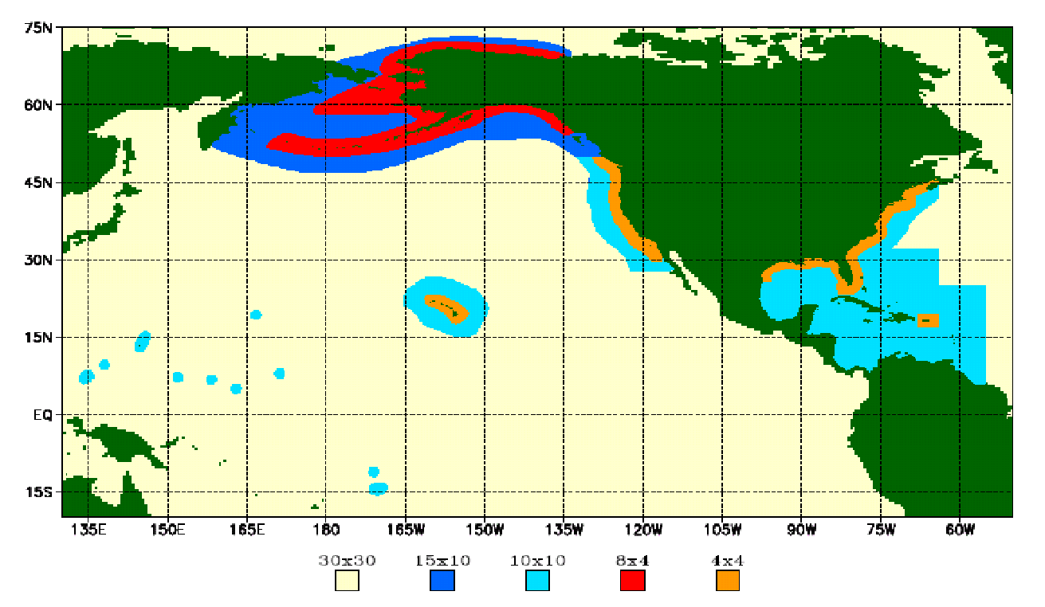
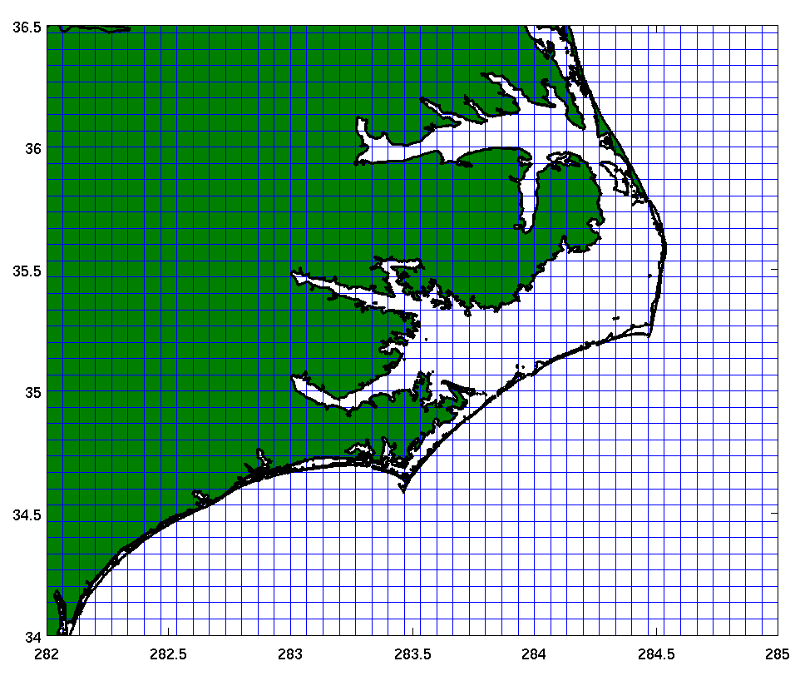
Global and coastal wave models
WAVEWATCH III
global wave model
Nearshore Wave Prediction System (NWPS)
Max. coastal resolution = 4 arc-min (7.5 km)
Forced by Global Forecast System (GFS) model winds
Available 4 times a day, out to 180 h
Resolution = 1.85 km – 500 m
Forced by forecaster-developed wind fields, currents and water levels
On-demand, out to 144 h
8

Slide 9
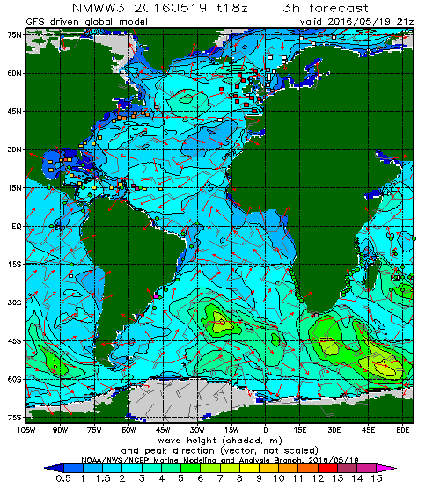
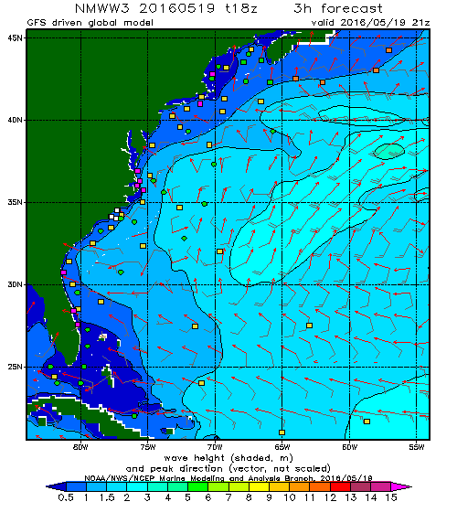
Global WAVEWATCH III model
9

Slide 10
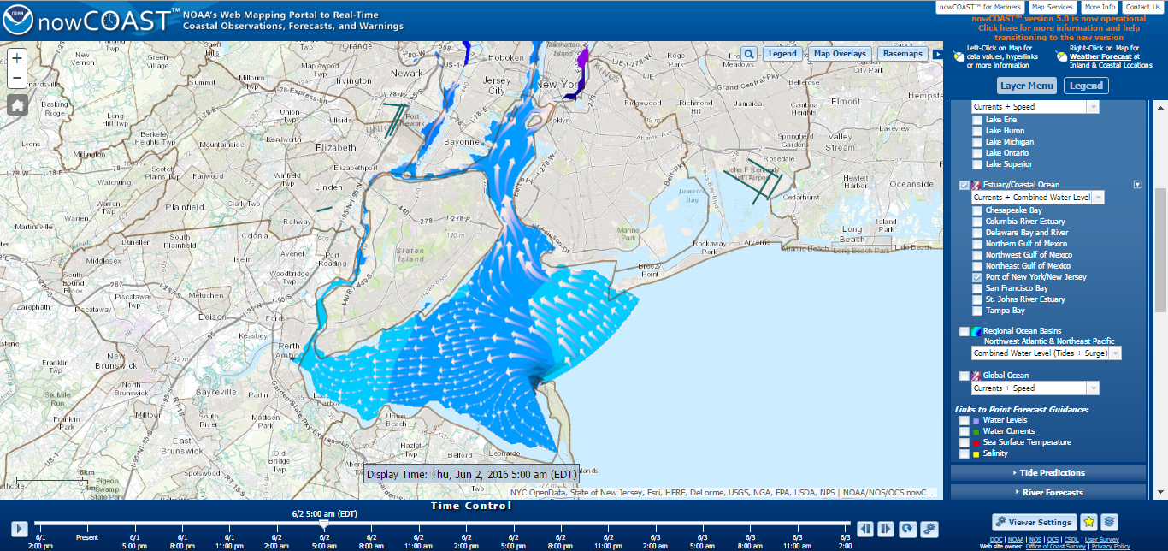
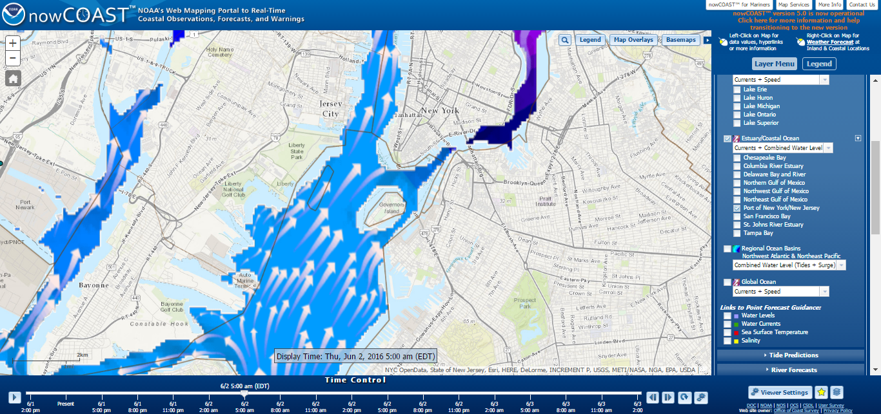
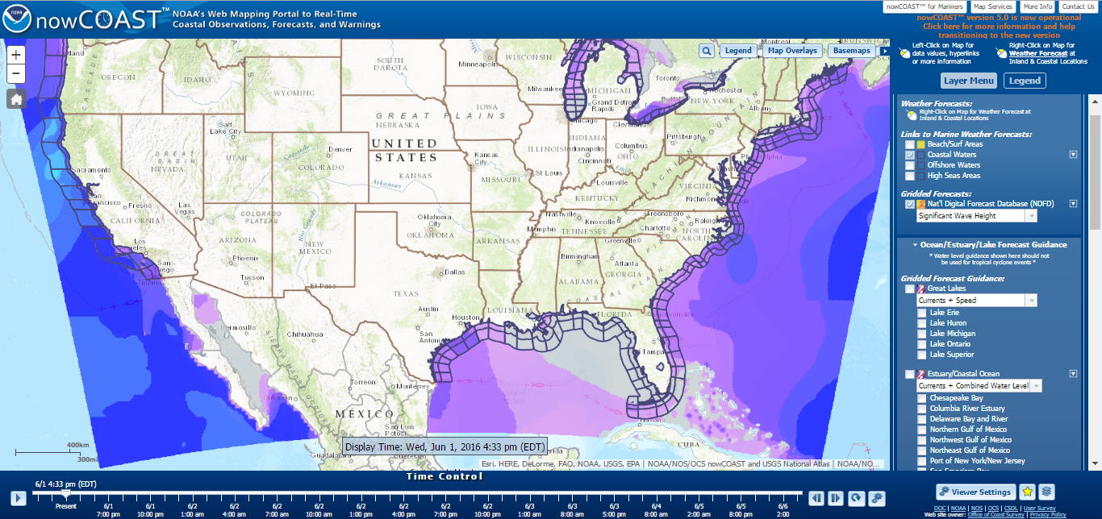
nowCOASTTM: Near real-time Coastal Data and Information
Waves, tides, currents and more…
http://nowcoast.noaa.gov/
10

Slide 11
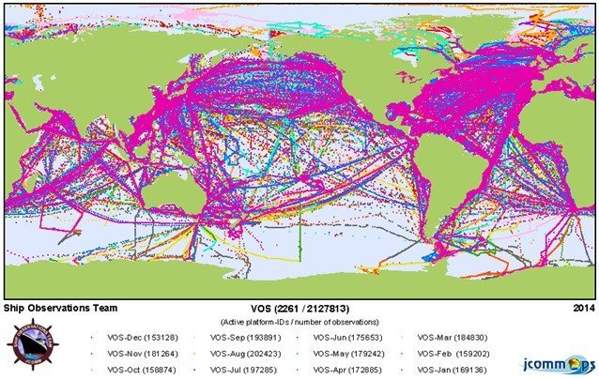
Crowdsourcing data: JCOMM*
Voluntary Observing Ships Scheme
http://sot.jcommops.org/vos/
*Joint Technical Commission for Oceanography and Marine Meteorology
11

Slide 12
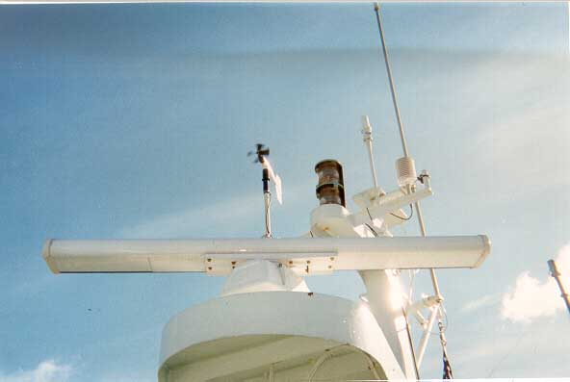
Crowdsourcing data: Ferry Weather
http://i90.atmos.washington.edu/ferry/
12

Slide 13
Summary
NOAA/National Weather Service maintains a wide range of global and mesoscale models, over various forecast horizons from weather to climate.
Meso/storm scale atmospheric models include: 12/4 km North American Model (NAM), hourly 13km Rapid Refresh (RAP), hourly 3 km High-res Rapid Refresh (HRRR) and Hurricane WRF (HWRF).
Ocean wave models include: Global WAVEWATCH III (0.5º to 4 arc-min), Nearshore Wave Prediction System (1 arc-min to 500 m).
NOAA model data is freely available via web interfaces, but it is advised to collaborate with a local Weather Forecast Office.
Possibilities are arising for obtaining observational data from crowdsourcing, which could be used for data assimilation and model validation.
Contact: Andre.VanderWesthuysen@noaa.gov
13

