Slide 1
National Operational Coastal Modeling Program
Paul Bradley (CO-OPS) & Ed Myers (Coast Survey Development Lab)
NOAA Industry Day
October 5, 2017

Slide 2
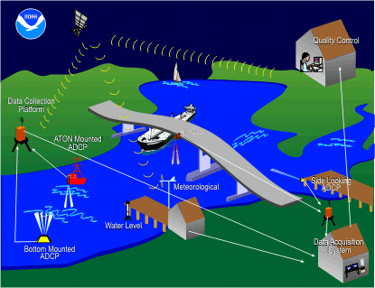
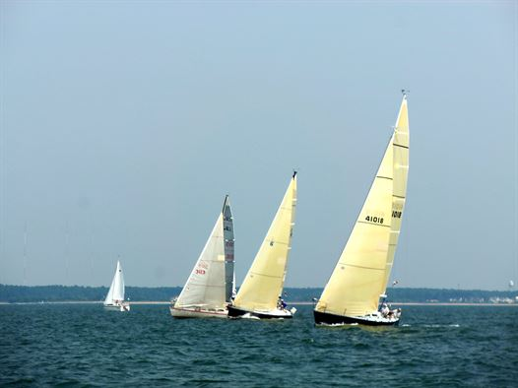
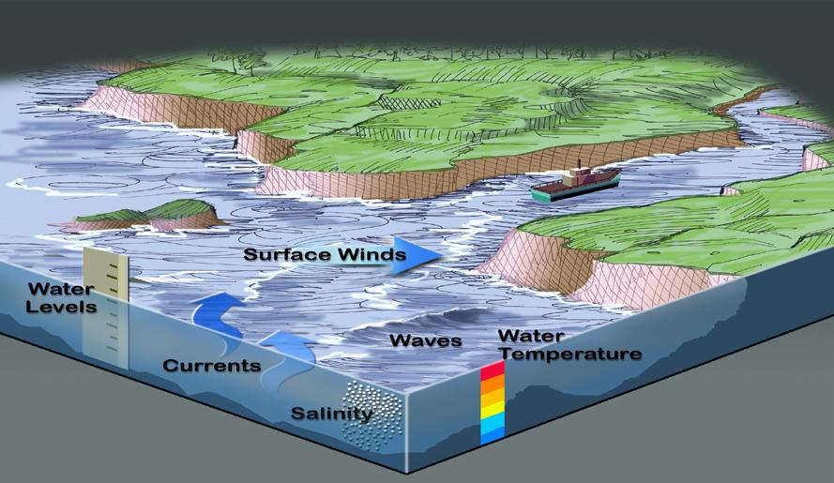
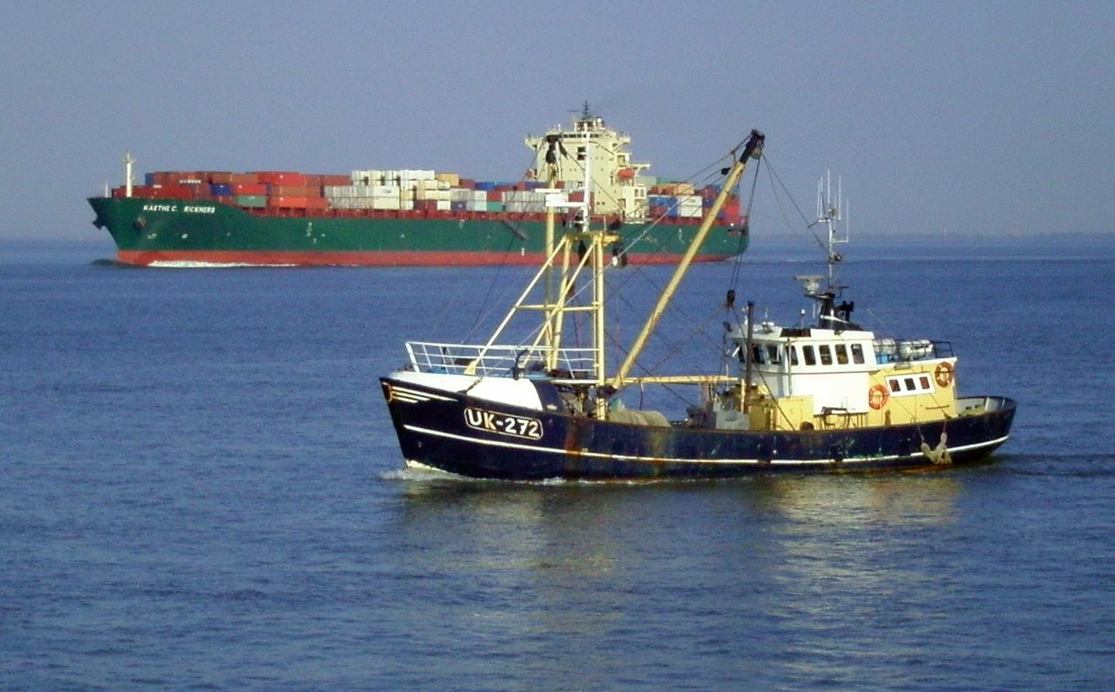
Why is Coastal Modeling Important?
2

Slide 3
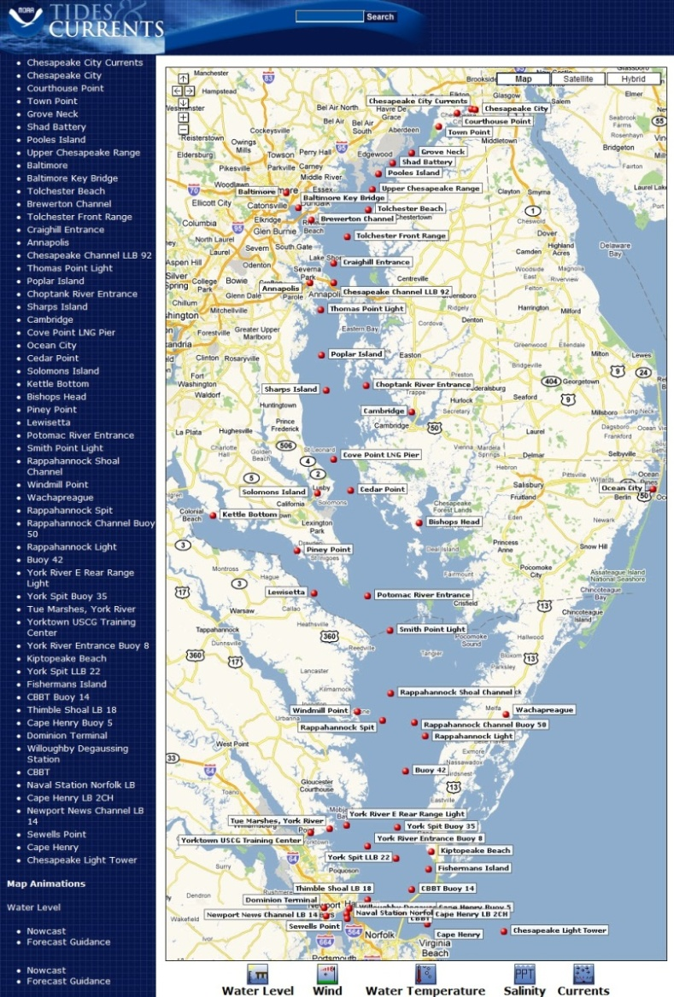
NOS Operational Forecast System
Network of 13 Operational Nowcast and Forecast Hydrodynamic Model Systems:
Chesapeake Bay
Delaware Bay
New York/New Jersey
St. John’s River, FL
Tampa Bay, FL
Northern Gulf of Mexico
San Francisco, CA
Columbia River
Lake Erie
Lake Huron
Lake Michigan
Lake Ontario
Lake Superior
http://tidesandcurrents.noaa.gov/ofs/cbofs/cbofs.html
3

Slide 4
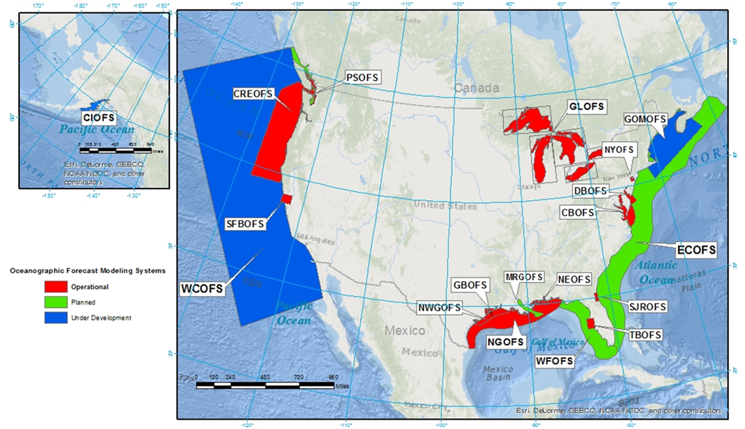
Current and Projected OFS Model Coverage
Where are models most needed?
4

Slide 5
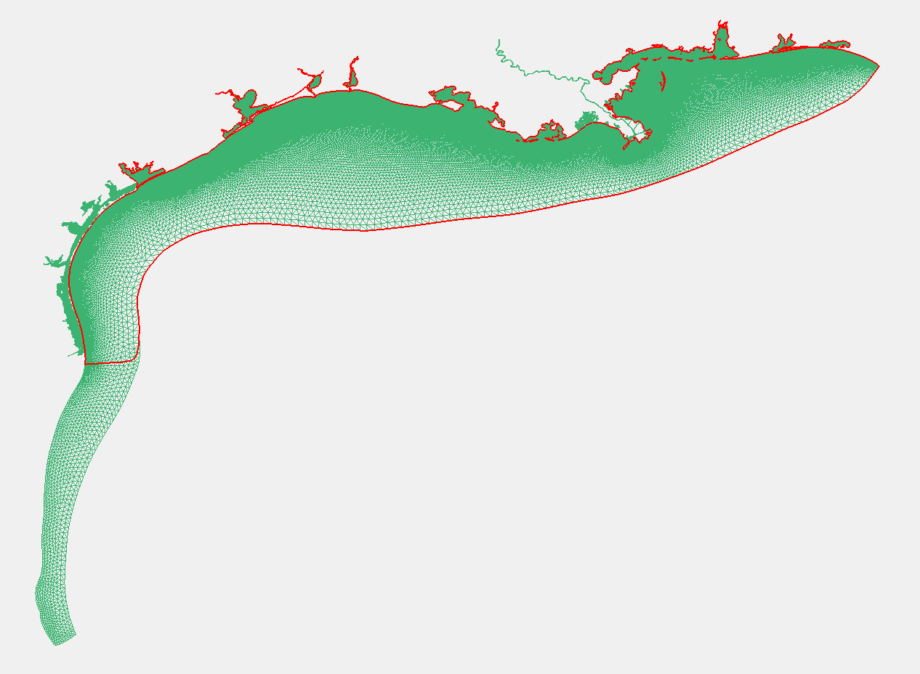
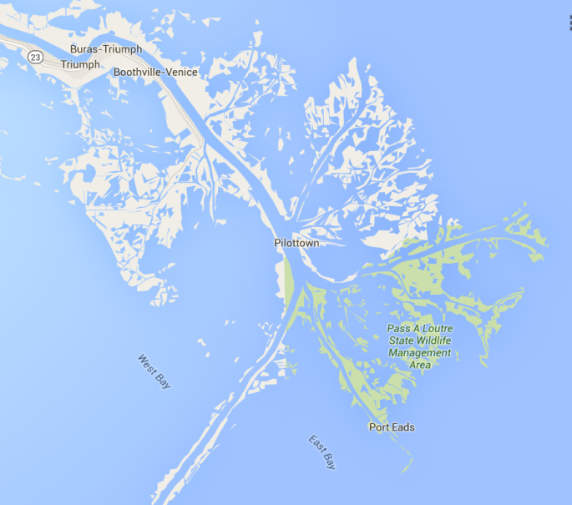
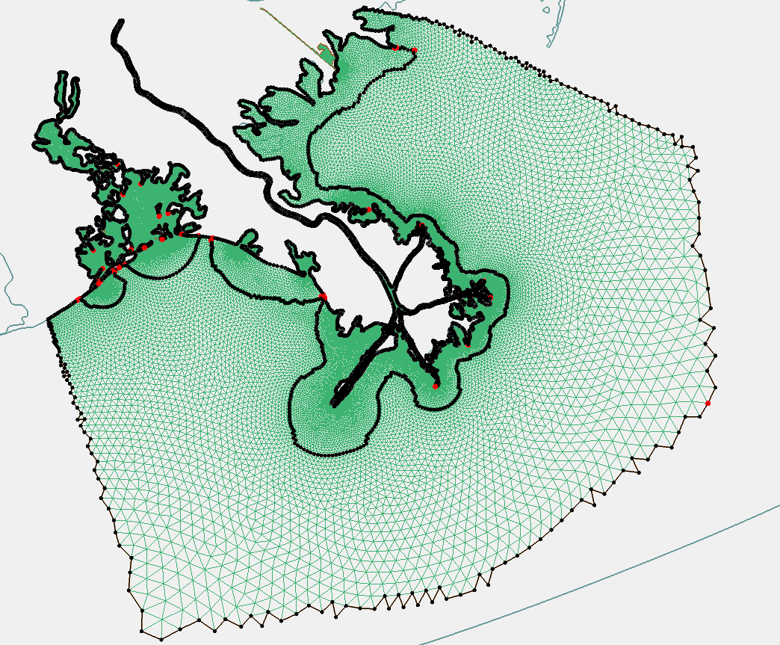
Model Grid Example: Integrated Northern Gulf OFS
Northeast Gulf OFS
Galveston Bay OFS
Integrates 3 grids into a single grid domain
Resolves bays and extends up Mississippi River
Extends down along coast of Mexico to capture HAB dynamics
Northwest Gulf OFS
5

Slide 6
NOAA Operational Coastal Modeling Program
A national network of operational hydrodynamic models providing nowcasts and short-term (2 -5 day) forecasts of:
Water levels
Currents
Salinity
Temperature
Future developments:
Waves
Ice coverage
Which parameters are most useful?
6

Slide 7
Examples of Output – Graphical Products
7

Slide 8
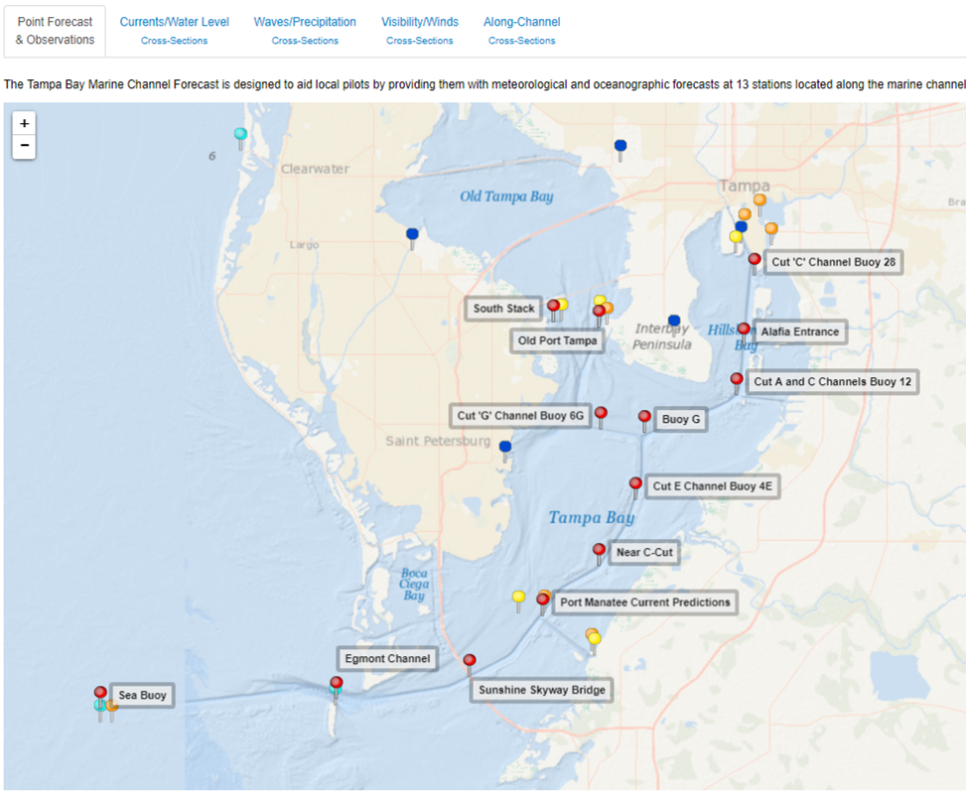
Tampa Bay Marine Channels Forecast
8

Slide 9
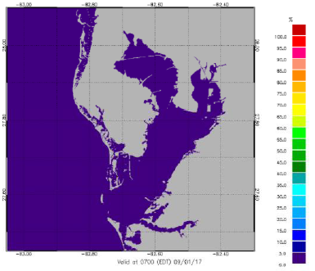
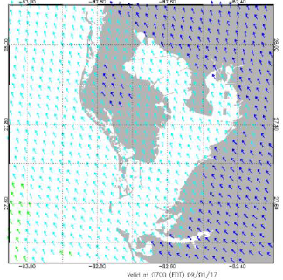
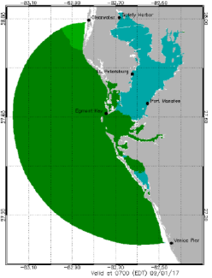
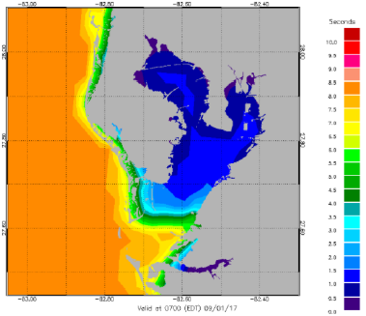
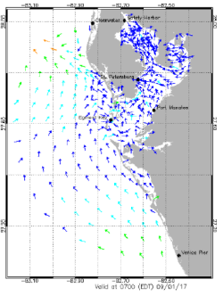
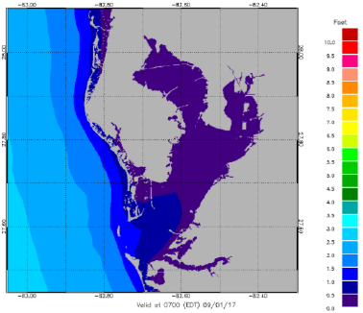
Tampa Bay Marine Channels Forecast https://tidesandcurrents.noaa.gov/ofs/tbofs/tbofs_mcf.html
Visibility
Winds
Water Level
Waves (period)
Currents
Waves (height)
9

Slide 10
How to Access Model Products https://tidesandcurrents.noaa.gov/models.html
10

Slide 11
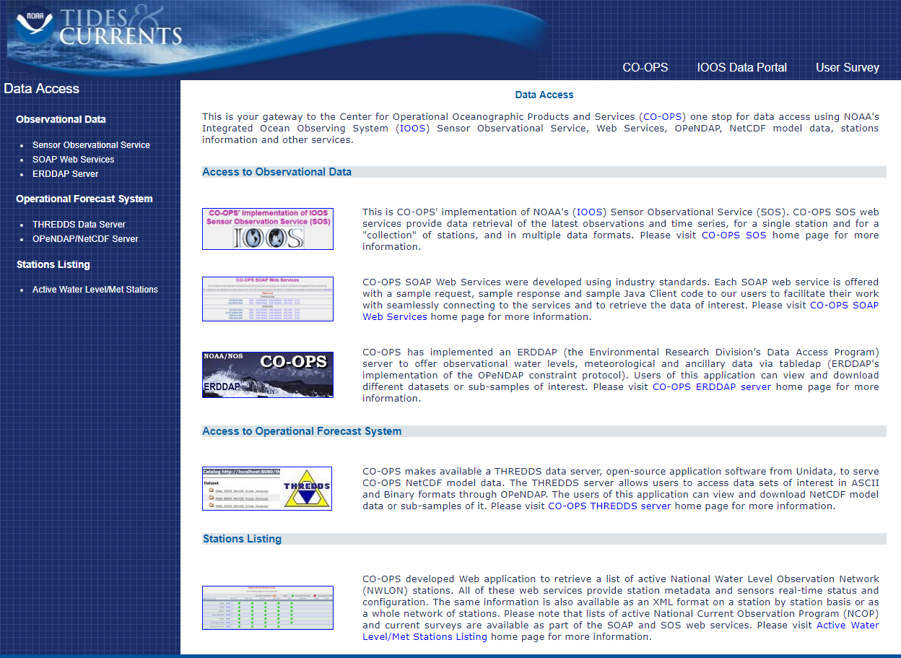
OFS Data via Web Services https://opendap.co-ops.nos.noaa.gov/
11

Slide 12
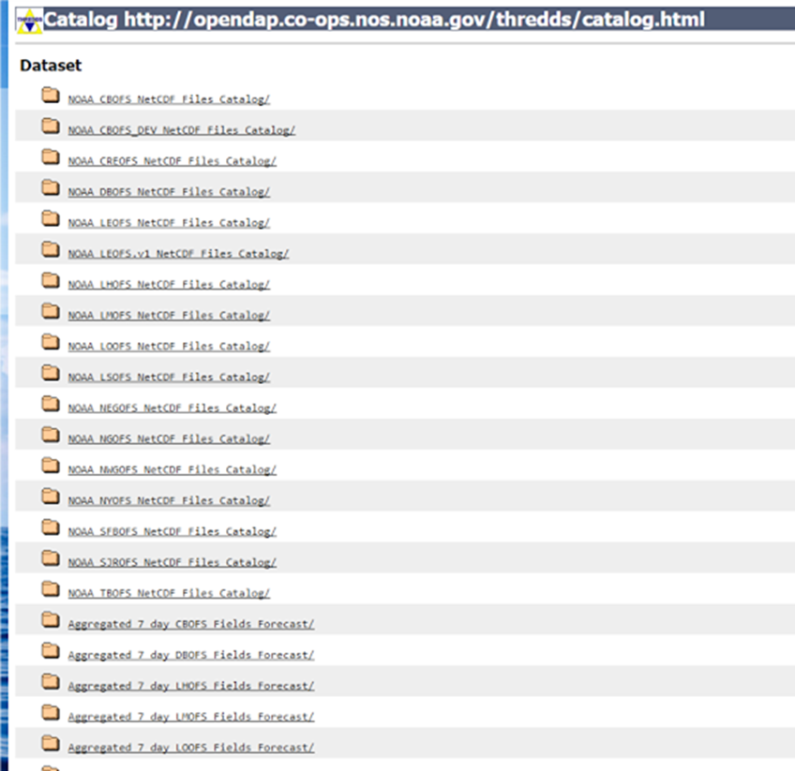
OFS Data via Web Services
How would you prefer to access the model data?
12

Slide 13
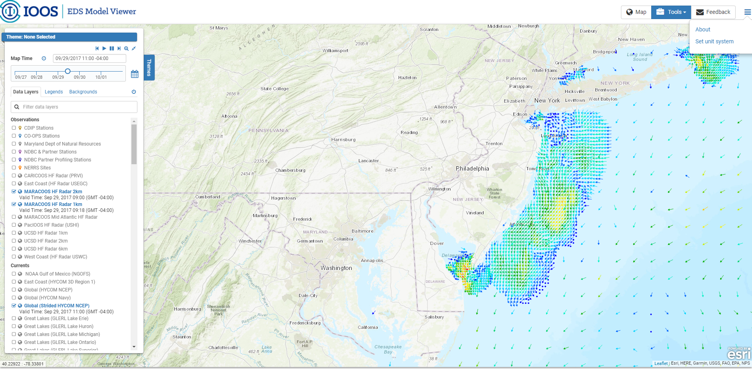
IOOS Environmental Data Server Model Viewer
IOOS aggregates models – https://eds.ioos.us/#
How do you want to see the data?
How could these models be best used for navigation?
13

Slide 14
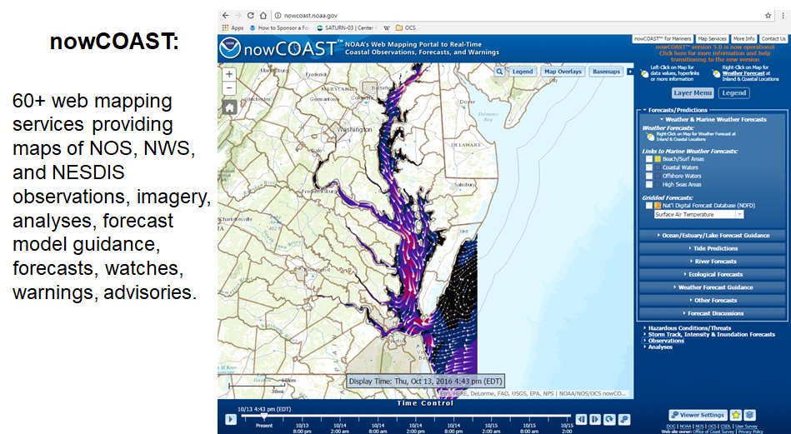
How to Access Model Output – nowCOAST https://nowcoast.noaa.gov
14

Slide 15
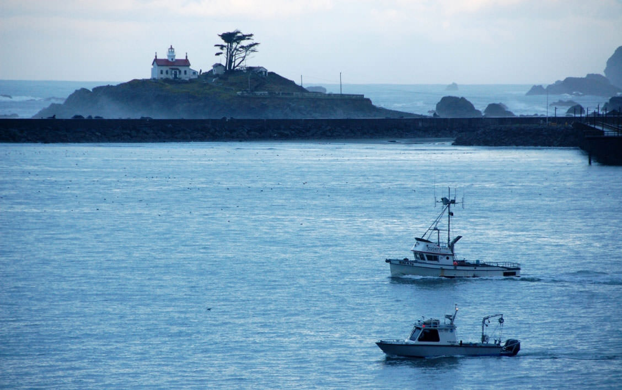
We’d Like to Hear from You!
Where are models most needed?
Which parameters are most useful?
How would you prefer to get the model output?
Are you more interested in model products (i.e., visualizations) or do you just want the raw data?
How frequently would you want the model updated?
What resolution is needed?
How much uncertainty in the predictions can be accepted?
Paul.Bradley@noaa.gov;
(240) 533-0582
Edward.myers@noaa.gov;
(240) 847-8256
NATIONAL OCEAN SERVICE
oceanservice.noaa.gov
15

