Slide 1
Tides and Currents - Station Observations and Predictions
https://tidesandcurrents.noaa.gov/
October 5, 2017
Armin Pruessner and Paul Bradley
NOAA/NOS/CO-OPS

Slide 2
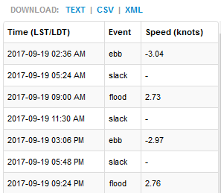
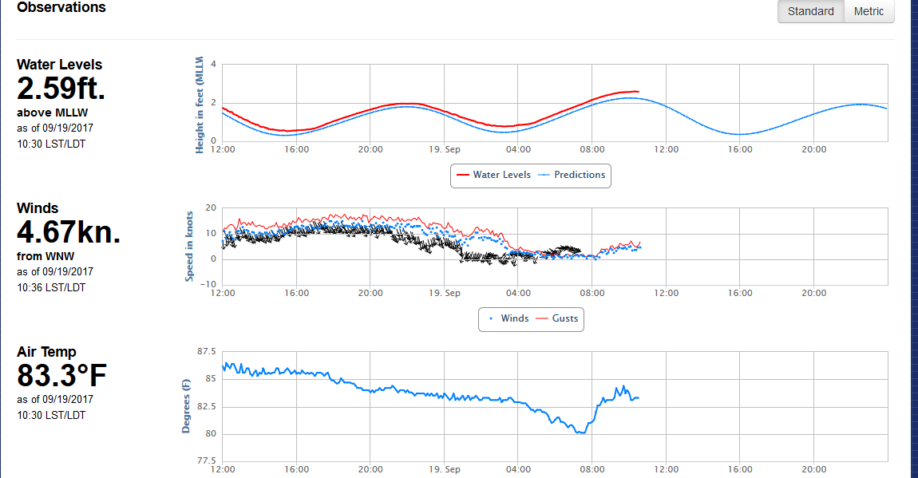
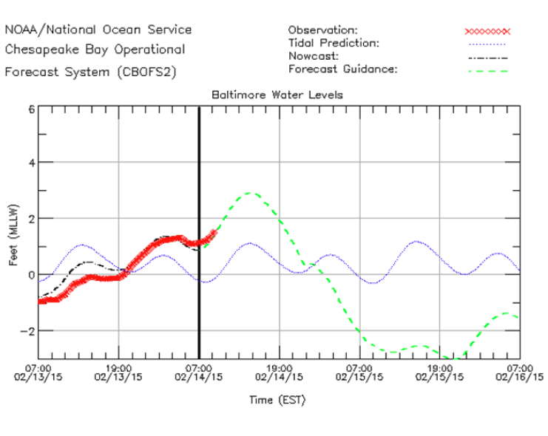
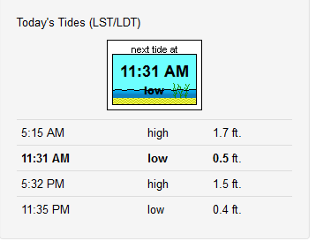
What Data Are Your Users
Interested In?
Real-Time Observations
Current Predictions
Tide Predictions
Operational Forecast/Model Data

Slide 3
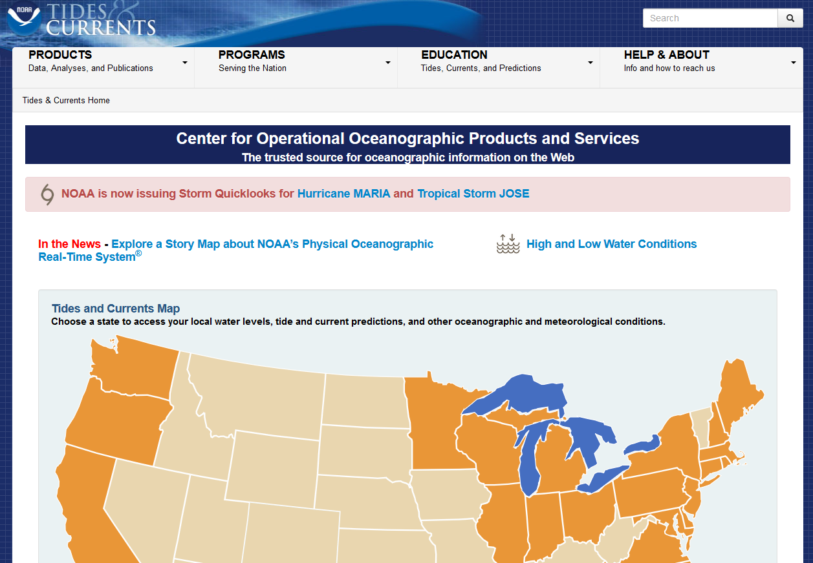
Center for Operational Oceanographic Products and Services (CO-OPS) https://tidesandcurrents.noaa.gov/
CO-OPS is the authoritative source for
accurate, reliable, and timely water-level and current measurements
We support:
safe and efficient maritime commerce
sound coastal management
recreation

Slide 4
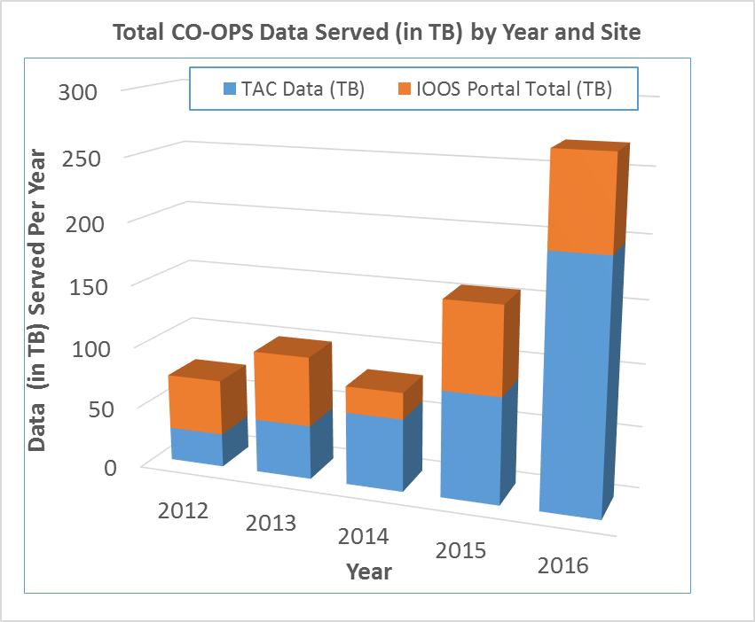
CO-OPS Data- Nationwide Coverage https://tidesandcurrents.noaa.gov/
Real-time and Historic Data Along US Coasts and Great Lakes (including Alaska and Hawaii)
Real-Time Observations:
> 300 real-time water level stations
> 200 real-time “tsunami” water level stations
> 60 real-time currents (water velocity) stations
> 300 real-time meteorological stations
Tide and Tidal Current Predictions:
> 3,200 tide prediction stations
> 4,000 current (water velocity) prediction stations

Slide 5
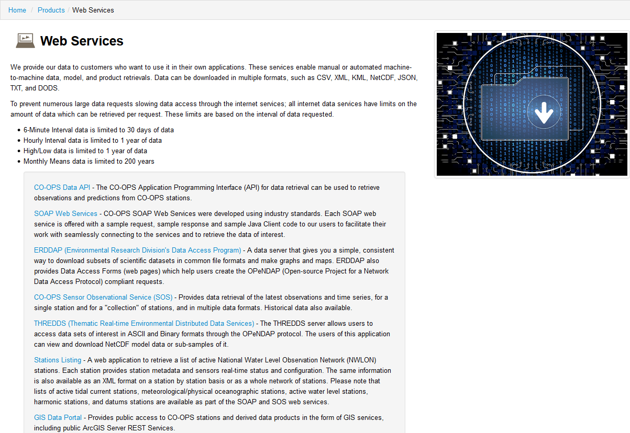
CO-OPS Data Portal / APIs https://tidesandcurrents.noaa.gov/web_services_info.html
Multiple APIs to retrieve data:
Real-time latest data
Data products (predictions, etc.)
Historical data (date/time ranges)
Various formats (CSV, XML, JSON, etc.)
Metadata (location, data available, etc.).
Data updates automatically
Easily integrate in applications

Slide 6
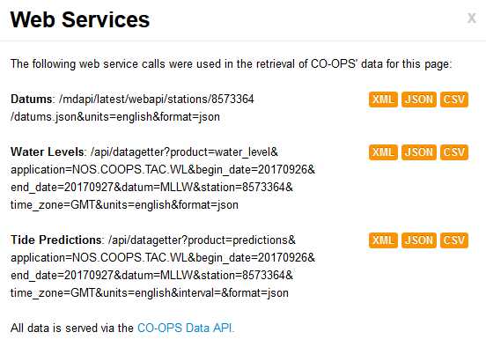
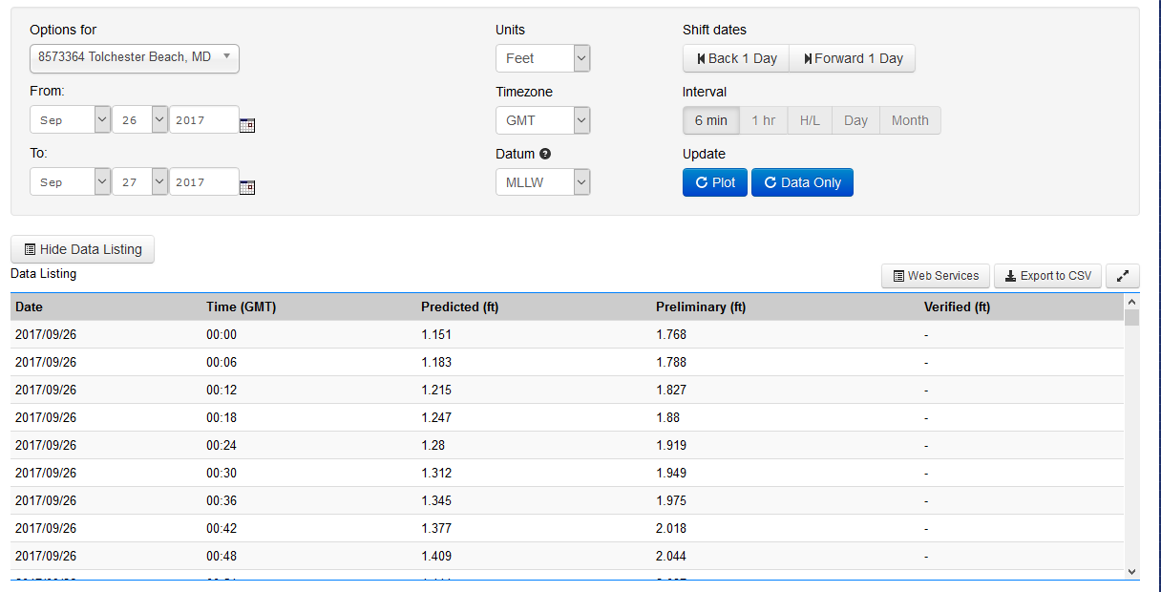
Data Retrieval via Data API (Water Levels) https://tidesandcurrents.noaa.gov/api/

Slide 7
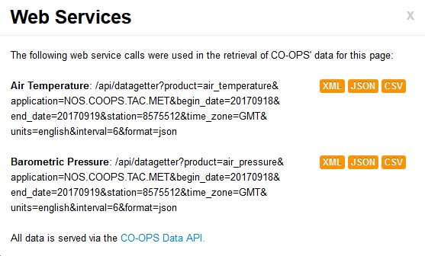
Data API and Plotting (Met. Data) https://tidesandcurrents.noaa.gov/api/
Use Data API to retrieve meteorological observations
Output in JSON
Plot directly in website (Highcharts software)

Slide 8
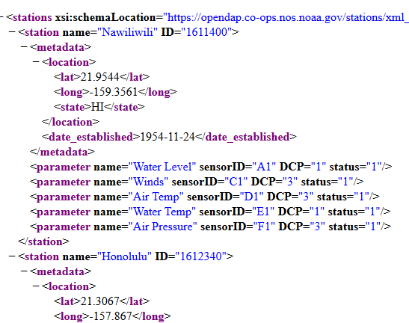
Retrieve Data Locations https://opendap.co-ops.nos.noaa.gov/stations/index.jsp

Slide 9
CO-OPS GIS Data Portal / APIs https://tidesandcurrents.noaa.gov/gis-data-portal/
GIS REST Services:
ESRI MapService / FeatureServices
Access to stations and products
Use within webapps
Use within GIS desktop software

Slide 10
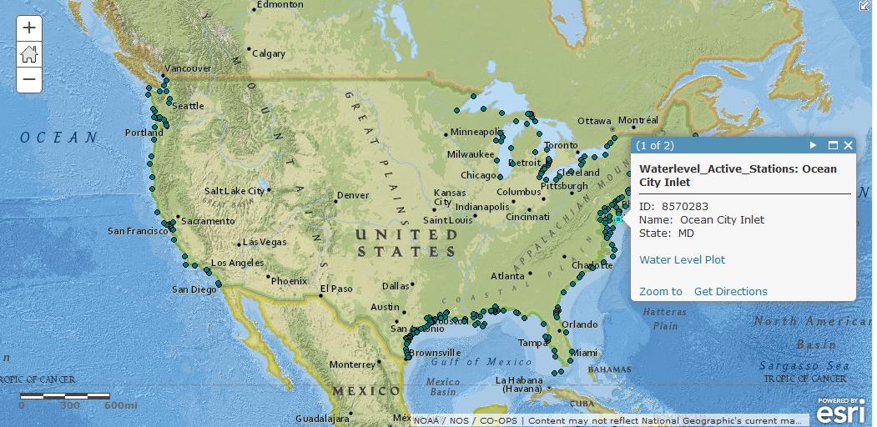
Mapping Via GIS Service
(Active Water Level Stations)
Quickly show active water level stations on a map
Uses GIS rest service and standard ESRI API
Access to metadata (popup window)
Easily embed in custom application.

Slide 11
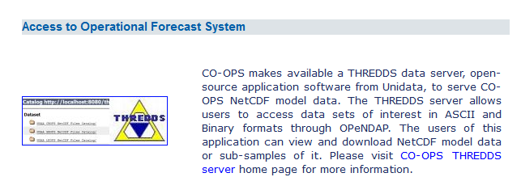
CO-OPS Operational Forecast Data
(THREDDS Server) https://opendap.co-ops.nos.noaa.gov/thredds/catalog.html
Download model data:
THREDDS server provides access to all OFS model data
Data in NetCDF files
Data archived

Slide 12
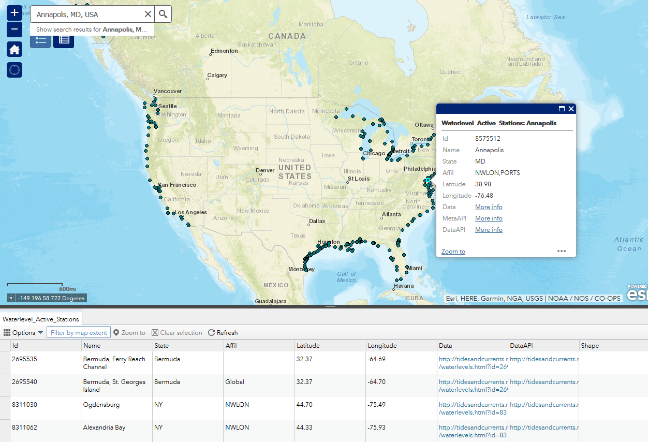
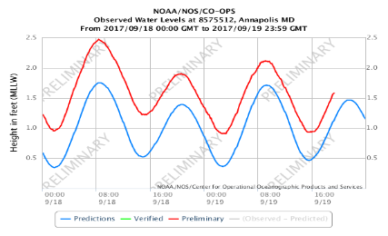
Mashup Using CO-OPS Services
Example of possible integrated app using various APIs and plotting etc. in one app.

Slide 13
Summary of Services
CO-OPS disseminates real-time and derived oceanographic data at thousands of locations nationwide
All data available via various APIs
Easily retrieve metadata
Easily embed data in custom web applications
Easily access data in desktop applications
CO-OPS Web Services:
https://tidesandcurrents.noaa.gov/web_services_info.html
CO-OPS GIS Data Portal:
https://tidesandcurrents.noaa.gov/gis-data-portal/
CO-OPS THREDDS Server (Modeling Data):
https://opendap.co-ops.nos.noaa.gov/thredds/catalog.html
Technical Point of Contact: Armin Pruessner@noaa.gov

