Slide 1
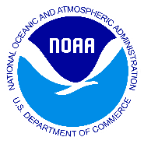
NOAA’s Office of Coast Survey ENC Quality improvements through IC-ENC Partnership
Sean Legeer
September 27, 2017
^{Office of Coast Survey}
National Oceanic and Atmospheric Administration

Slide 2
NOAA Electronic Navigational Charts (ENC)
1220 ENCs
Free for download at http://www.charts.noaa.gov/
Created from a central database for ease of maintenance and data consistency.
NOAA’s primary charting product.
Covers the same geographic area as traditional paper charts and more.
^{Office of Coast Survey}
National Oceanic and Atmospheric Administration

Slide 3
History of ENC production
ENCs were originally digitized from the raster / paper charts and maintained after the raster / paper chart
Inconsistencies were created by this process
Lack of understanding of S-57, S-52 and ECDIS standards created charts that were cluttered and hard to use.
During this time electronic navigational charts are not to be used for navigation
^{Office of Coast Survey}
National Oceanic and Atmospheric Administration

Slide 4
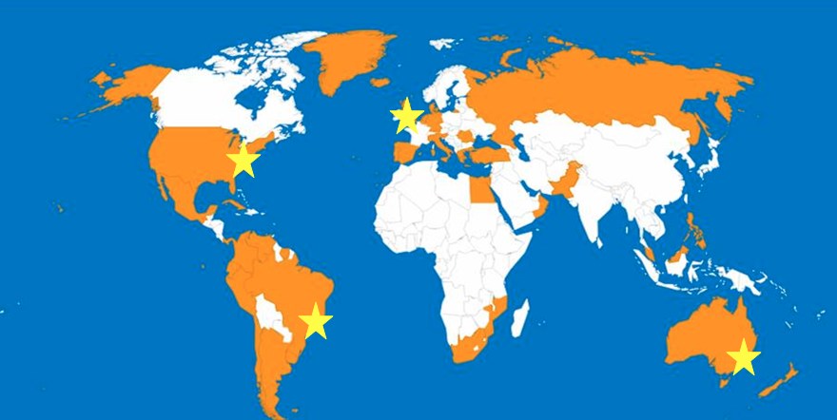
International Centre for ENCs (IC -ENC)
IC-ENC is a not for profit organization that assists Hydrographic Offices (HOs) in harmonizing the production and distribution of high quality ENCs.
IC-ENC is mariner focused and supports the achievement of the IHO Worldwide Electronic Navigational Chart Database (WEND) principal
Locations:
Taunton, UK (HQ)
Wollongong, Australia
Niteroi, Brazil
Washington, USA
42 current members
^{Office of Coast Survey}
National Oceanic and Atmospheric Administration

Slide 5
How the partnership works
All New Editions and Updates are uploaded to IC-ENC FTP site for Validation.
The upload is accomplished through in-house software and is seamless to the cartographers.
Typical turnaround times for return of validation reports:
3 working days for updates (ER profiles)
5 working days for new editions
10 working days for new cells
^{Office of Coast Survey}
National Oceanic and Atmospheric Administration

Slide 6
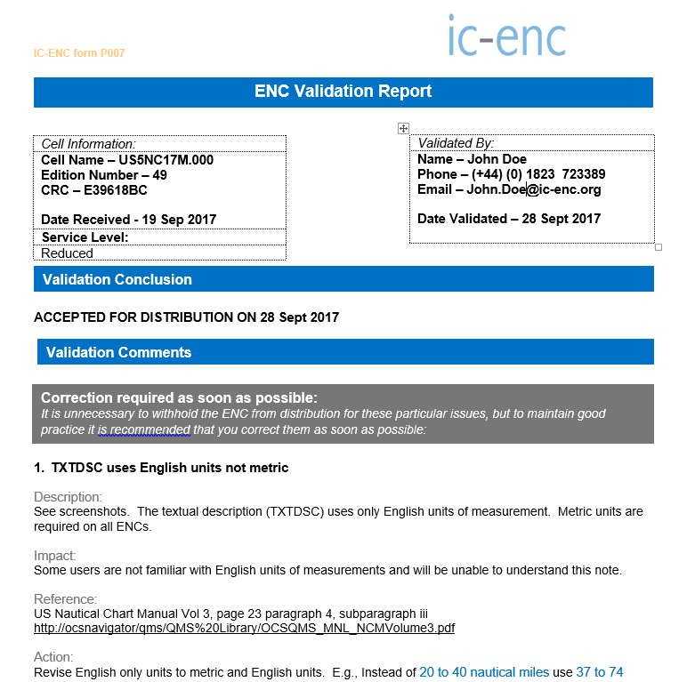
Validation Reports
Reports are sent back to NOAA via email, accepting or rejecting the ENC for distribution.
Before this process we would often send updates out that wouldn't load in navigation software.
IC-ENC loads every new edition and update into a variety of navigation software is to ensure that it loads and operates properly.
^{Office of Coast Survey}
National Oceanic and Atmospheric Administration

Slide 7
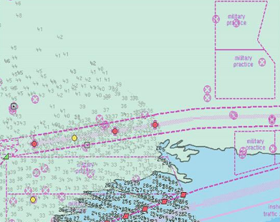
IC- ENC Quality Assurance
S-58 Checks
Consistency Checks
Gaps in coverage between adjacent ENCs
Hole in data coverage within an ENC cell
COMF Value
Overlapping data coverage
Horizontal Consistency
edge matching
Vertical consistency
^{Office of Coast Survey}
National Oceanic and Atmospheric Administration

Slide 8
NOAA and IC-ENC Distribution
The Same ENC datasets are distributed by IC-ENC and NOAA each week.
All data is distributed on Thursday by NOAA and IC-ENC within 4 hours of each other.
NOAA distributes on our website
IC-ENC distribute through Value Added Resellers (VARs).
^{Office of Coast Survey}
National Oceanic and Atmospheric Administration

Slide 9
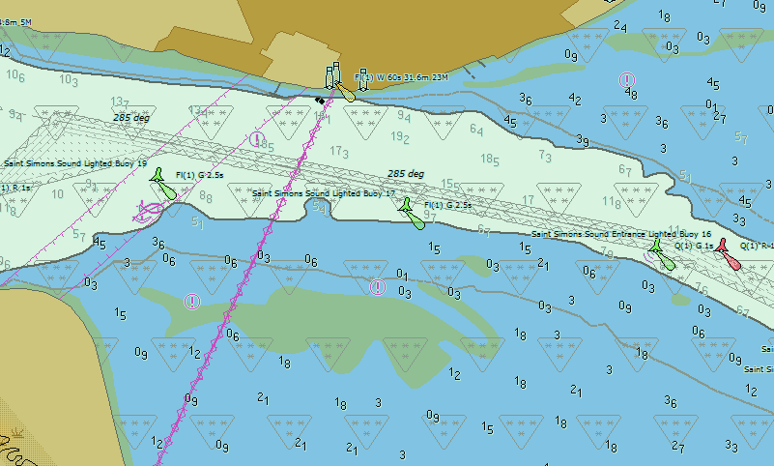
Result of the Partnership
A better and more widely available ENC product for Safe Navigation
Higher quality individual ENCs
Consistency in the chart suite
Consistency with adjoining ENC's from other countries.
Better understanding of international standards and best practices by NOAA cartographers
Better availability of ENC's through a wider distribution to ensure that Mariners are you are using United States official ENCs within United States waters.
^{Office of Coast Survey}
National Oceanic and Atmospheric Administration

Slide 10
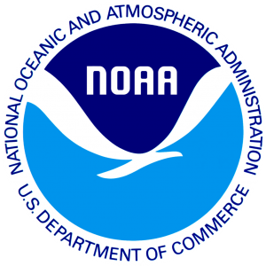
NOAA and IC-ENC Contact Infromation
http://www.ic-enc.org
General Manager
James Harper
james.harper@ic-enc.org
Electronic Navigational Charts
http://www.charts.noaa.gov/ENCs/ENCs.shtml
http://www.charts.noaa.gov/ENCs/ENCProdCat_19115.xml
http://www.charts.noaa.gov/ENCs/ENCProdCat.xml
http://www.charts.noaa.gov/ENCs
Office of Coast Survey
http://www.nauticalcharts.noaa.gov/
Format and Distribution Systems
Chief: Mark Griffin (mark.griffin@noaa.gov)
Team Lead: Sean Legeer (sean.legeer@noaa.gov)
^{Office of Coast Survey}
National Oceanic and Atmospheric Administration

