Slide 1
High Resolution Seafloor Data
October 5,2017
CAPT Rick Brennan, NOAA
Chief, Hydrographic Surveys Division
^{Office of Coast Survey}
National Oceanic and Atmospheric Administration

Slide 2
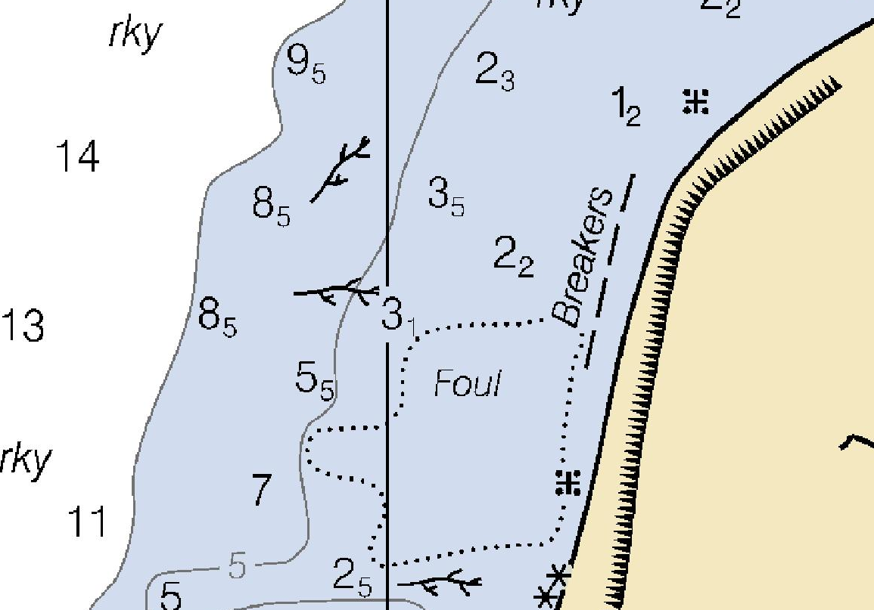

Slide 3
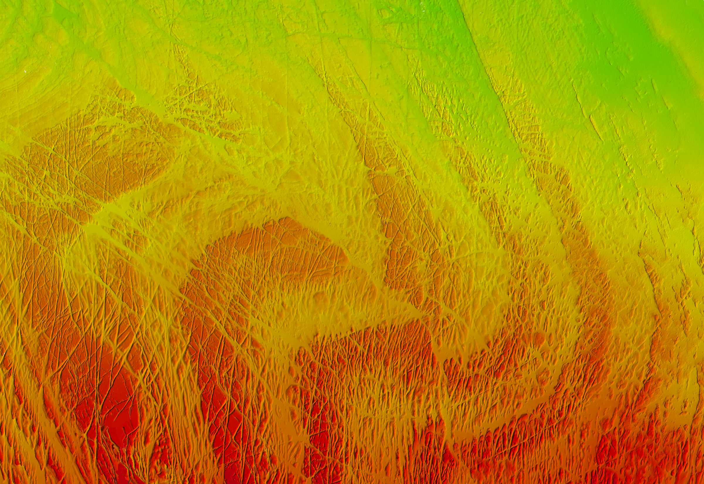

Slide 4
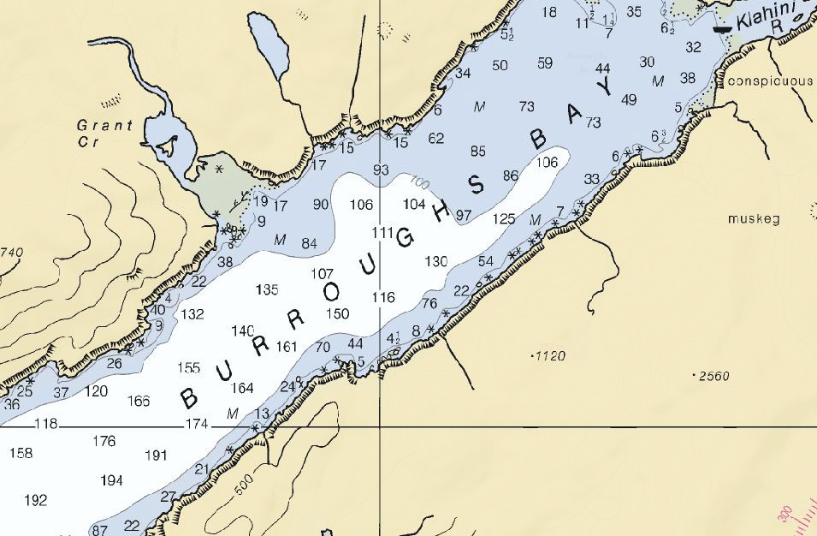

Slide 5
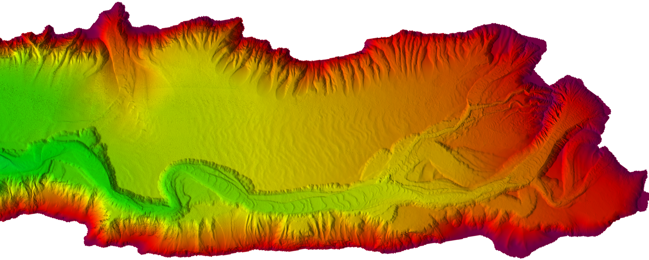

Slide 7
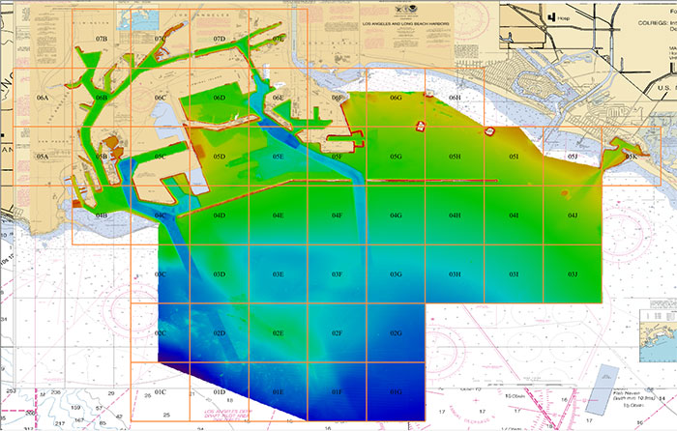
Prototype Products
http://www.nauticalcharts.noaa.gov/mcd/enc_overlays.html

Slide 8
Prototype Products

Slide 11
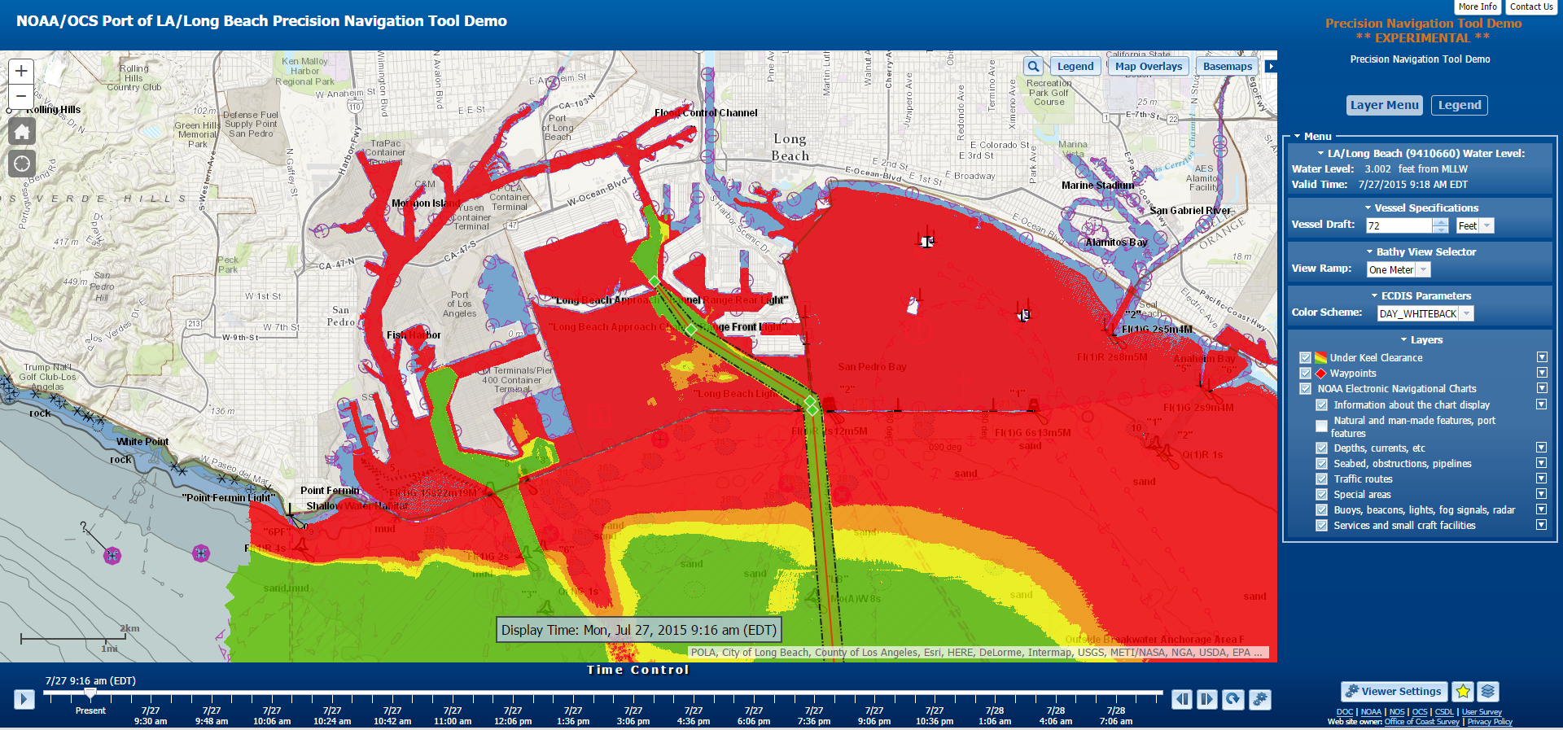
Precision Navigation Tool Demo

Slide 12
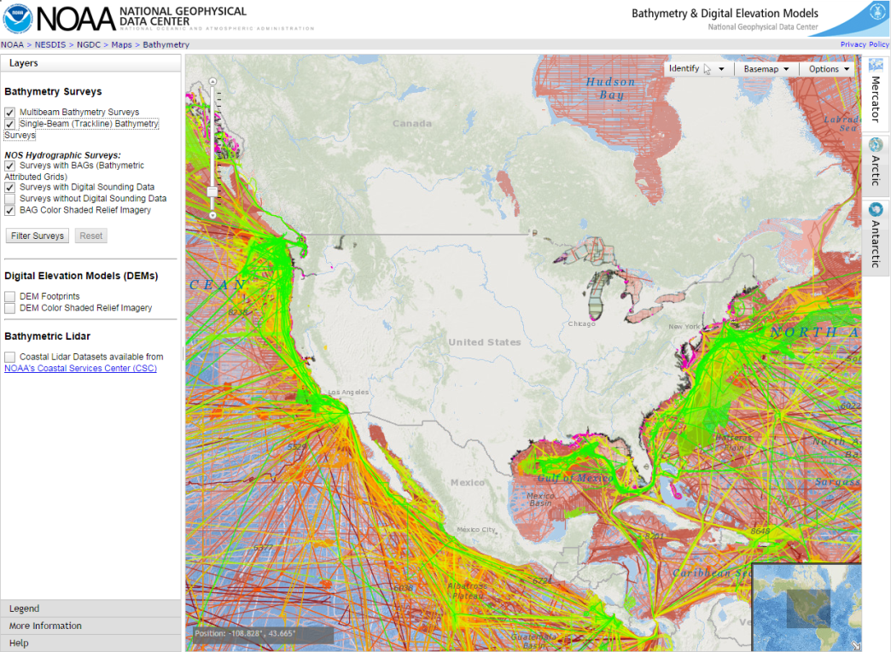
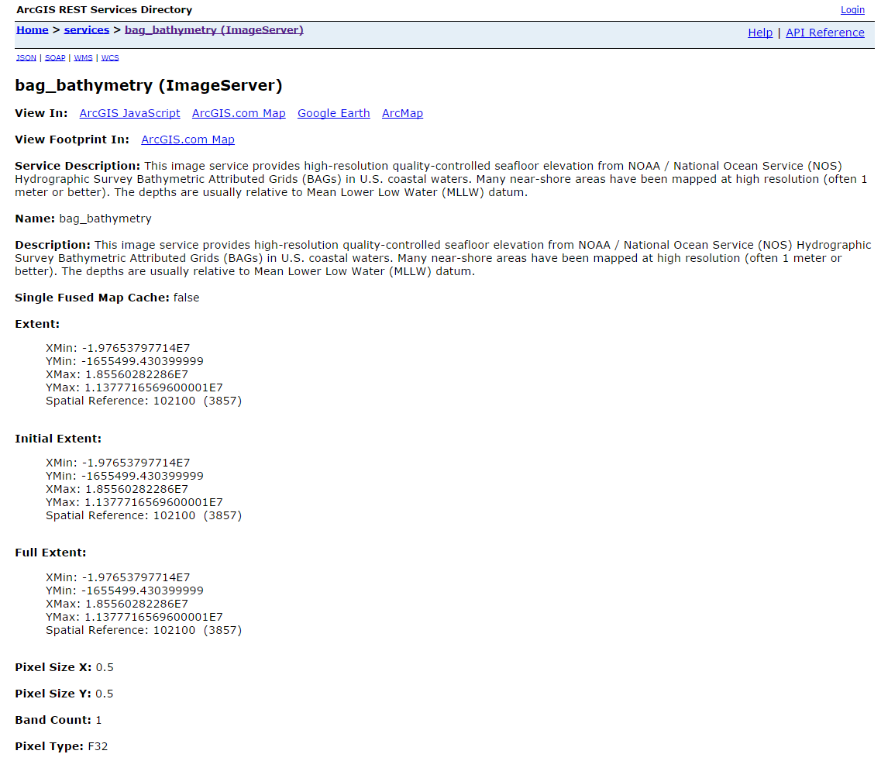
Sonar Data Distribution Portals
Multibeam Sonar Bathymetry: http://maps.ngdc.noaa.gov/viewers/bathymetry/
Bathymetry GIS Portal: http://gis.ngdc.noaa.gov/arcgis/rest/services/bag_bathymetry/ImageServer

Slide 13
Thank You!
CAPT Rick Brennan
Chief, Hydrographic Surveys Division
NOAA Office of Coast Survey
Email: richard.t.brennan@noaa.gov
Phone: ​(240)-533-0030
www.noaa.gov
www.nos.noaa.gov
www.nauticalcharts.noaa.gov

