Slide 1
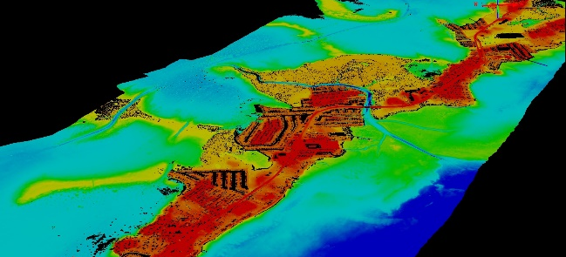
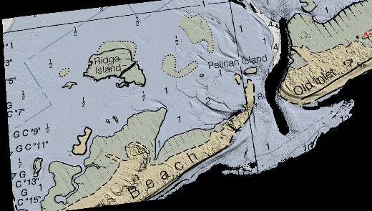
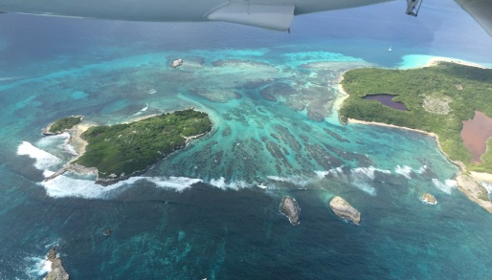
NGS Coastal Mapping Program Shoreline and Nearshore Bathymetry
Mike Aslaksen
Chief, Remote Sensing Division
National Geodetic Survey

Slide 2
Outline
Background
Products
Topobathy lidar
Coastal Imagery
Shoreline
Geographic Cells (GCs)
Continuously Updated Shoreline Product (CUSP)
Coastal Oblique Imagery
Emergency Response Imagery
Questions

Slide 3
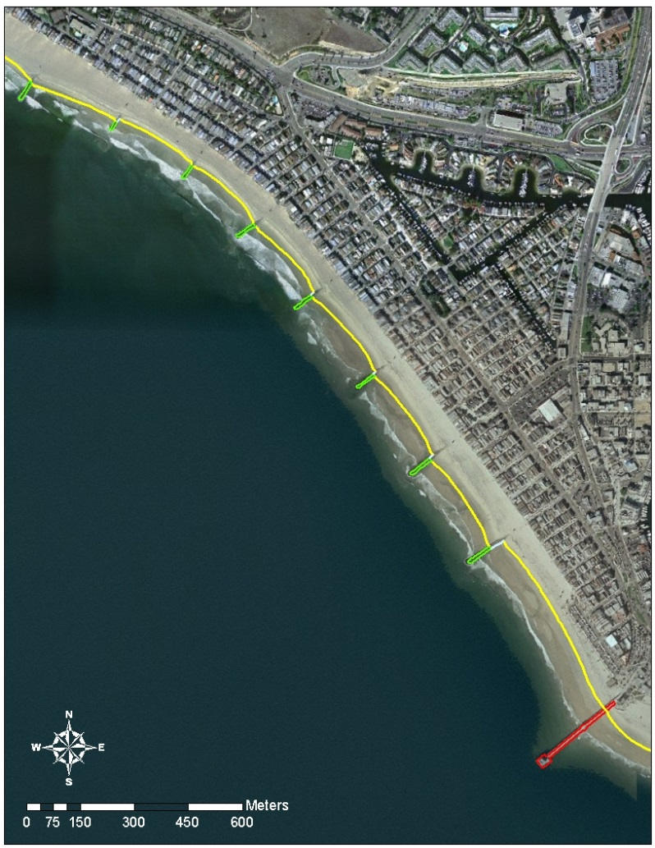
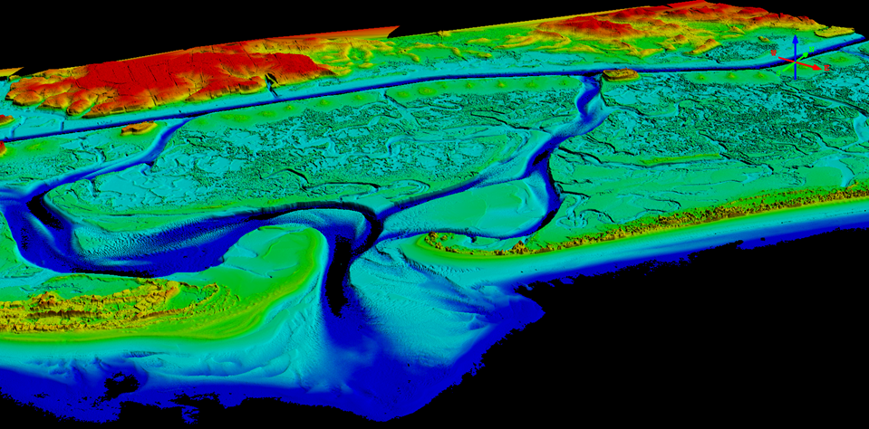
NOAA’s Coastal Mapping Program
Defines the National Shoreline and provides nearshore elevation data
NOAA nautical charts updates
Other important applications:
Used in defining the United States’ territorial limits
Coastal resource management
Storm surge and coastal flooding modeling
GIS analysis
Benthic habitat mapping
Coastal Intelligence and Resiliency…

Slide 4
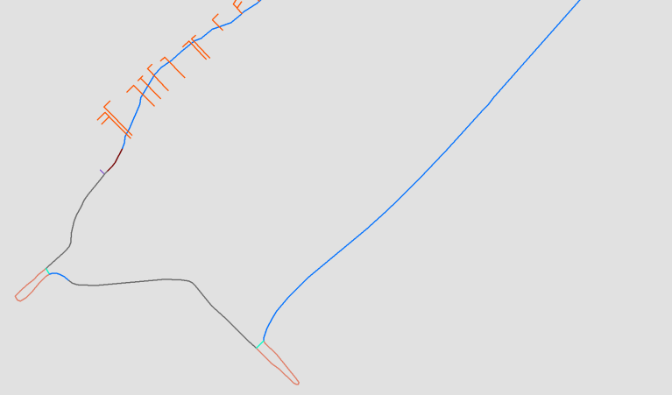
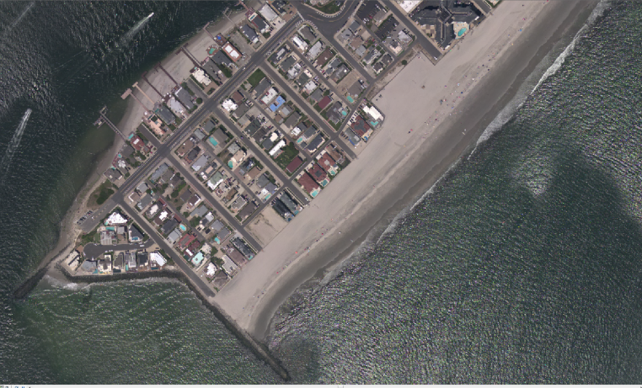
Products NGS delivers and derivatives
Shoreline
Ortho Mosaic Imagery
Lidar Point Cloud and DEMs
(elevation)
Lidar Point
Cloud
(intensity)
Map once use many times!
RGB
Colorized Lidar
Point Cloud

Slide 5
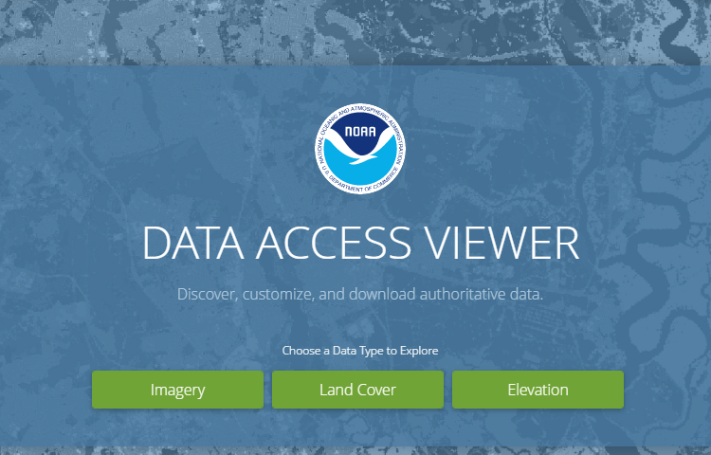
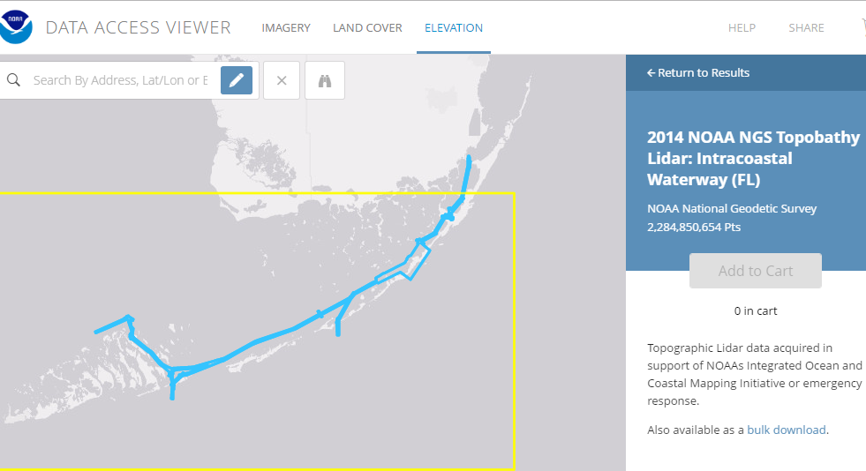
NOAA Digital Coast

Slide 6
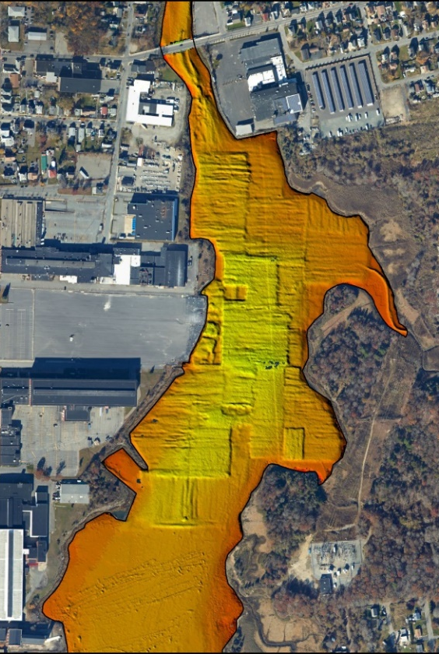
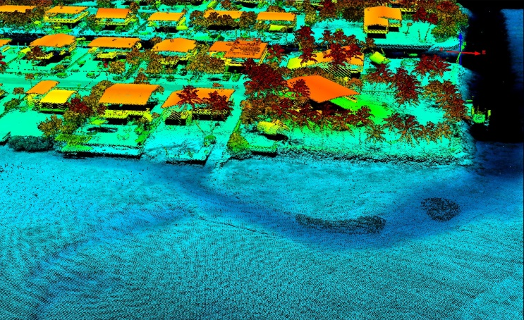
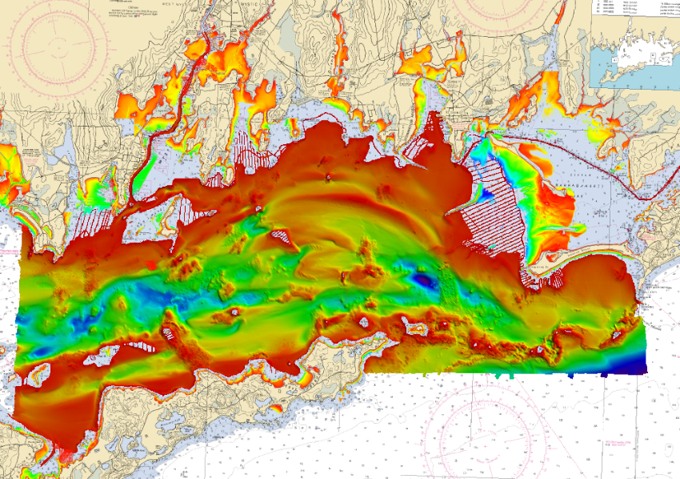
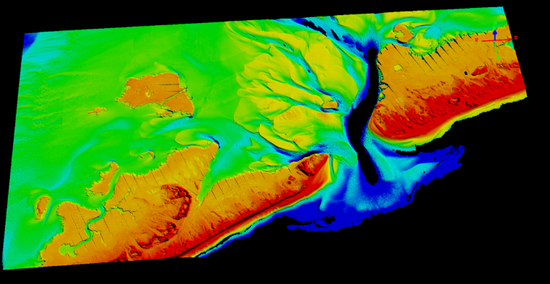
RSD’s Topobathy lidar data

Slide 7
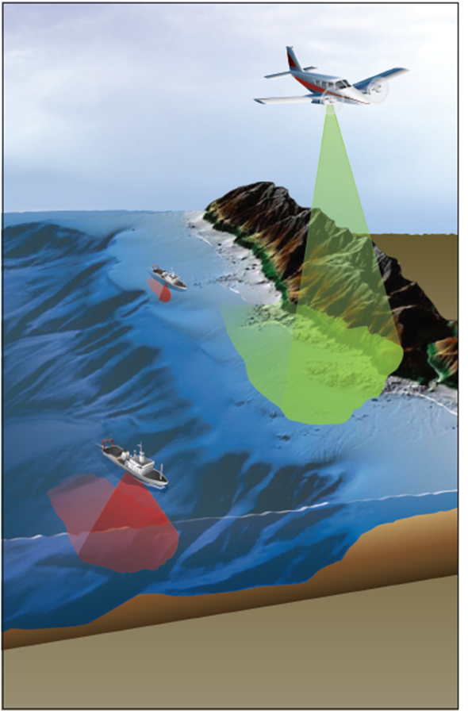
Why of interest to NOAA & partners?
Uniquely suited for shoreline mapping
Seamless, high-resolution data across backshore, intertidal, and nearshore marine zones
Fill in shallow water gap (shoreward of NALL line)
IOCM! Map Once-Use Many Times!
SLR analysis, inundation modeling
Habitat mapping
Riverine mapping
Coastal zone management, coastal science
Increases efficiency and safety of launch and ship operations
Graphic courtesy of Dewberry

Slide 8
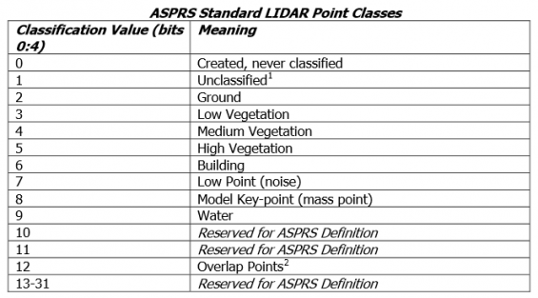
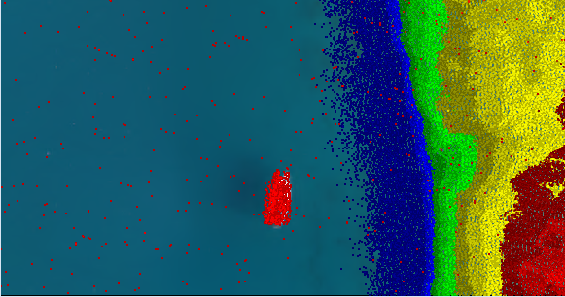
Lidar Data Formats
Topobathy lidar classified point-cloud data in ASPRS standard LAS 1.2 format, and topobathy DEMs (1-meter) in IMG format are provided to NOAA’s Digital Coast website for distribution to the public.

Slide 9
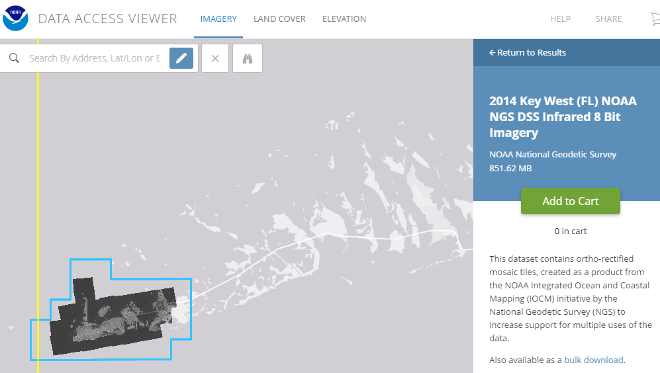
NOAA Digital Coast

Slide 10
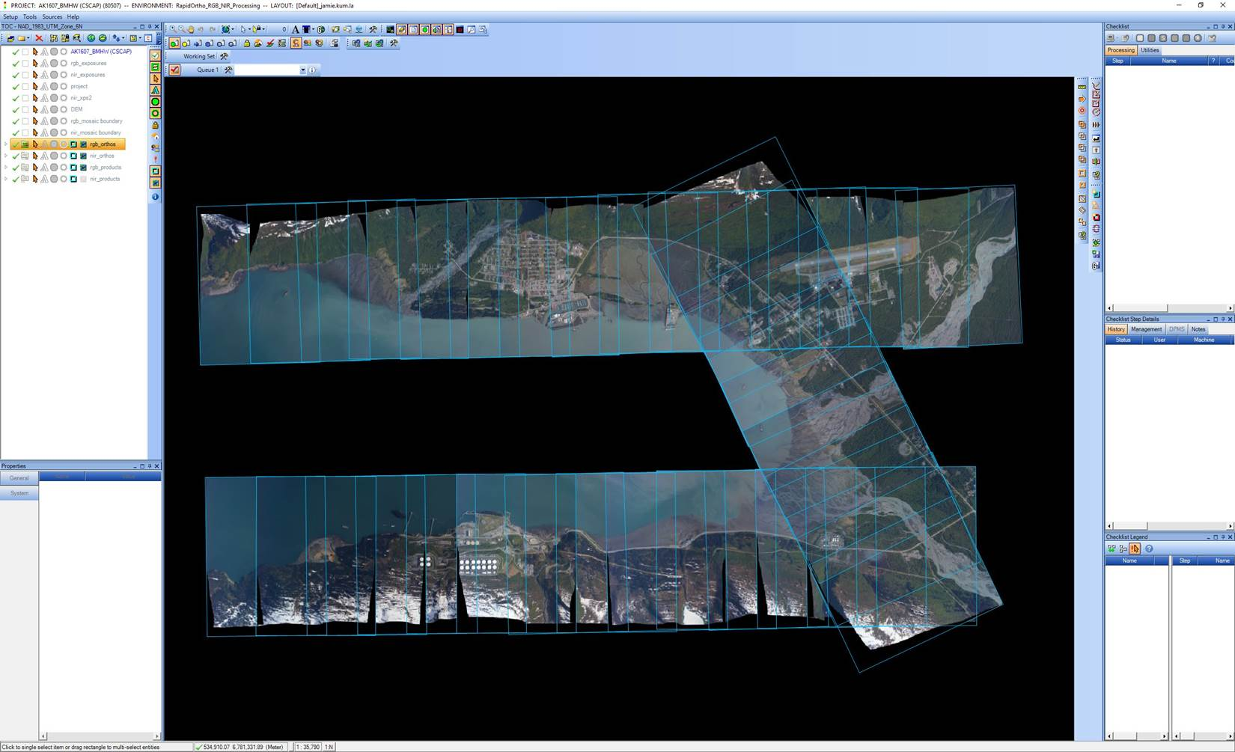
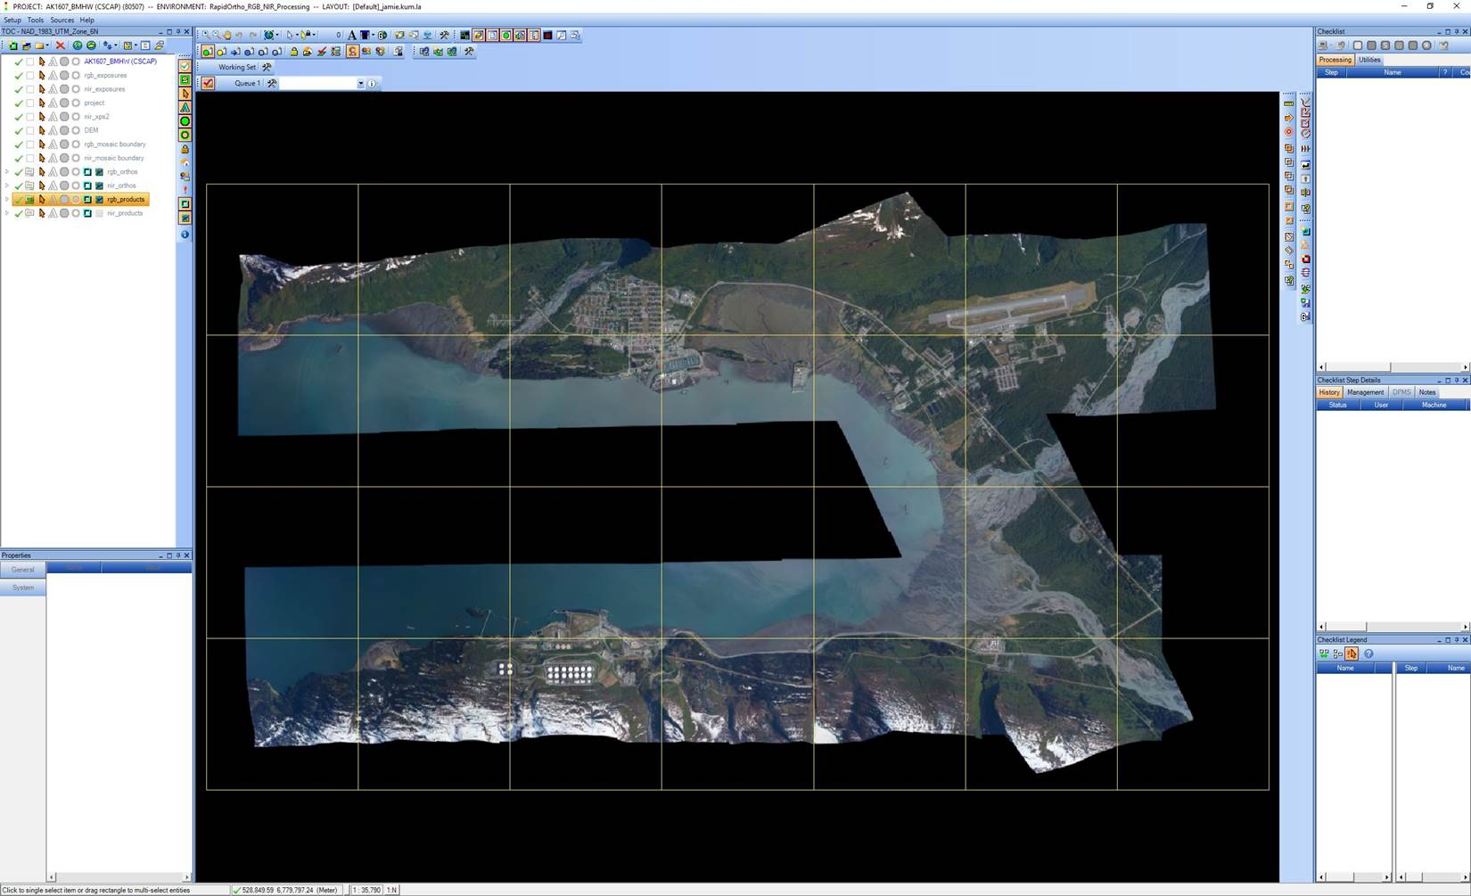
Orthoimagery Format
GeoCue is used as a workflow manager to coordinate the production of 2.5 km square orthomosaic tiles in GeoTiff format (UTM projection) using OrthoVista and RapidOrtho software.

Slide 11
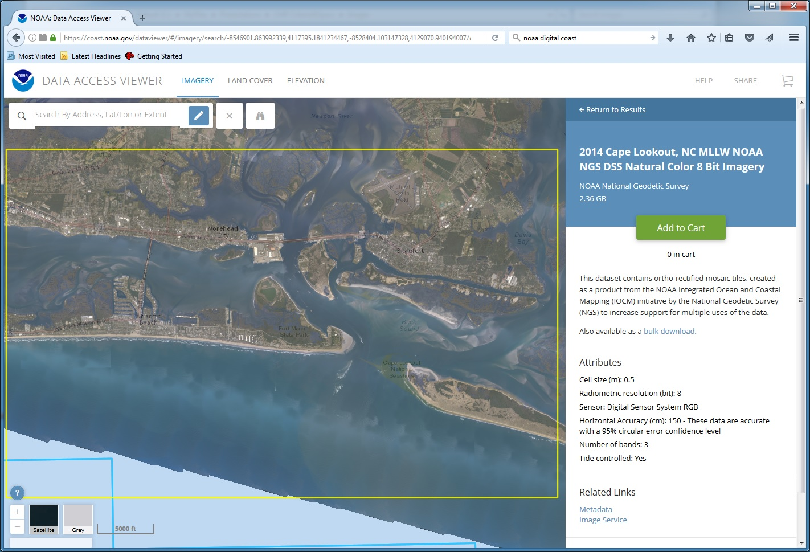
Orthomosaic Imagery on Digital Coast

Slide 12
Access to NGS Data on Digital Coast
Data Registry (Imagery and Lidar)
https://coast.noaa.gov/dataregistry/search/collection
Data Access Viewer (Imagery and Lidar)
https://coast.noaa.gov/dataviewer/#
Coastal Lidar Datasheet
https://coast.noaa.gov/htdata/lidar1_z/geoid12a/data/

Slide 13
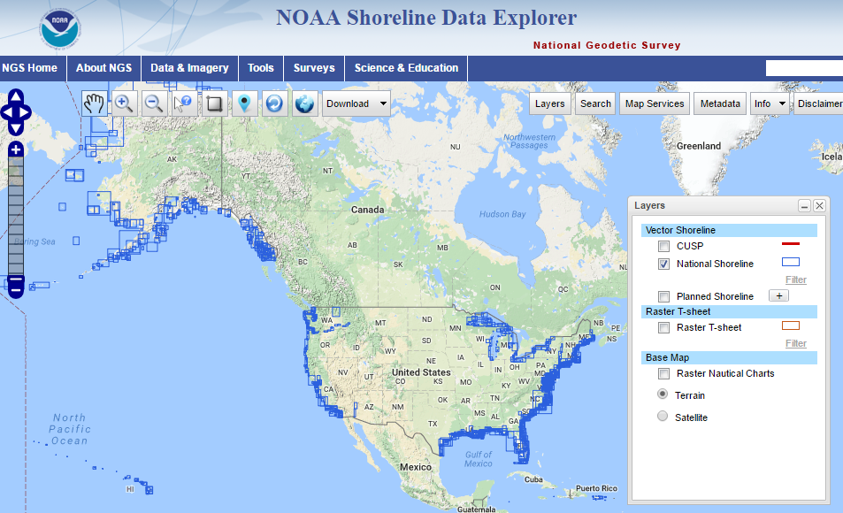
https://www.ngs.noaa.gov/NSDE/

Slide 14
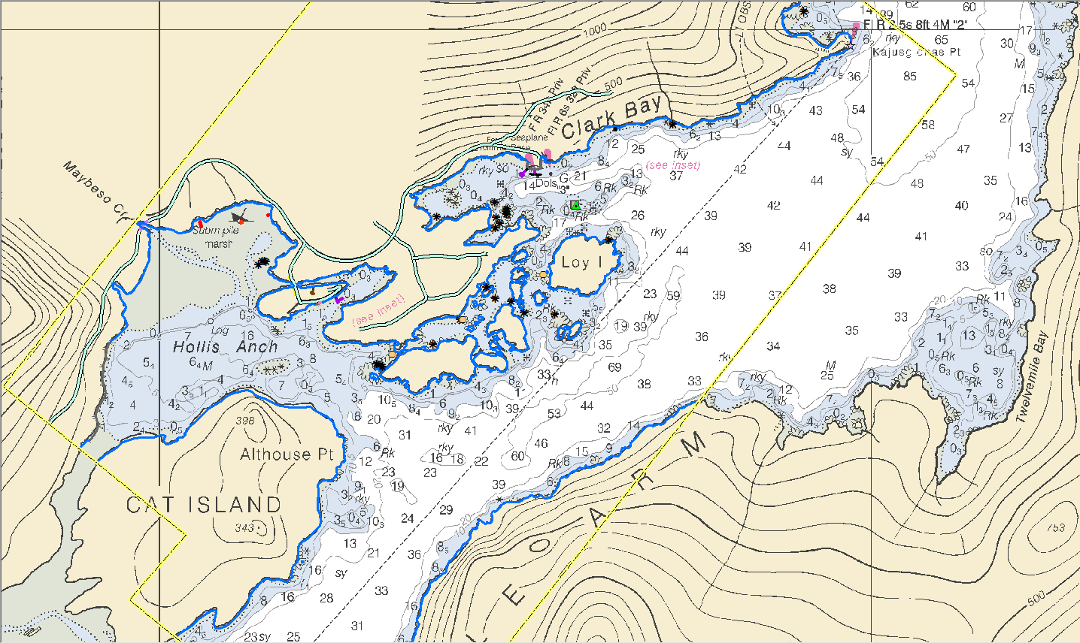
Geographic Cells

Slide 15
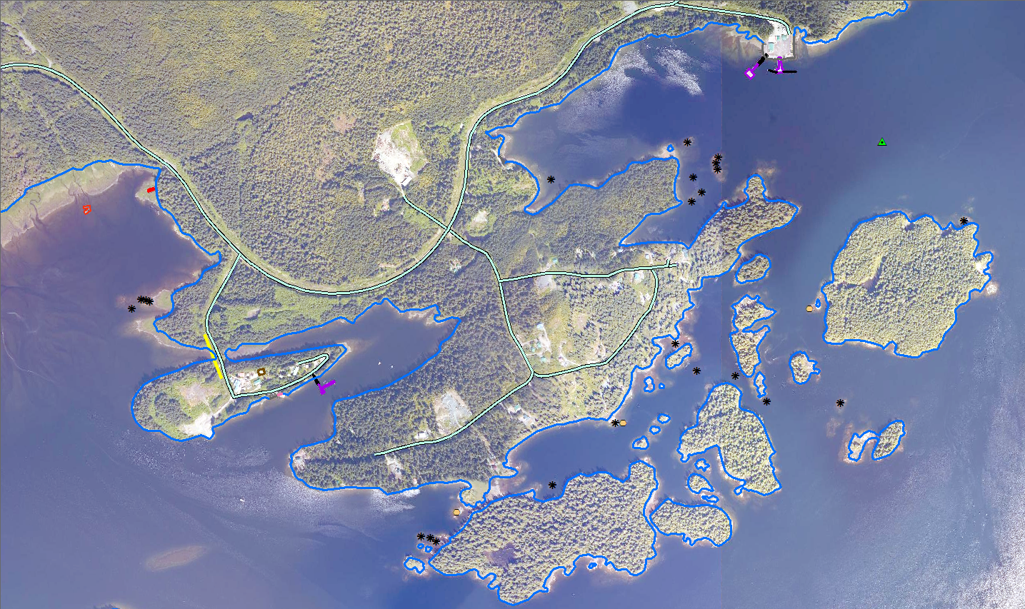
Fixed Pier
Rip Rap Shoreline
Road
Floating Pier
Daybeacon
Wrecks
Building
Overhead Cable
Covers/Uncovers Rock
Ramp
MHW Shoreline
Bare Rock

Slide 16
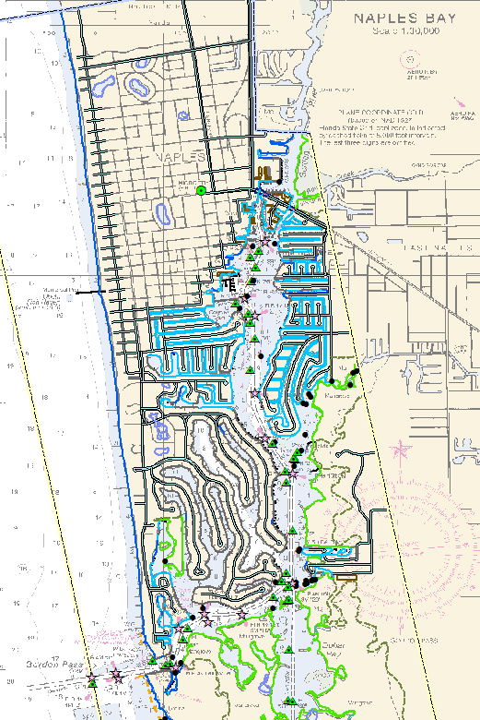
CMP Project with full shoreline compilation

Slide 17
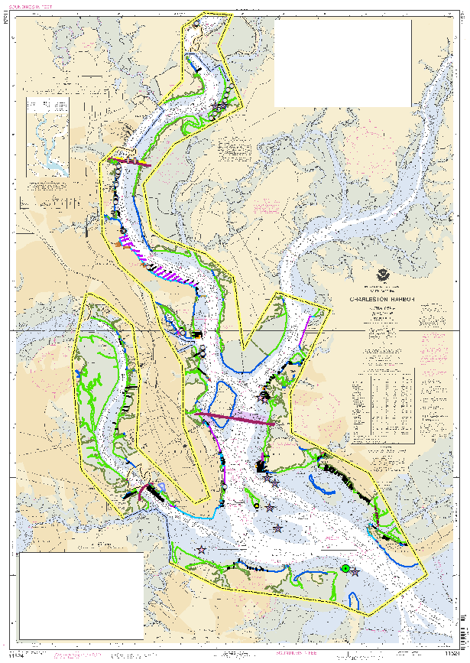
Charleston Harbor near-full shoreline compilation in 2006

Slide 18
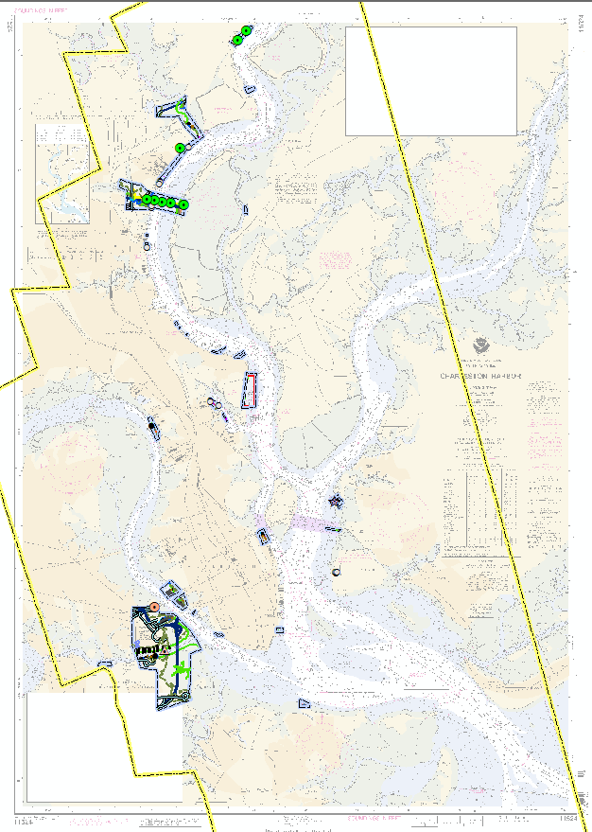
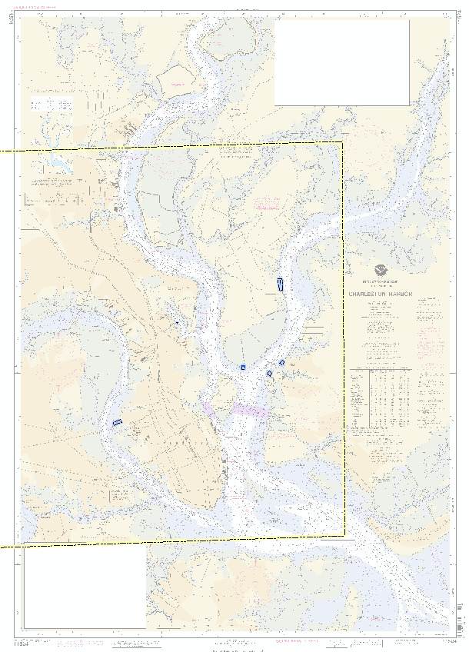
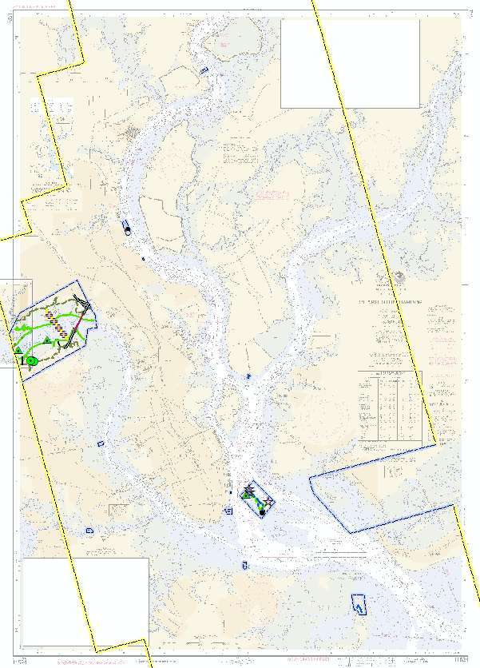
Coast & Shoreline Change Analysis Program (CSCAP) Charleston Harbor
2011
2013
2015

Slide 19
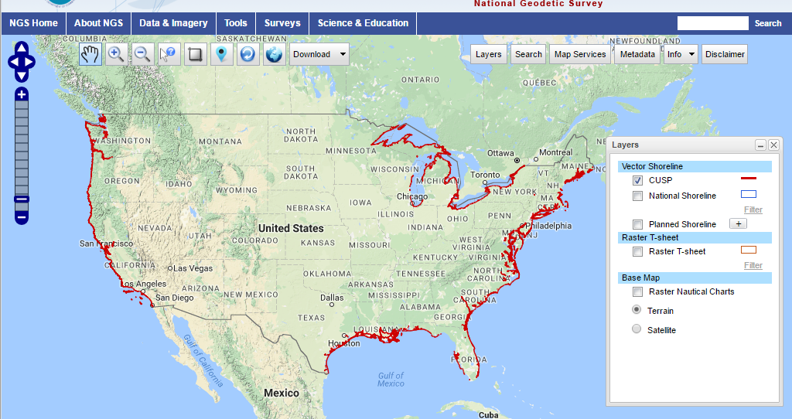
Continually Updated Shoreline Product (CUSP)
https://www.ngs.noaa.gov/NSDE/

Slide 20
Continually Updated Shoreline Product
To provide the most current shoreline representation
Designed to deliver continuous shoreline with frequent updates
Employ state-of-the-art technologies
Attributed shoreline features
Referenced to Mean High Water datum where applicable
Includes NOAA and non-NOAA contemporary sources

Slide 21
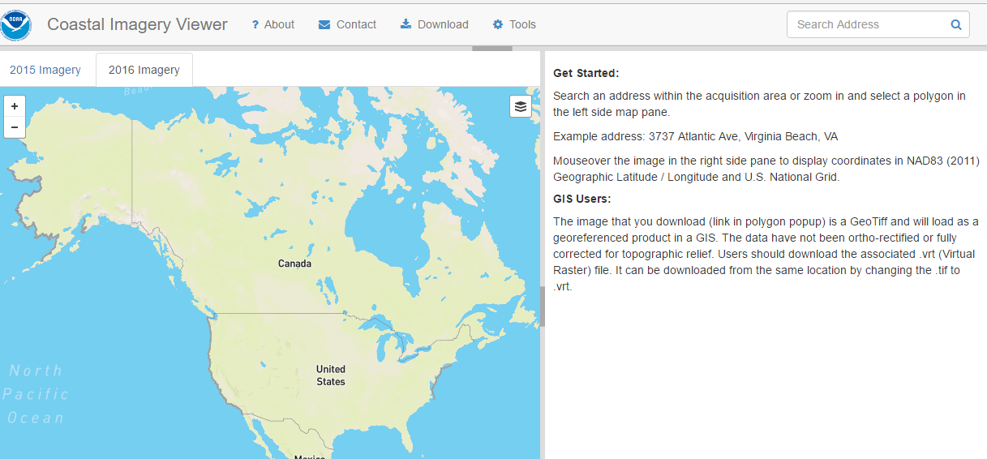
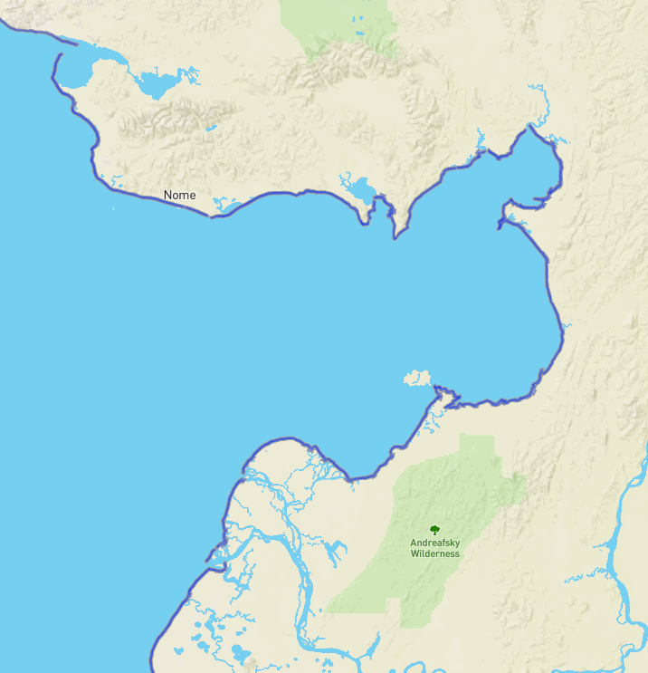
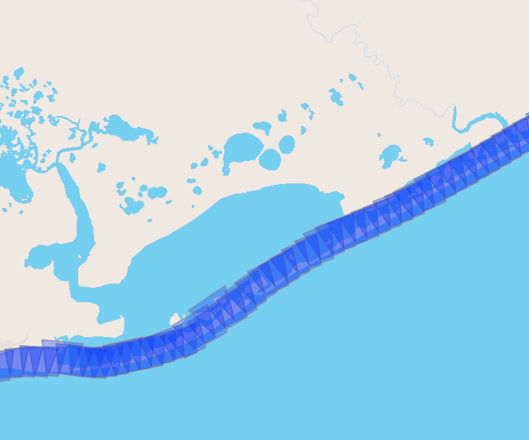
Coastal Oblique Imagery viewer
https://geodesy.noaa.gov/storm_archive/coastal/viewer/index.html

Slide 22
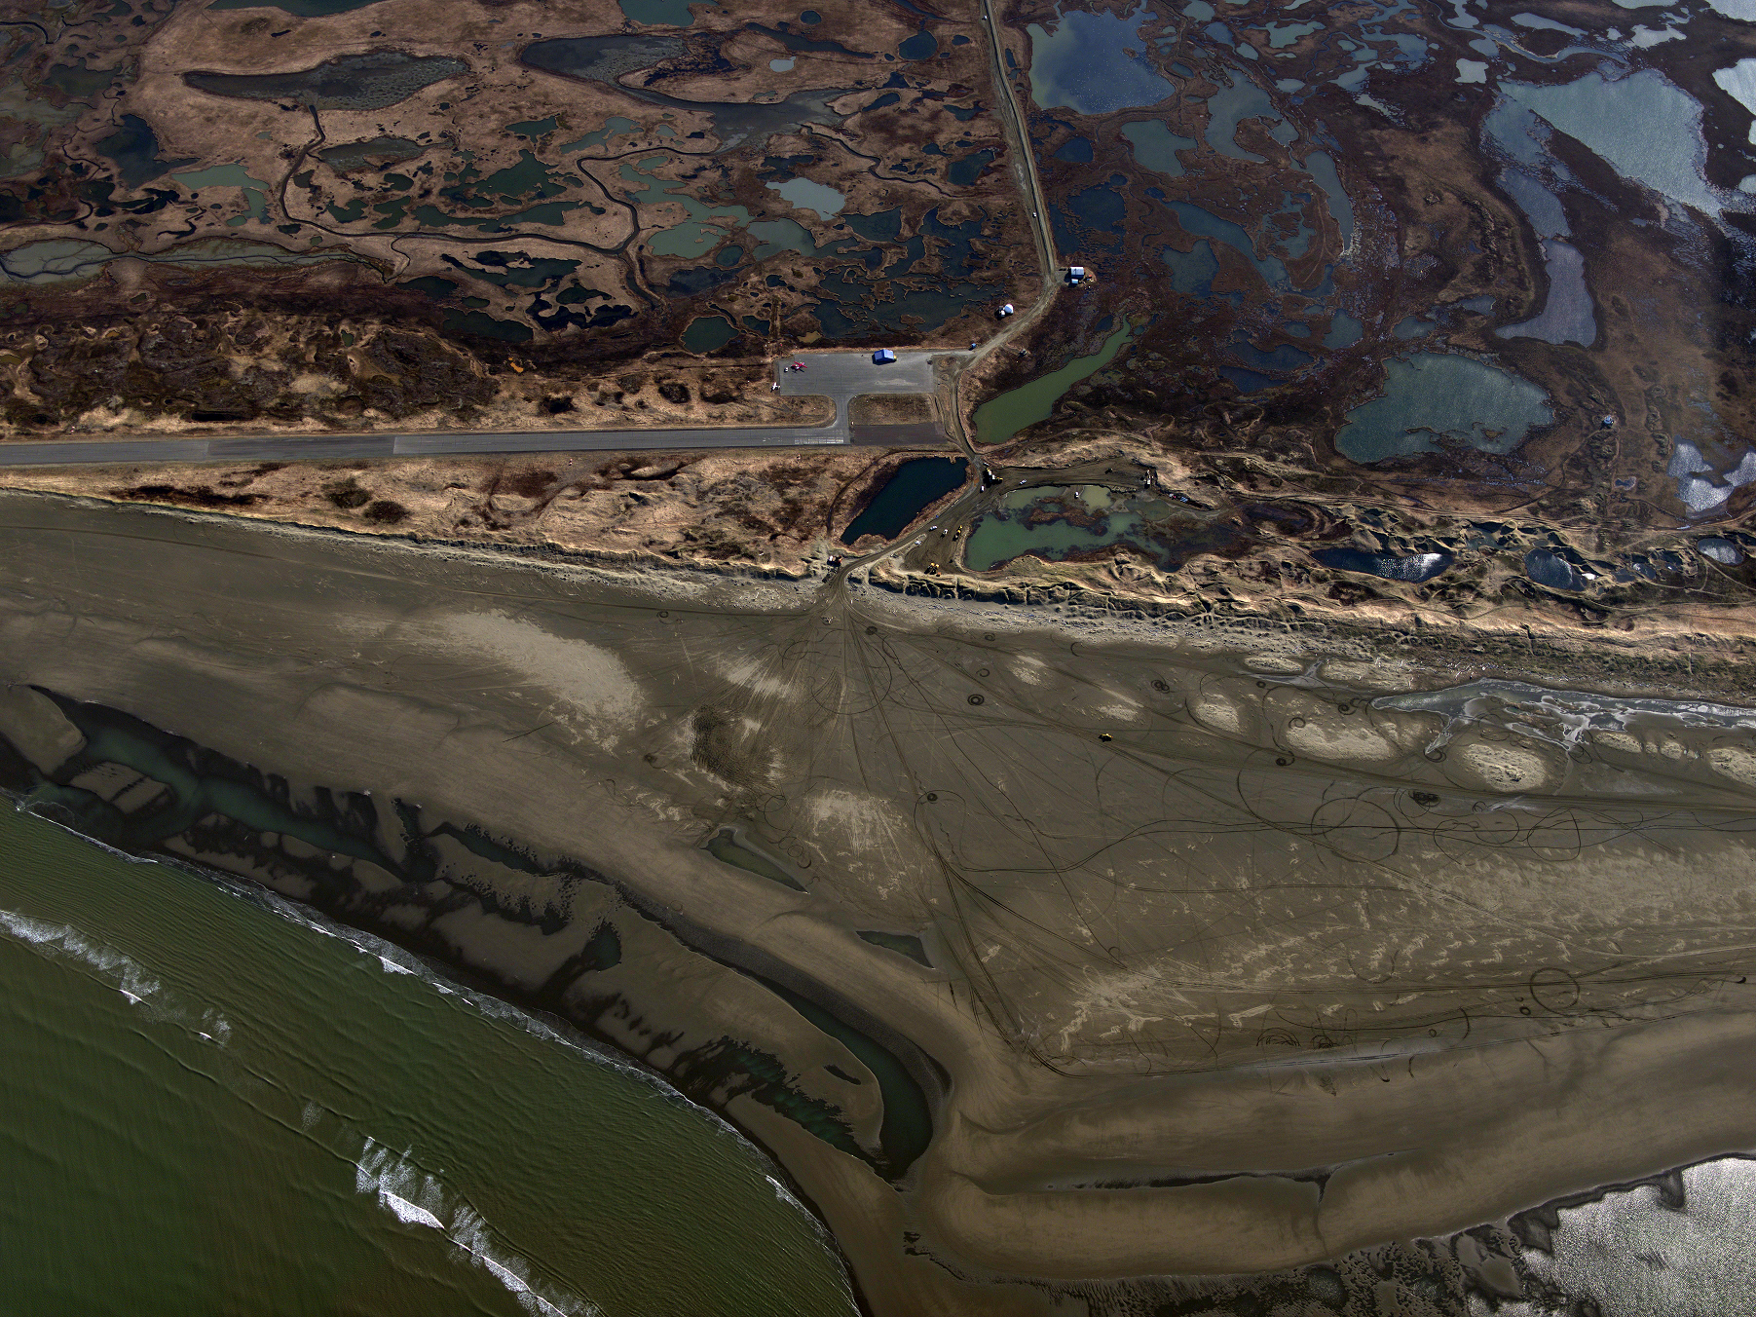
NOAA Semi-Oblique Coastal Imaging
Hooper Bay Airport, May 27 2016

Slide 23
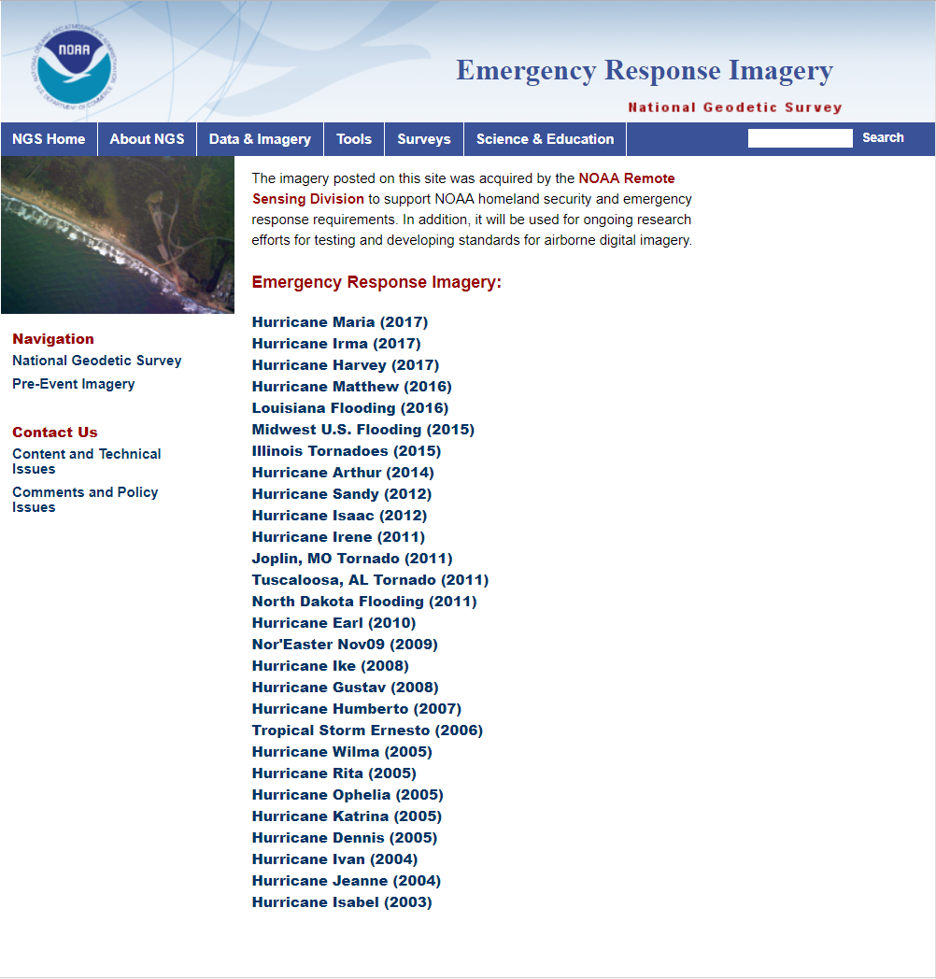
https://storms.ngs.noaa.gov/

Slide 24
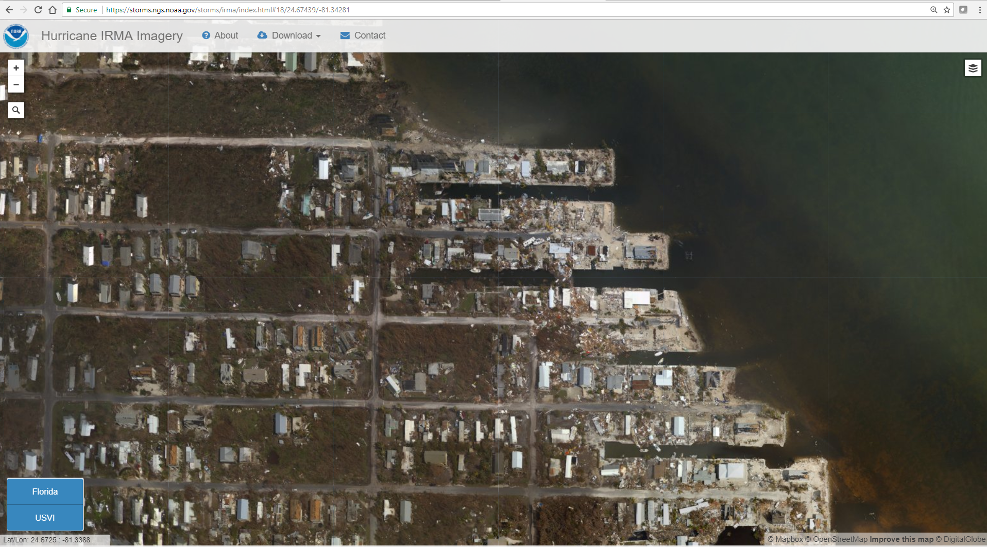
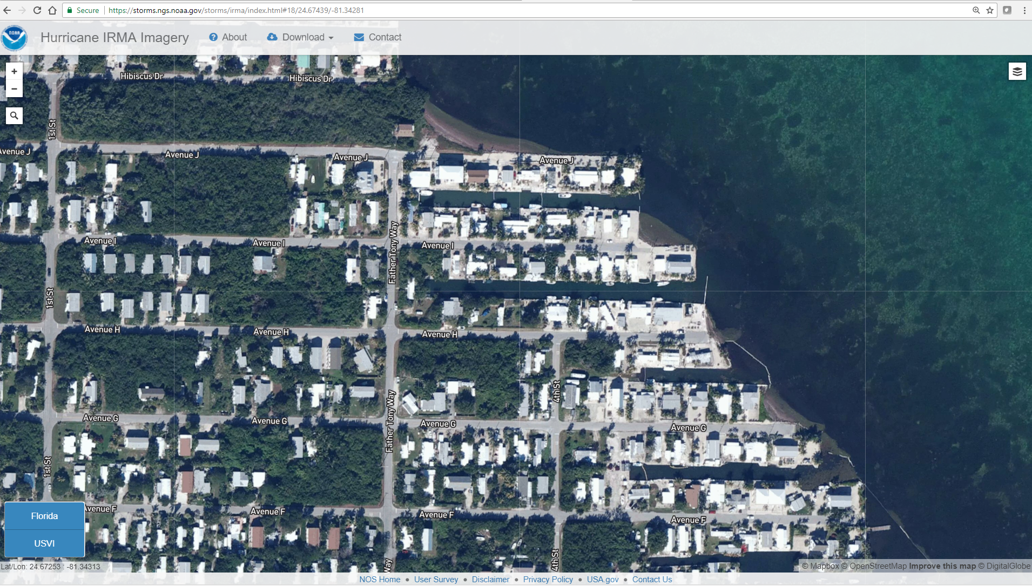
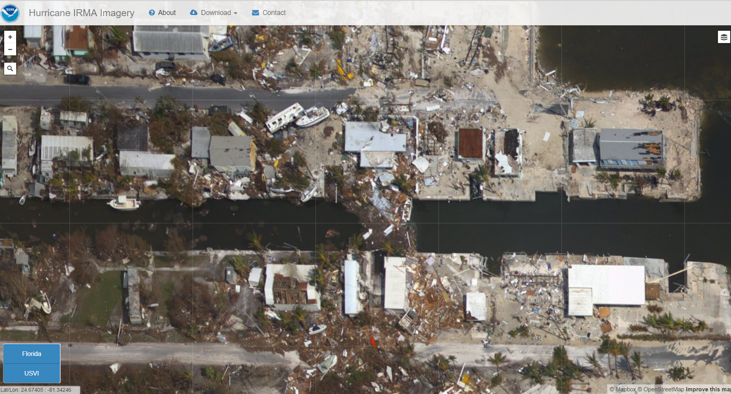

Slide 25
Questions?
Mike Aslaksen
Chief, Remote Sensing Division
NOAA National Geodetic Survey
mike.aslaksen@noaa.gov

