Slide 1
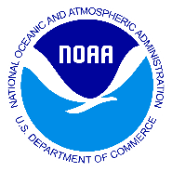
NOAA Paper Chart Providers
10/5/17
^{Office of Coast Survey}
National Oceanic and Atmospheric Administration

Slide 2
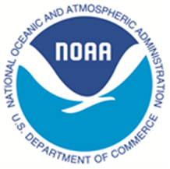
Paper Chart Facts
After 150 years, the US Government (FAA) stopped printing lithographic paper charts on April 13, 2014.
At that time NOAA had 2 Certified Print-on-Demand (POD) partners.
NOAA certified paper chart products meet stringent print quality standards and meet requirements for those vessels required to carry navigational charts and publications "published by the National Ocean Service" under Title 33 of the Code of Federal Regulations (SOLAS Class). Paper charts can be recognized by an official NOAA certification of authenticity printed on the chart.
^{Office of Coast Survey}
National Oceanic and Atmospheric Administration

Slide 3
NOAA Paper Chart Info
Paper Chart Key Features:
Created from a PDF file of nautical chart which is updated with critical corrections. Coast Survey reviews charts weekly, and applies all critical corrections specified in Notices to Mariners.
All NOAA paper charts are now sold by NOAA certified chart agents found at: http://www.nauticalcharts.noaa.gov/staff/print_agents.html
NOAA no longer sells charts or other navigational products directly. When you order a chart, the agent prints and ships NOAA’s latest version of the chart. Some agents or their sub-agents are able to print a chart in their store and some maintain small pre-printed supplies of high-turnover charts.
Most orders are made on-line; charts will be shipped by the next business day.
Beyond meeting standard requirements, chart agents may offer options for premium services, such as customized user overlays.
^{Office of Coast Survey}
National Oceanic and Atmospheric Administration

Slide 4
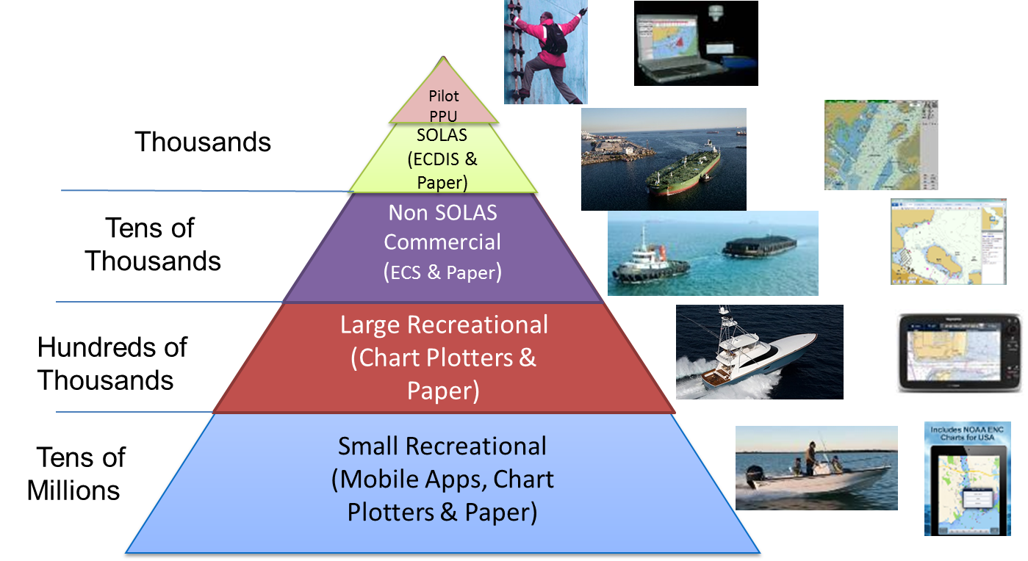
NOAA Charting Products Depends on Use Case
^{Office of Coast Survey}
National Oceanic and Atmospheric Administration

Slide 5
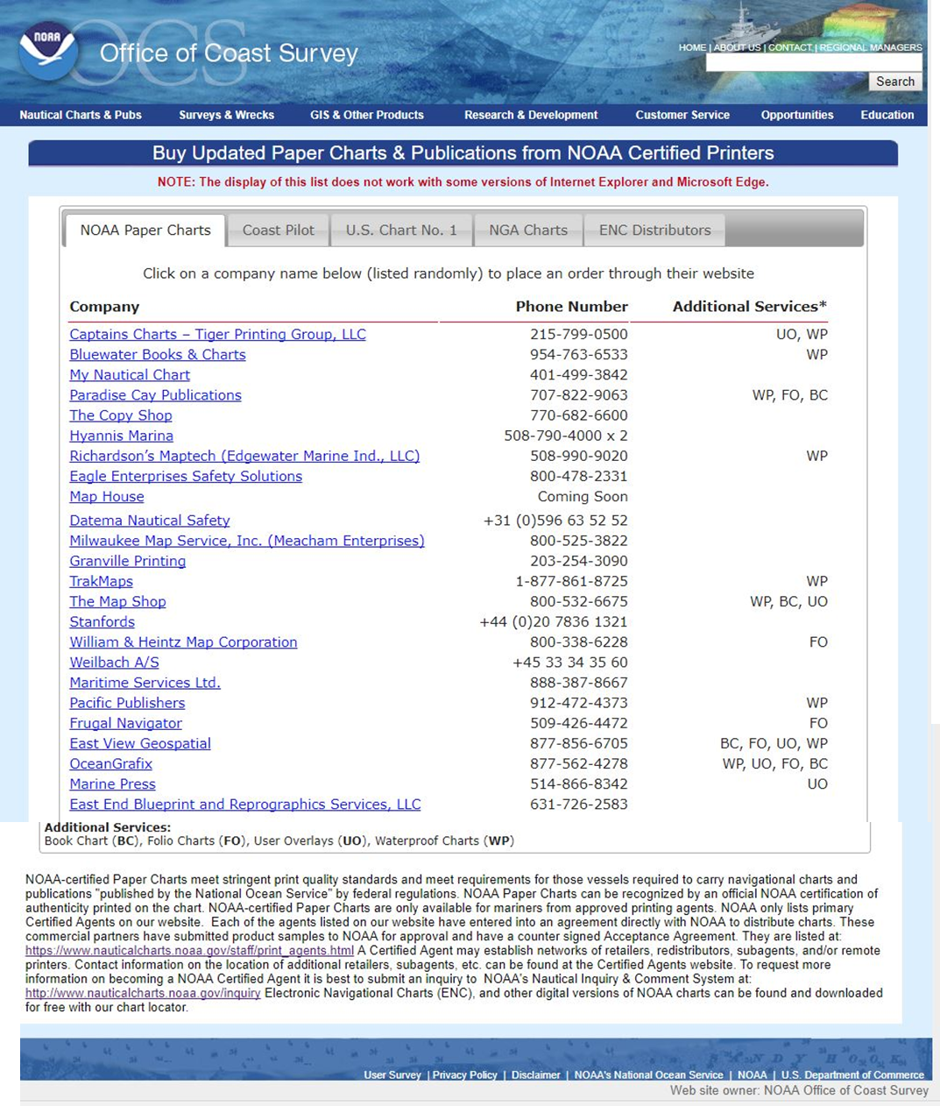
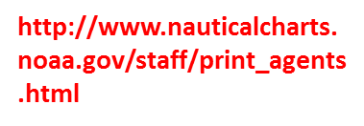
NOAA Certified Vendor Website
^{Office of Coast Survey}
National Oceanic and Atmospheric Administration

Slide 6
Paper Chart Facts
We now have 25 NOAA certified chart agents.
Almost half also offer nautical charts of international waters published by the National Geospatial Intelligence Agency (NGA).
Additional services provided by select chart agents include:
Book Charts (Great Lakes)
Small Craft Folio Charts
User Overlays
Waterproof Charts
8 agents sell the US Coast Pilot and 4 sell Chart #1
^{Office of Coast Survey}
National Oceanic and Atmospheric Administration

Slide 8
Point of Contact
Sam De Bow
sam.debow@noaa.gov
Office Phone: 240-533-0054
^{Office of Coast Survey}
National Oceanic and Atmospheric Administration

